Slide 1
Risks of Using Bulk Soap Dispensers

Slide 2
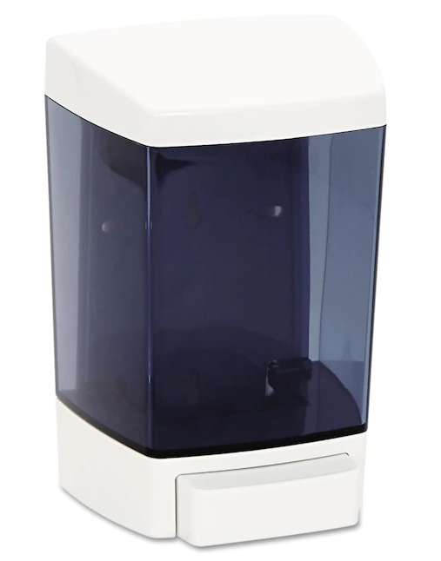
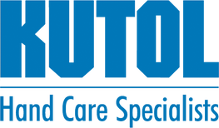
Bulk soap dispensers are unsealed, refillable soap dispensers typically mounted on a wall.
What are bulk soap dispensers?

Slide 3
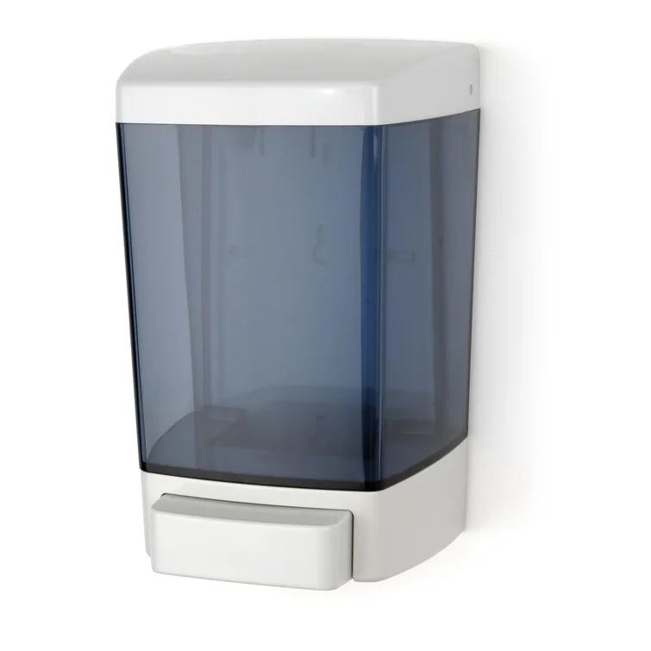
Why are bulk dispensers used?
Cost effective
Easy to refill
Ease of use

Slide 4
Then what's the catch?

Slide 5
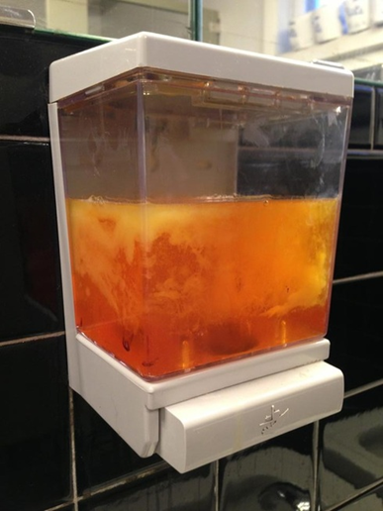
Contamination
Studies have shown that bulk soap (soap in large containers designed to be poured into universal soap dispensers) are susceptible to bacterial contamination.
Notes:
Bulk soap dispensers are widely used in many environments as a cost effective means for providing users soap for washing their hands. Studies have shown that bulk soap (soap in large containers designed to be poured into universal soap dispensers) are susceptible to bacterial contamination.

Slide 6
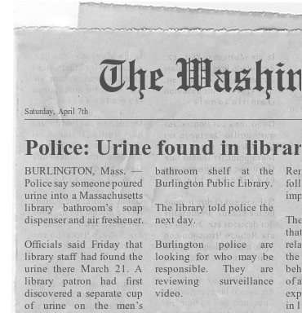
April 17, 2017
Airport officials find bodily fluids in soap dispensers
April 17, 2017: Airport officials find bodily fluids in soap dispensers
April 7, 2018
Urine found in library soap dispensers

Slide 7
A recent study, conducted by microbiologists at the University of Arizona, found that 25% of bulk soap dispensers contain unsafe levels of bacteria
16% contained fecal matter
Notes:
Independent tests show that bacteria transfers to hands after hand washing with contaminated bulk soap**
Bulk dispensers tested in previous studies showed at least 20 – 25% of the dispensers were contaminated**
Illness risk - typical pathogens from contaminated soap can cause respiratory, blood and skin infections as well as others.
After 1 year of sealed soap dispensing used in buildings tested, soap dispensed was confirmed to be contamination free**
Link to Study: https://www.janrep.com/wp-content/uploads/2017/04/BulkSoap_UofAStudy.pdf

Slide 8
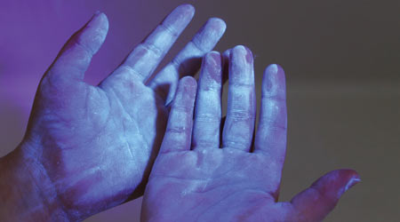
Why does this happen?
Lack of proper dispenser cleaning and cleaning frequency
Refilling contamination
Open dispenser design
Notes:
Lack of proper dispenser cleaning and cleaning frequency
Proper cleaning includes cleaning with a disinfecting solution and air drying (completely dry)
Dispenser continues to harbor bacteria in a damp environment
Refilling contamination
New soap can be contaminated as it is introduced to contaminated soap
Open dispenser design
Unprotected soap allows access of soap to all users
Open environment

Slide 9
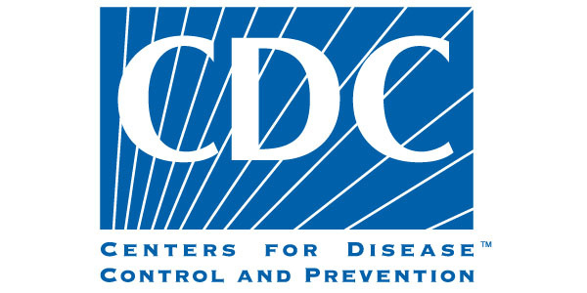
Regulatory Agency Position
Do not add soap to a partially empty soap dispenser. This practice of “topping off” dispensers can lead to bacterial contamination of soap.
Reusable bottles should never be refilled until they have been completely emptied and then cleansed and disinfected….If reusable reservoirs have to be used, they should be cleaned and disinfected.

Slide 10
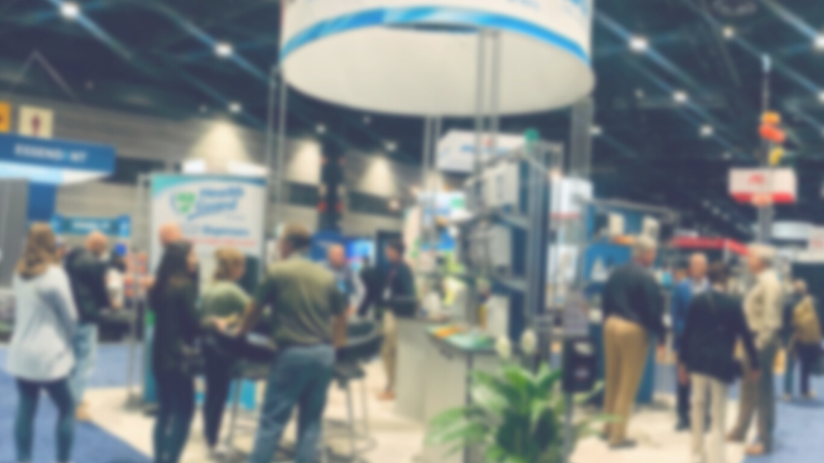
Kutol's Solutions

Slide 11
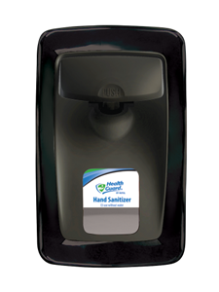
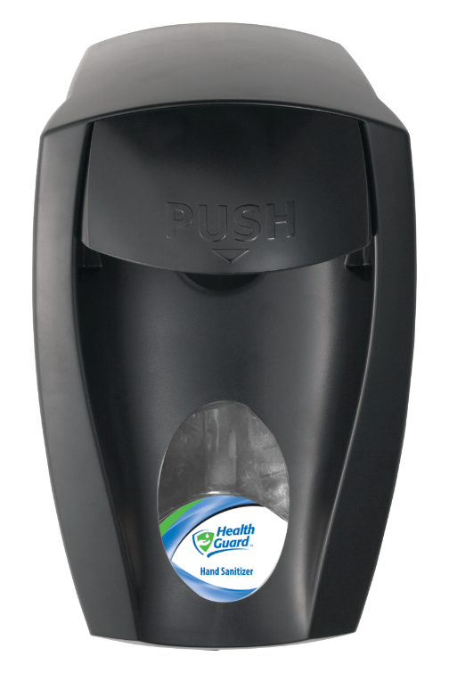
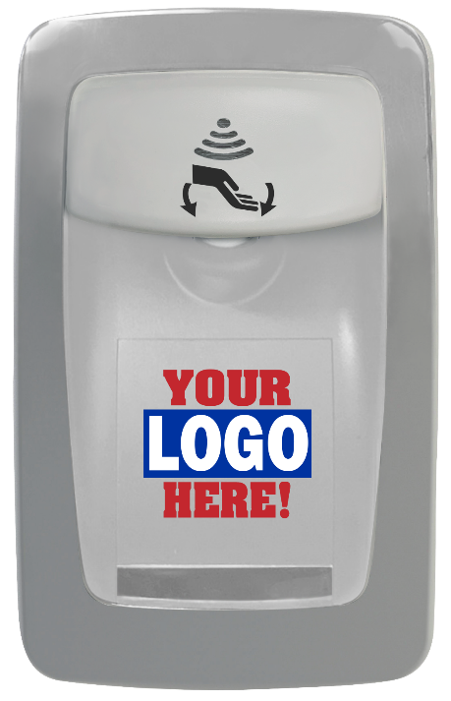
Wall Mount
Dispensers
Designer Series
DECO
EZ Foam

Slide 12
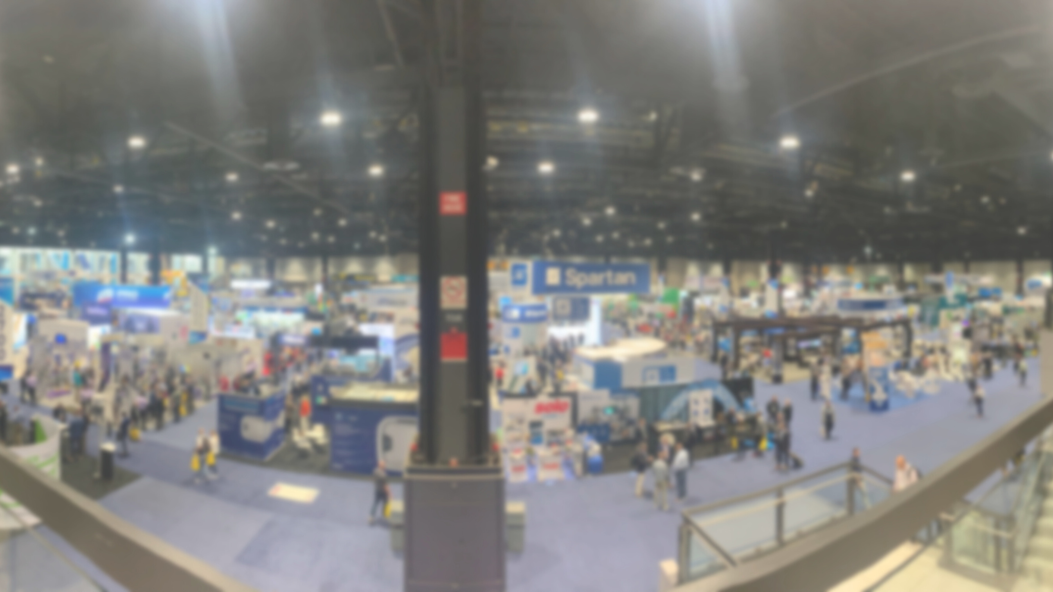
Advantages of Wall Mount Dispensers
Sealed refill bags eliminate contamination
Recycle when empty and replace with a fresh refill bag
Key locking system to prevent tampering
Cost effective vs. liquid systems
Notes:
Kutol Designer Series & EZ Foam wall mount dispensers
Disposable sealed refill bags eliminates contamination
Discard when empty and replace with a fresh refill bag
Manual and no touch versions available
Cost effective vs. liquid systems

Slide 13
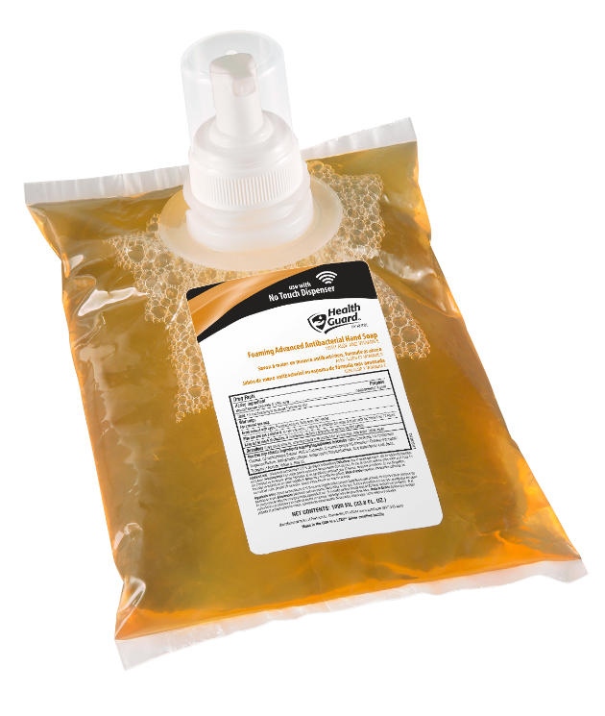
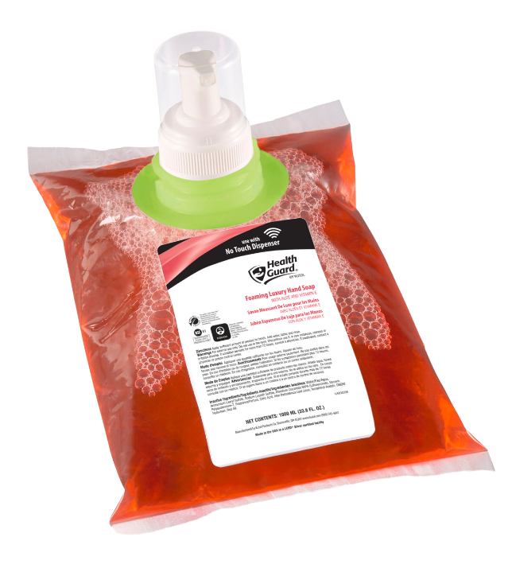
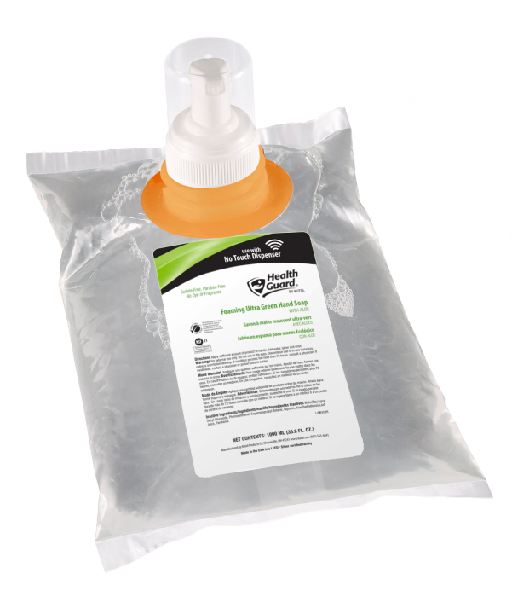
Sustainable/Recyclable
Wall Mount
Dispensers
All refill bags are recyclable. They are made of LLDPE plastic – linear low-density polyethylene (recycle code 4).

Slide 14
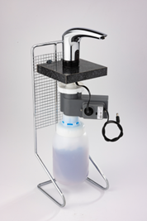
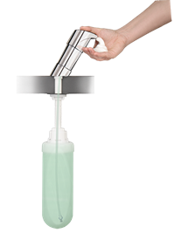
Counter Mount
Dispensers
No Touch
Manual

Slide 15
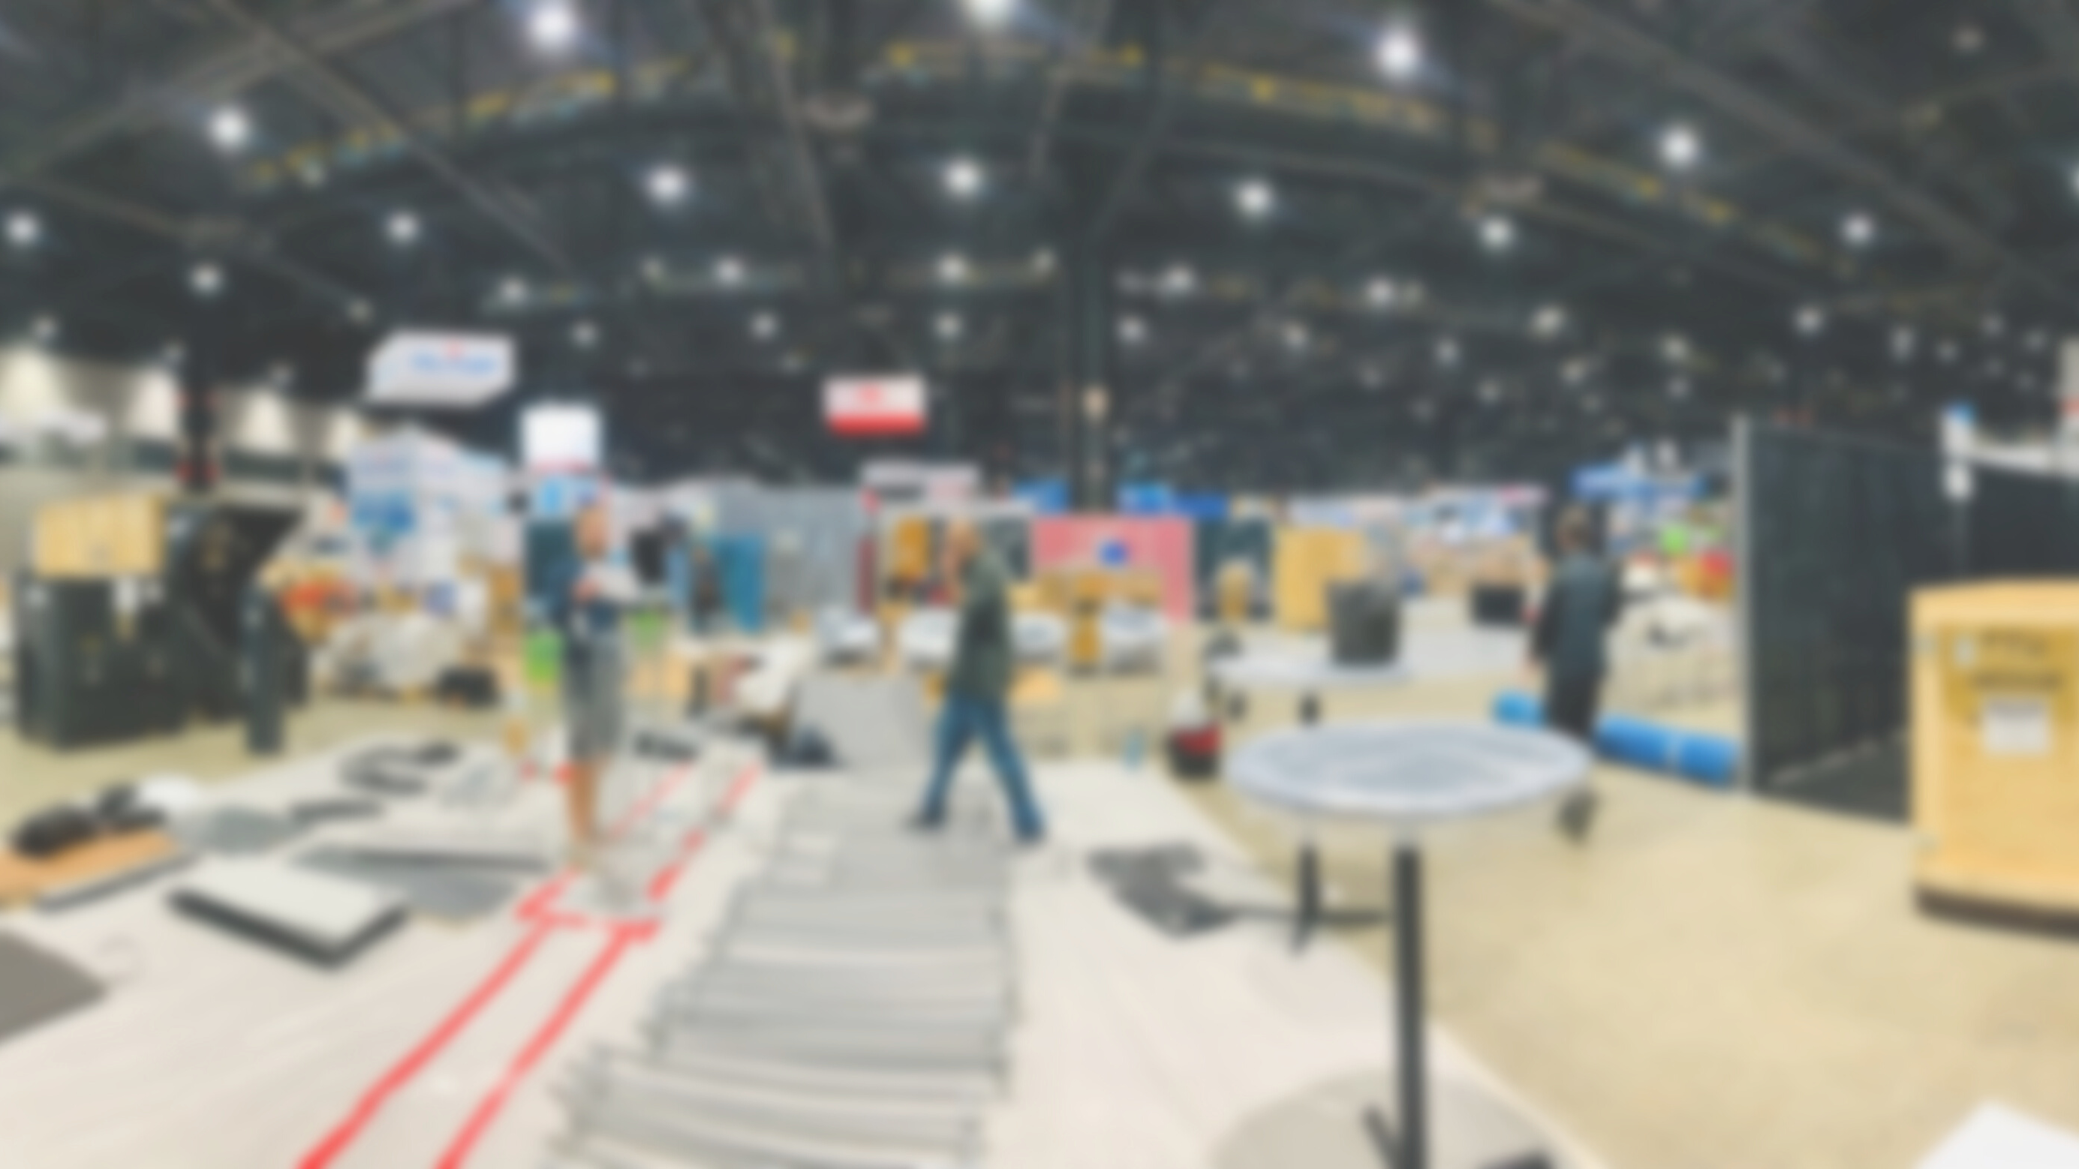
Advantages of Counter Mount Dispensers
Disposable, sealed refill bags only fit counter mount docking station
"Closed" system eliminates soap contamination
Saves time – no need to remove ADA panels
Notes:
Kutol Counter Mount Dispensers
Disposable sealed refill bags ONLY fits Kutol Counter Mount docking station
“Closed” system eliminates soap contamination
Saves time and money from removing ADA panels
Manual only. No Touch version coming soon
Available in black and chrome

Slide 16
Why Kutol?
Offering sealed, sanitary dispensing systems
Cost effective foam or liquid options
Attractive dispensers promoting your message or brand

Slide 17
Recap and Questions

