Slide 1
Experts in Skin Care
Kutol Products Company

Slide 2
About Us
Clean Hands for a Healthy World
FDA-registered, LEED Silver Certified Facility
Sole Focus on
Skin Care
Fourth Generation Family Owned
Notes:
FDA – All products are made in our LEED Silver Certified manufacturing facility in Cincinnati, Ohio
Skin Care ONLY Focus
No leveraging to buy SKUs outside of skin care
Full line from General Purpose to Heavy Duty
No retail – focus on away-from-home skin care products
4th Generation – 100 yrs in business. Not for sale = Stability

Slide 3
The Kutol Difference
100+ Years Have Made Us the Experts in Skin Care
Stability
Value
“
These are the five promises Kutol makes to our customers and partners – they guide every decision we make.
Tom Rhodenbaugh
President
”
Notes:
{Tom’s quote}: Five promises Kutol makes to our customers and partners:
Stability
Family owned business not for sale
Innovation
Dispensing & Packaging Options
Top dispensing prevents dripping & equates to cost savings
1 refill platform across all dispenser styles
New Top Fill, sealed sanitary counter mount system launching soon
Value
Efficient production practices + proprietary dispenser programs + reliable and consistent service =
Unmatched VALUE to our customers
Flexibility
Private Label Expertise
Many Network members currently utilize Kutol as a Private label brand
New Kutol “DECO” dispenser for best in class end user branding
Customized member partner literature
Sustainability
LEED Silver certified facility ensures a high degree of “green” compliance
Offer Green Seal™, BioPreferred™ and Eco Logo products that are tested and certified to meet or exceed environmental standards

Slide 4
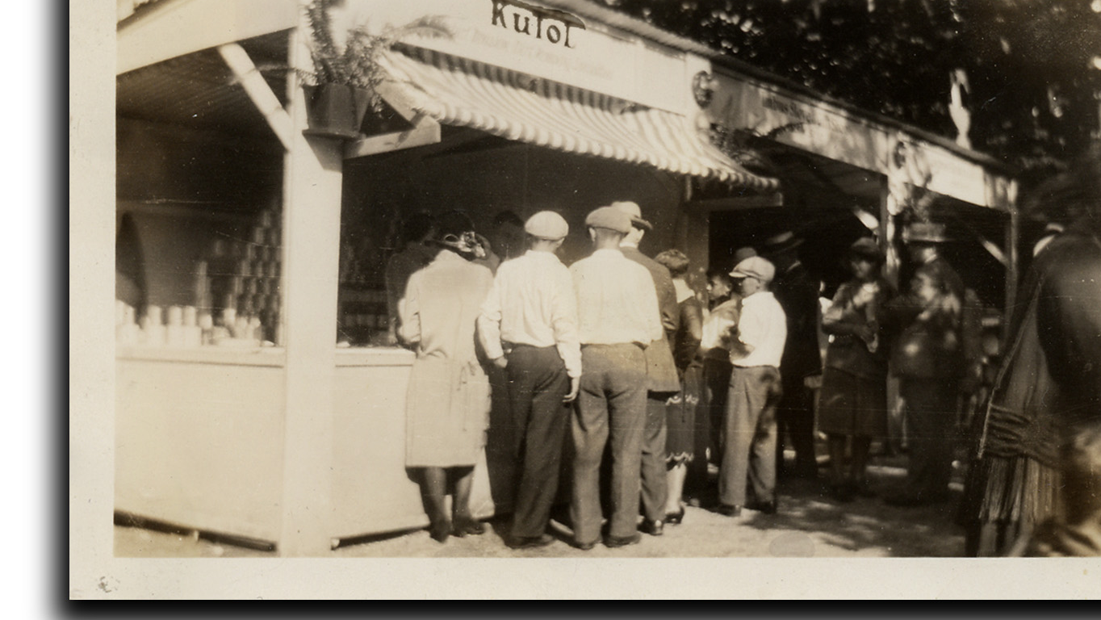
Stability
Founded in 1912
Investments in capacity and quality
Longevity of dispensing platform
15 years
6 million dispensers
Dispenser system sticks
Notes:
Let’s highlight one key promise we make to our stakeholders: Stability
Founded in 1912
100+ years of focused experience in skin care
Family owned with thoughtful succession planning – we have the next 30+ years of ownership (of leadership?) planned out
Investments:
Capacity = fill lines, supply chain partners
Quality = tech center
Longevity of dispensing platform
Since we launched our current wall mount dispenser platform in 2007, we’ve had iterations, but the platform remains the same
In that time, we’ve placed more than 6 million dispensers
It’s a dispenser system that sticks = profit in product, refills, etc.
**For internal purposes
Dispenser placement breakdown (Jan 2009-July 2022)
DECO – 94,029
DECO NT – 2,309
Designer Series – 1,748,096
Designers Series NT – 270,316
EZ Foam – 3,655,400
EZ Foam NT – 263,747

Slide 5
Segment Strengths
Market-based Solutions
Notes:
These segments show the many segments where we have strengths in meeting the needs of our customers and end-users

Slide 6
Scalable, Thoughtful Growth
2021 and Beyond
Pandemic Bump
Tech and Innovation
Sanitizer Shift
New Product Offerings
Notes:
2020 taught us all a lot – we are using this knowledge to fuel our scalable, thoughtful growth.
Topics top-of-mind:
Pandemic bump and business shift to sanitizer – what will this look like moving forward?
Investing in tech and innovation
New product offerings to answer customer and industry needs

Slide 7
Our Brands
Commercial and industrial hand care solutions

Slide 8
For everyday handwashing and sanitizing
For hard-to-clean soils and stains
General purpose hand care
Heavy duty, industrial hand care
Notes:
Kutol brands: general purpose and heavy duty
Full product lines

Slide 9
Dispenser Options
No Touch or Manual

Slide 10
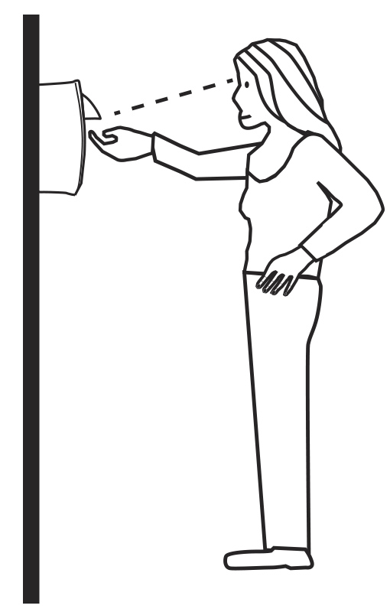
Top Dispensing
Benefits of this technology
Eye-level dispensing
Reduces wasteful product dispensing
Saves on product and cost
Top placement eliminates valve leaks
Notes:
Innovative top dispensing technology – one of the only JanSan suppliers to offer this
Top dispensing prevents dripping = cost savings
No drip tray needed!
Top dispensing placement eliminates valve leaks
Better dispensing visibility: eye-level
Reduces wasteful pushes and extra product dispensing
Saves on product and cost

Slide 11
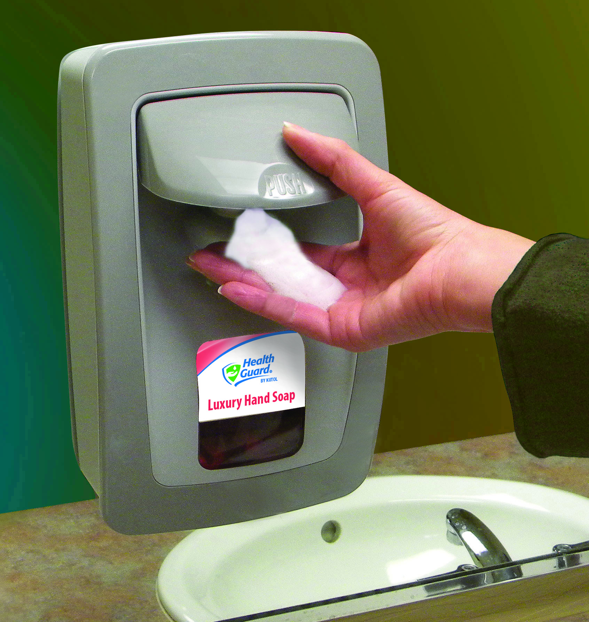
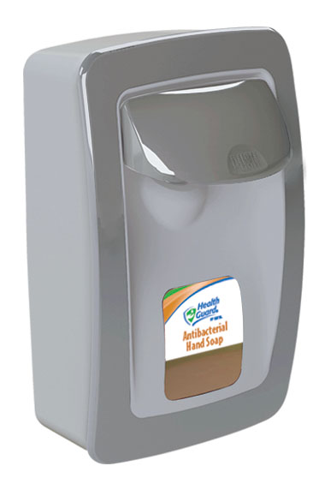
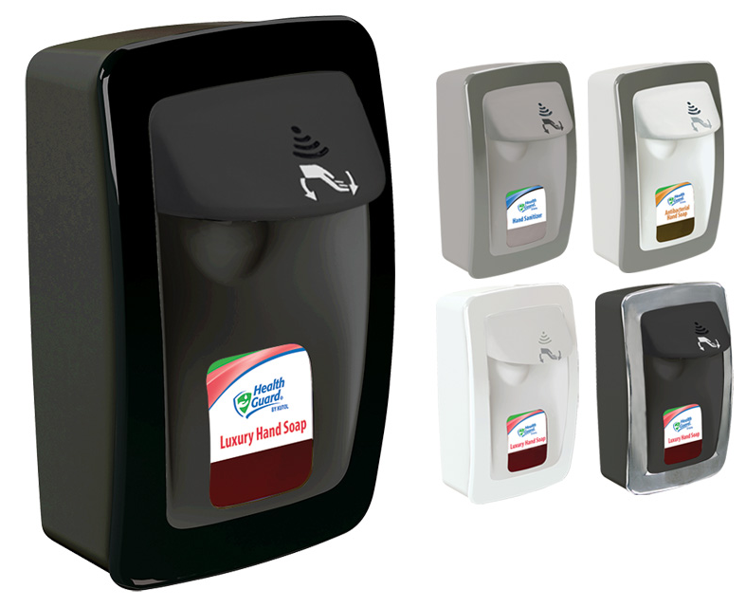
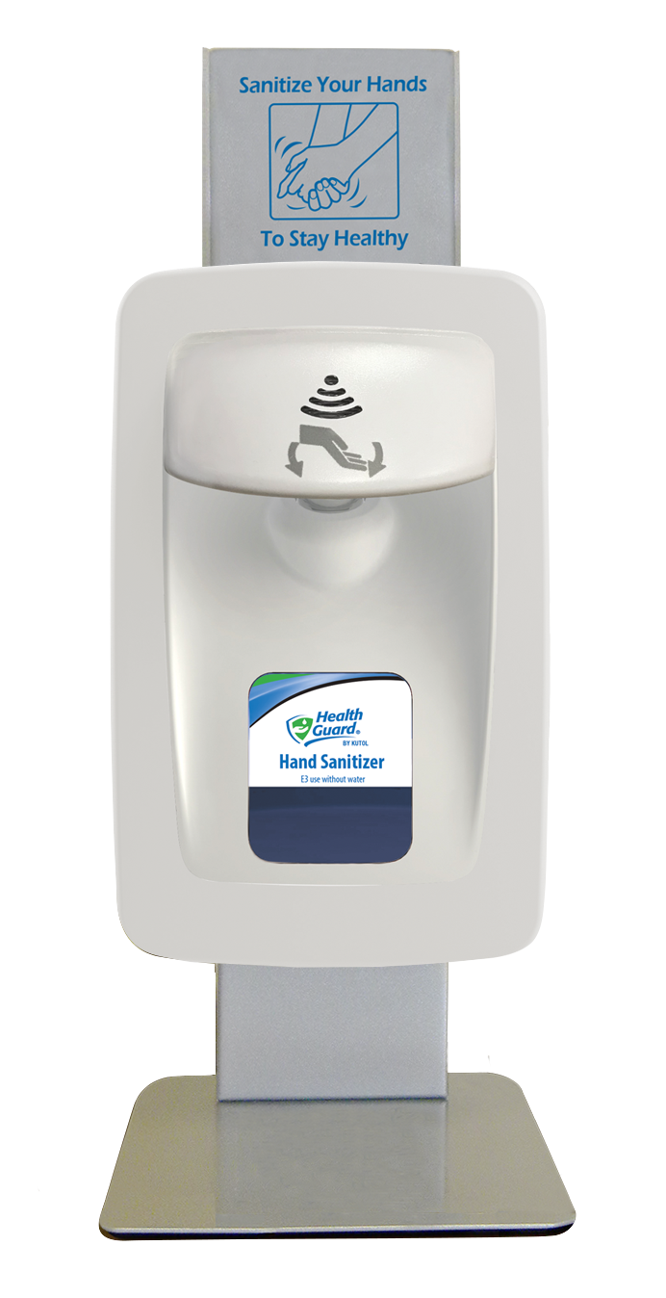
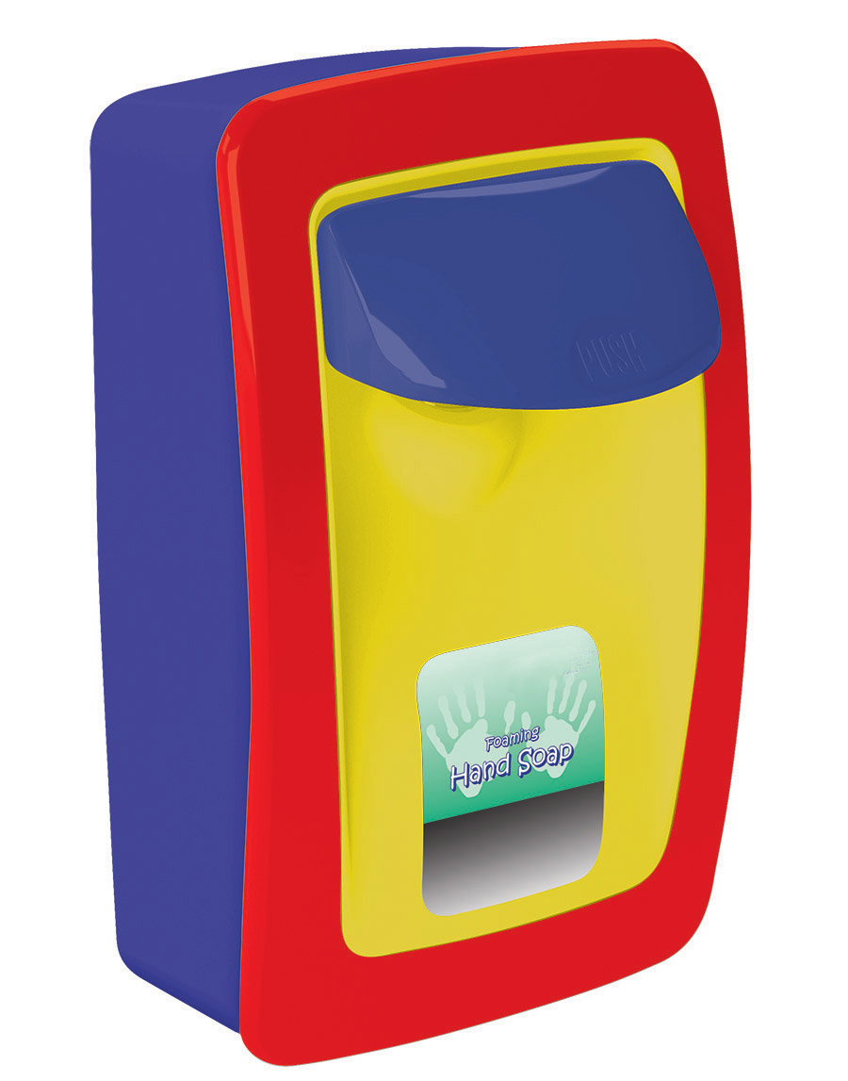
No Touch and Manual
Wall Mount, Counter and Floor Stands
Designer Series
Sleek, modern styling
Manual
(six color options)
No Touch

Slide 12
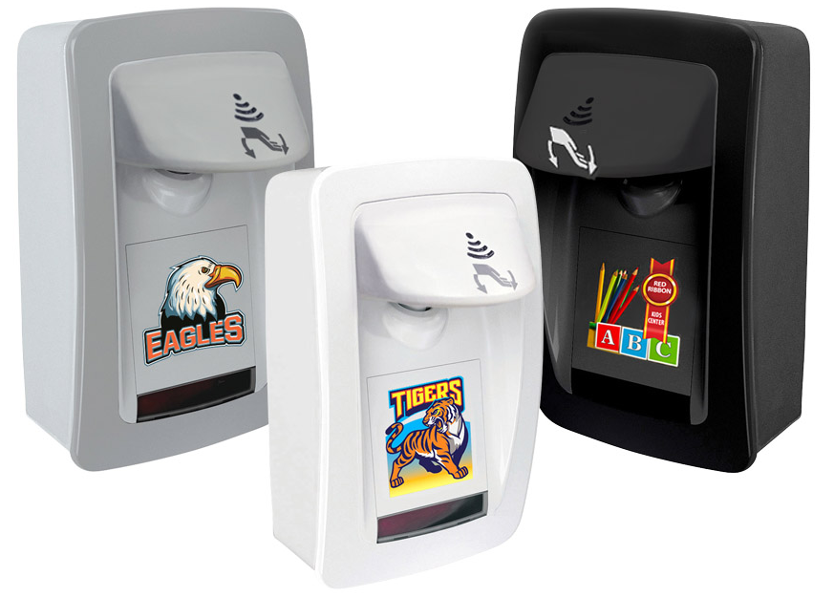
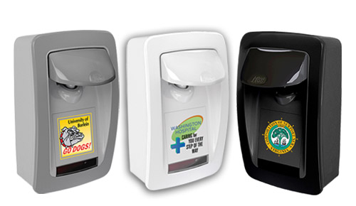
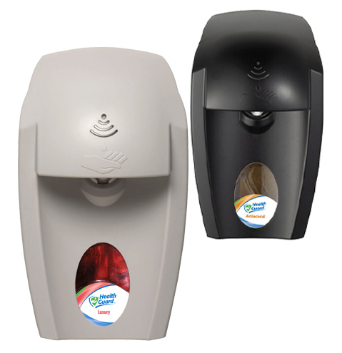
No Touch and Manual
Wall Mount
DECO
Custom branded
Full-color printing
Manual
No Touch
EZFoam®
Durable and economical

Slide 13
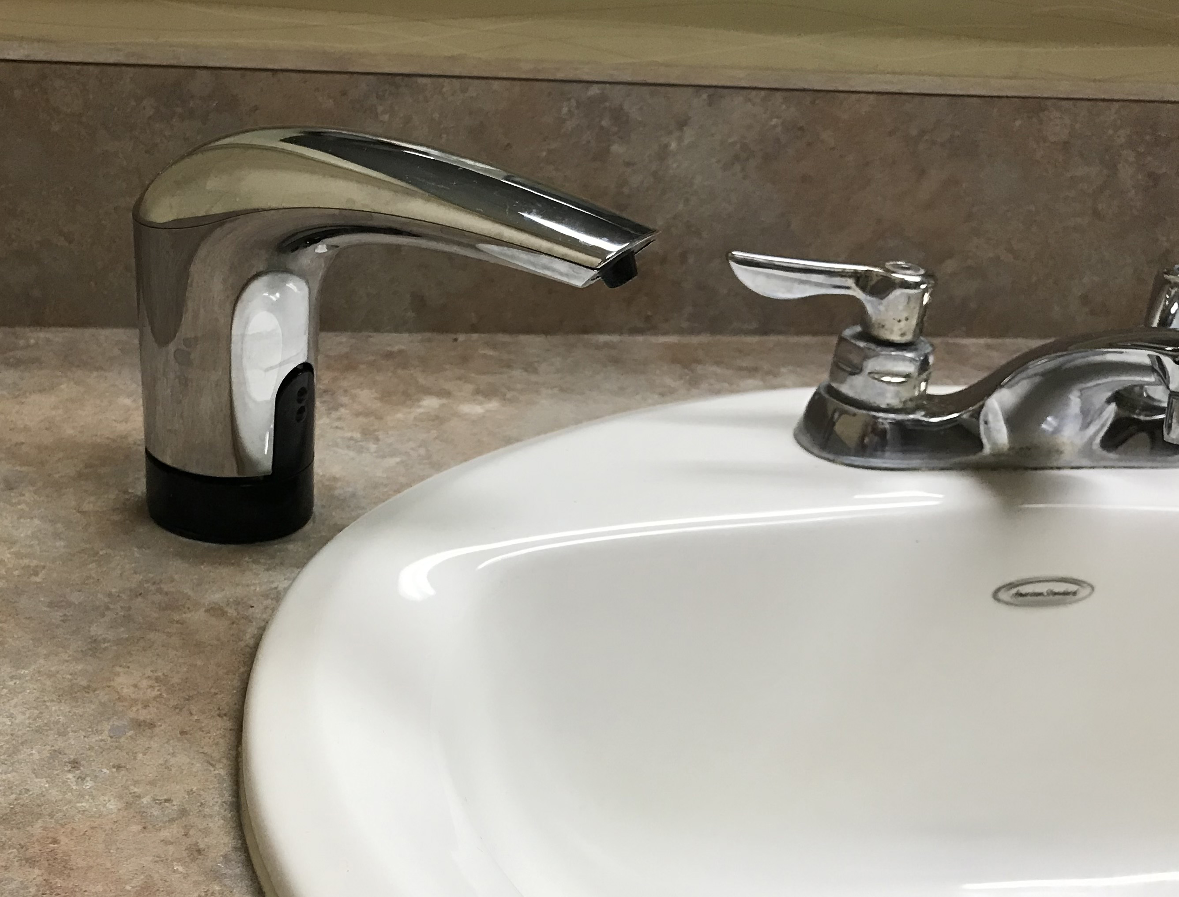
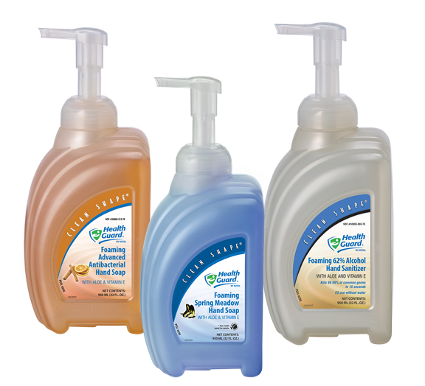
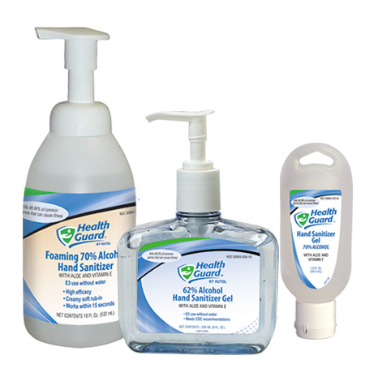
Counter Mount, Sinktop and Portable
TOPFILL™ Counter Mount: Manual and No Touch (coming soon!)
Patented design – refills from ABOVE the counter
Sealed system eliminates risk of contamination
Clean Shape®
portable bottles
Specialty bottles

Slide 14
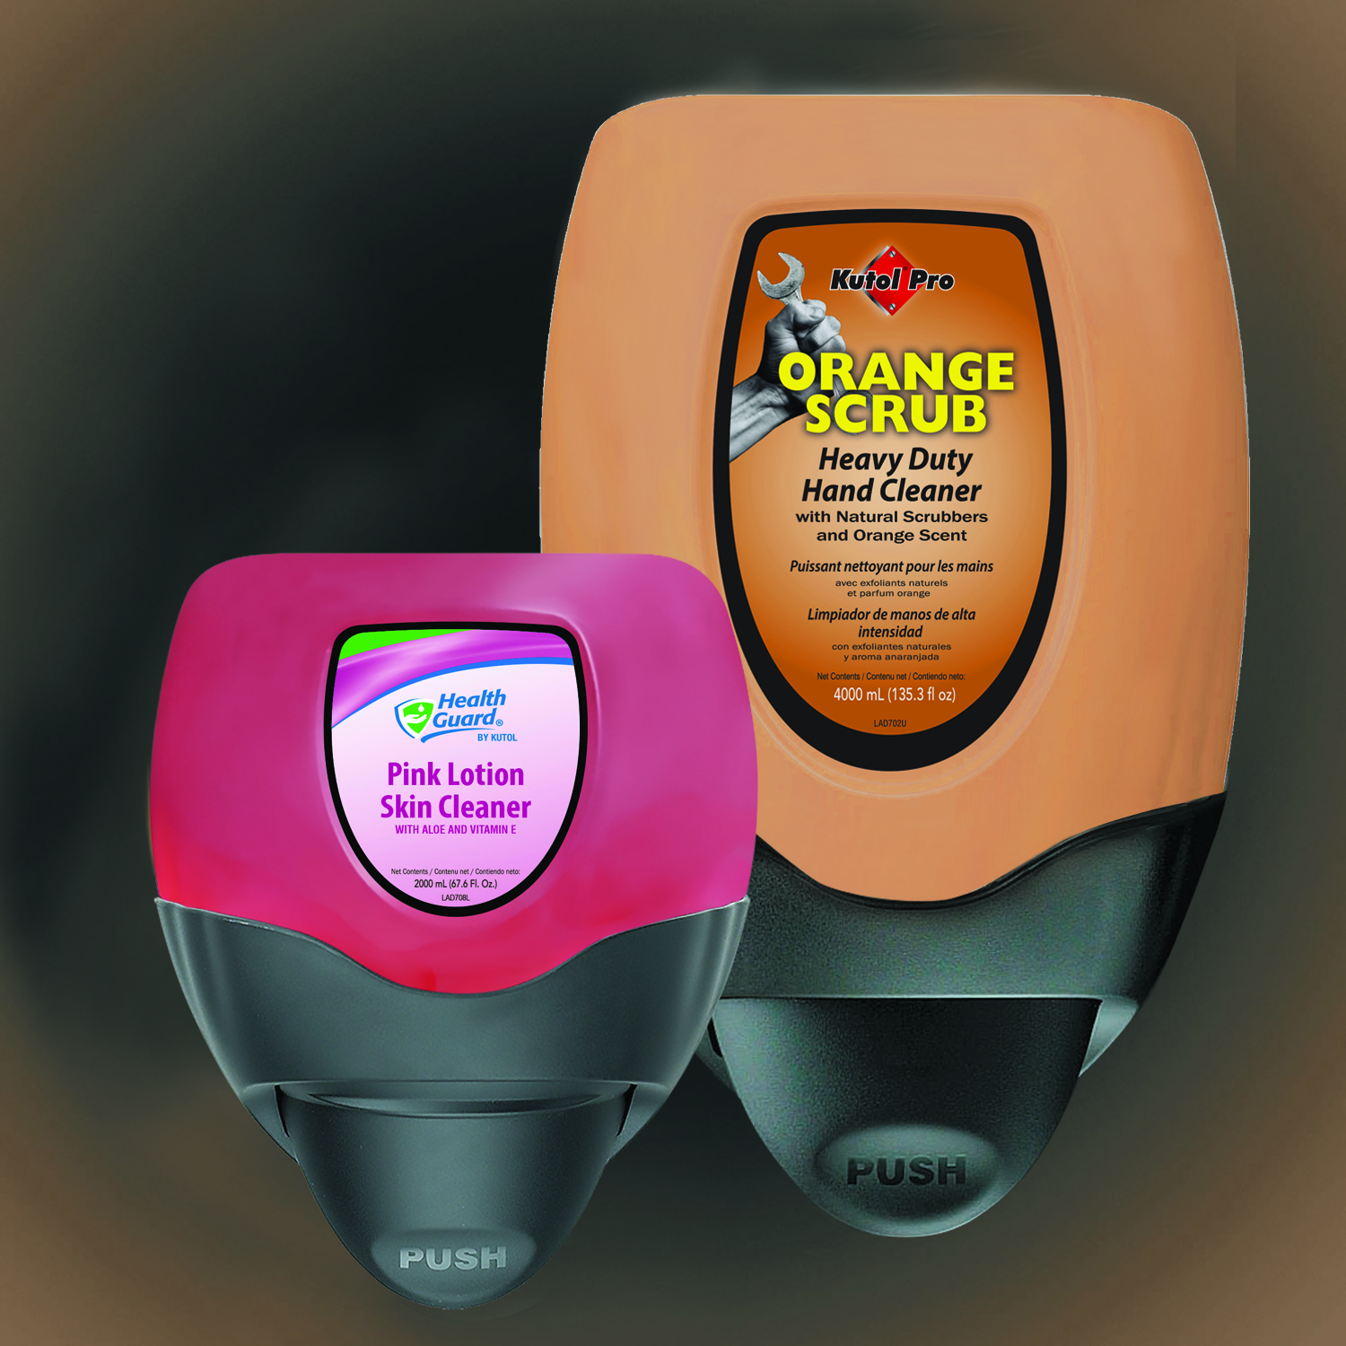
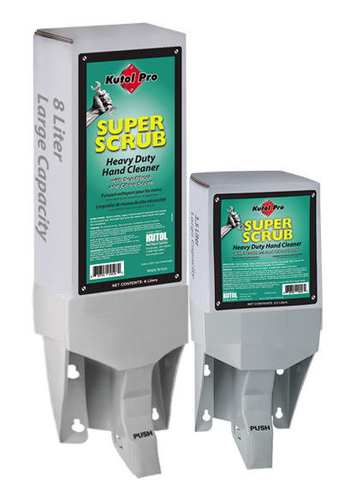
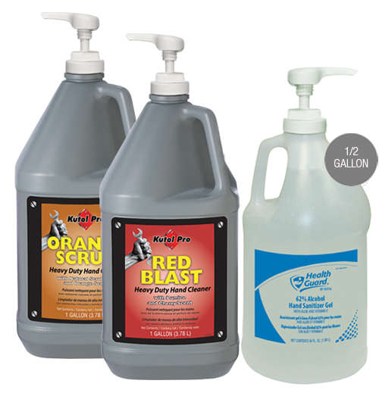
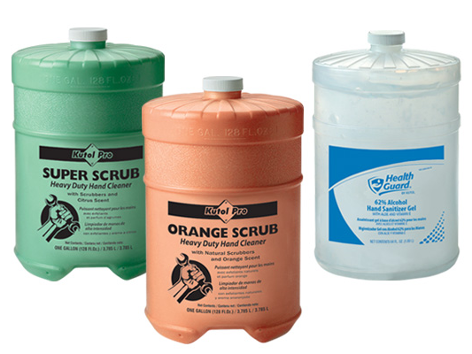
Heavy Duty and Bulk
DuraView
Large capacity: 2 L and 4 L refills
Waterproof
Gallons
Flat top, pour top and pump
Capacity Plus
Largest bag-in-box system
3.5 L and 8 L refills

Slide 15
Formula Options
Soap, sanitizer and specialty skin care

Slide 16
Top 10 Products
Foaming Luxury Soap
Foaming Advanced Antibacterial Soap
Foaming 62% Alcohol Sanitizer
Antibacterial Soap
Foaming Luxury Dye & Fragrance Free Soap
Pink Lotion Skin Cleanser
62% Alcohol Sanitizer Gel
Super-Scrub with Scrubbers
Hair & Body Shampoo
Foaming No Alcohol Sanitizer
Notes:
Top selling products across all formulas

Slide 17
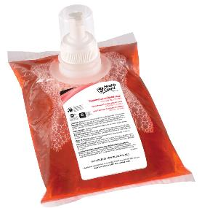
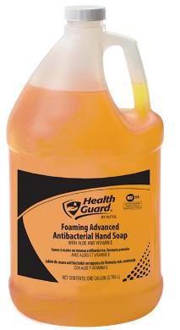
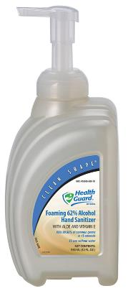
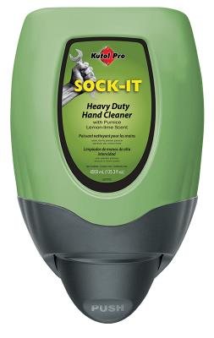
Top Formulas
Soap
690: Foaming Luxury Soap
213: Foaming Advanced Antibacterial Soap
686: Foaming Luxury Dye & Fragrance Free
566: Pink Lotion Skin Cleanser
683: Foaming E2 Sanitizing Soap
Sanitizer
688: Foaming 62% Alcohol Hand Sanitizer
056: 62% Alcohol Hand Sanitizer Gel
682: Foaming No Alcohol Hand Sanitizer
Heavy Duty
045: Super-Scrub with Scrubbers
016: Sock-It with Pumice

Slide 18
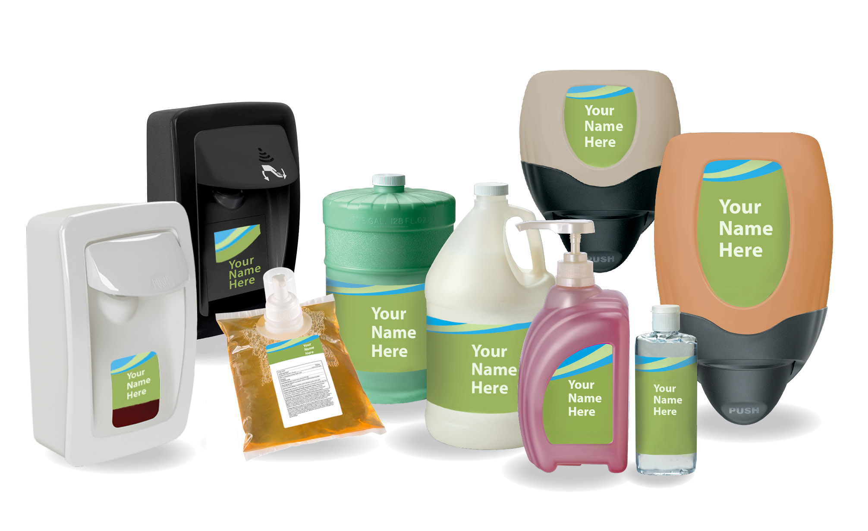
PRIVATE Branding
Contract Soap Manufacturing
Private Label
Custom Formulas
Notes:
Tailored solutions to meet your hand hygiene needs
Expertise: we’ve perfected the process because we’ve been doing it for more than 50 years

Slide 19
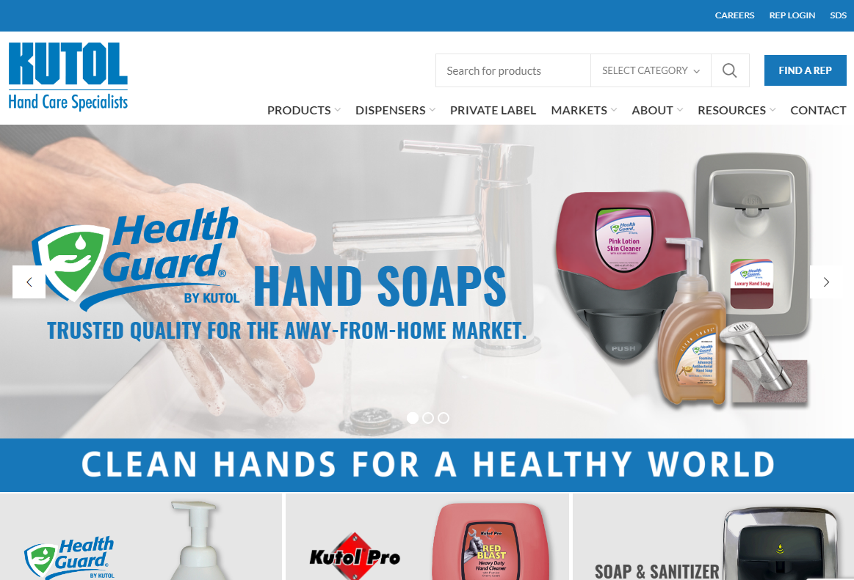
Digital Resources
Kutol.com
Follow us for updates and shareable content:
Scan now!
Notes:
Don’t forget to check out our website – a great resource for digital tools including: cost calculator, DECO visualizer, SKU search, SDS, etc
Follow Kutol on LinkedIn for usable, shareable content relative to your customers

Slide 20
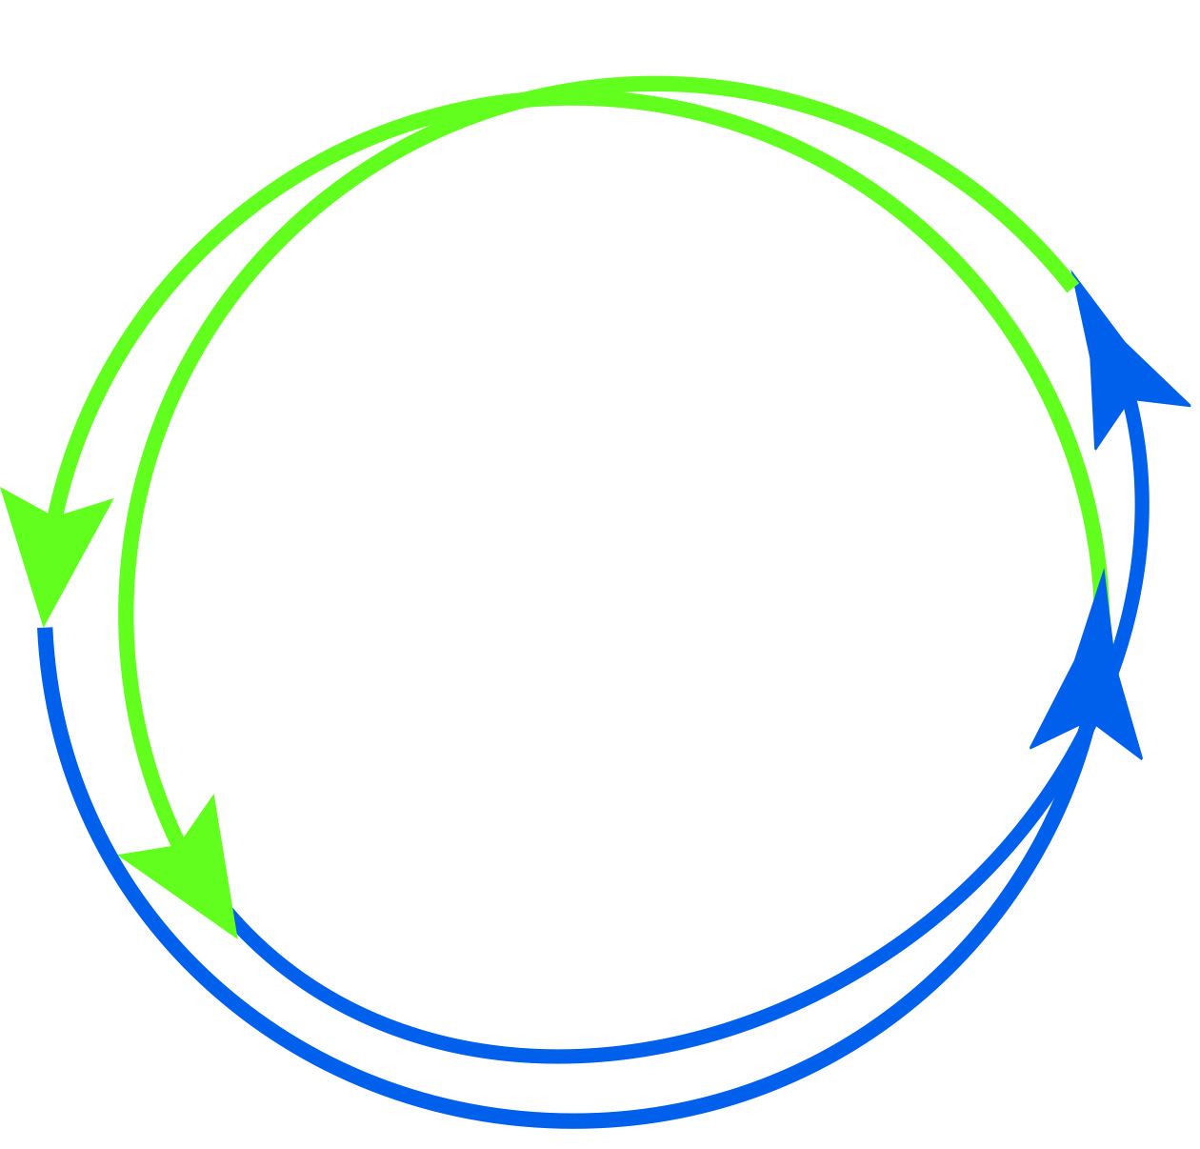
Depend on Kutol
Your Partner in Hand Care
Notes:
{Display Kutol and partner logos within circle. Do not distort circle by dragging to adjust size – marketing is available to help with resizing, etc.}
Grow your customer base with Kutol
We look forward to the next steps in the process to be your preferred skin care partner

Slide 21
Kutol Products
Recap and Questions

