Slide 1
Experts in Skin Care
Kutol Products Company

Slide 2
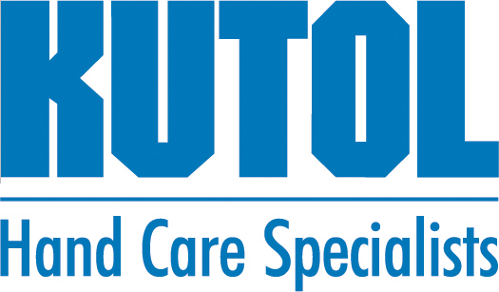
About Us
Clean Hands for a Healthy World
FDA-registered, LEED Silver Certified Facility
Sole Focus on
Skin Care
Fourth Generation Family Owned
Notes:
FDA – All products are made in our LEED Silver Certified manufacturing facility in Cincinnati, Ohio
Skin Care ONLY Focus
No leveraging to buy SKUs outside of skin care
Full line from General Purpose to Heavy Duty
No retail – focus on away-from-home skin care products
4th Generation – 100 yrs in business. Not for sale = Stability

Slide 3
The Kutol Difference
100+ Years Have Made Us the Experts in Skin Care
Stability
Value
“
These are the five promises Kutol makes to our customers and partners – they guide every decision we make.
Tom Rhodenbaugh
President
”
Notes:
{Tom’s quote}: Five promises Kutol makes to our customers and partners:
Stability
Family owned business not for sale
Innovation
Dispensing & Packaging Options
Top dispensing prevents dripping & equates to cost savings
1 refill platform across all dispenser styles
Top Fill, sealed sanitary counter mount system – No Touch launching soon
Value
Efficient production practices + proprietary dispenser programs + reliable and consistent service = Unmatched VALUE to our customers
Flexibility
Private Label Expertise
200+ customers currently utilize Kutol for private branding
New Kutol “DECO” dispenser for best in class end user branding
Customized member partner literature
Sustainability
LEED Silver certified facility ensures a high degree of “green” compliance
Offer Green Seal™, BioPreferred™ and Eco Logo products that are tested and certified to meet or exceed environmental standards

Slide 4
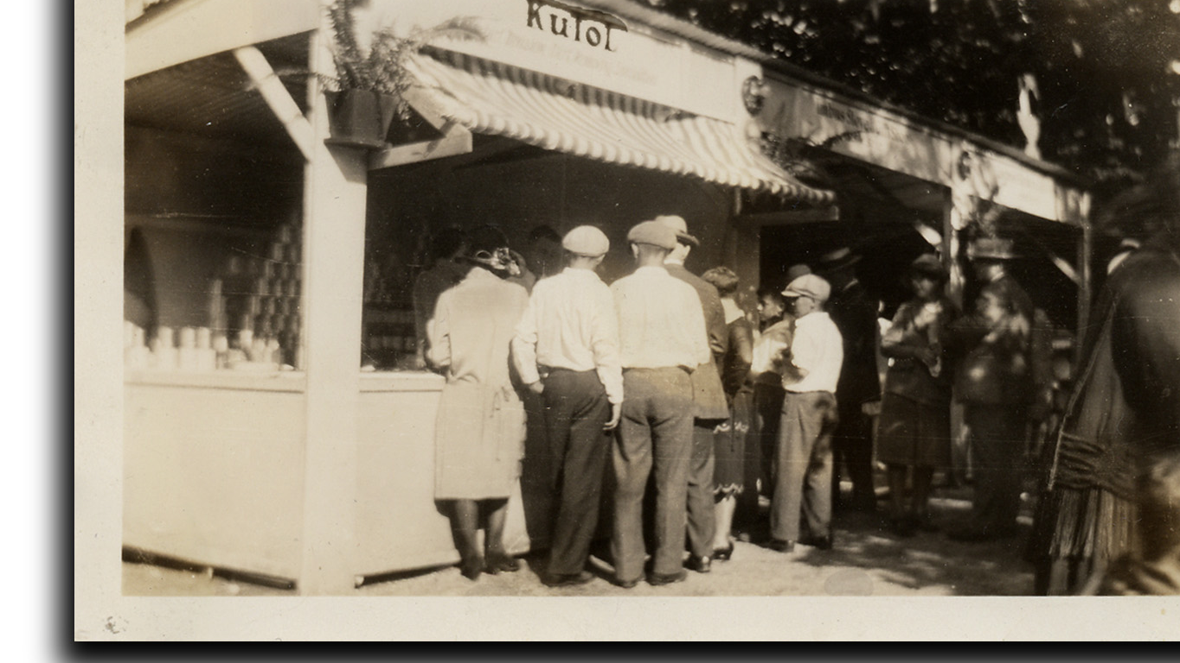
Stability
Founded in 1912
Investments in capacity and quality
Longevity of dispensing platform
15 years
6 million dispensers
Dispenser system sticks
Notes:
Let’s highlight one key promise we make to our stakeholders: Stability
Founded in 1912
100+ years of focused experience in skin care
Family owned with thoughtful succession planning – we have the next 30+ years of ownership (of leadership?) planned out
Investments:
Capacity = fill lines, supply chain partners
Quality = tech center
Longevity of dispensing platform
Since we launched our current wall mount dispenser platform in 2007, we’ve had iterations, but the platform remains the same
In that time, we’ve placed more than 6 million dispensers
It’s a dispenser system that sticks = profit in product, refills, etc.
**For internal purposes
Dispenser placement breakdown (Jan 2009-July 2022)
DECO – 94,029
DECO NT – 2,309
Designer Series – 1,748,096
Designers Series NT – 270,316
EZ Foam – 3,655,400
EZ Foam NT – 263,747

Slide 5
Our Offerings
Commercial and industrial hand care solutions

Slide 6
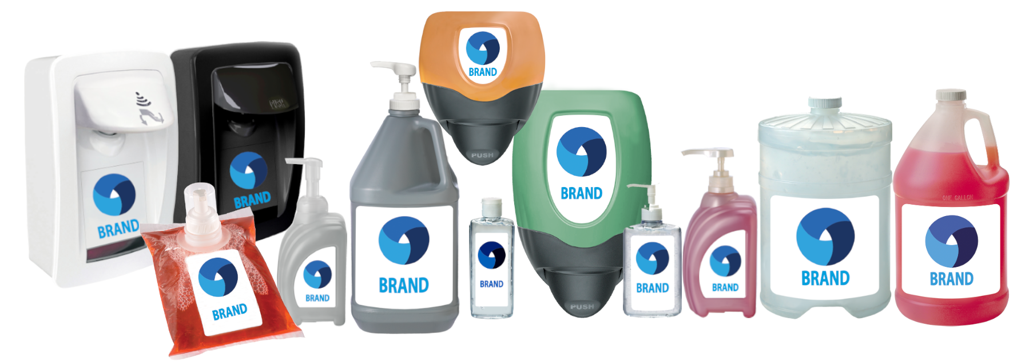
PRIVATE Branding
Contract Manufacturing
Private Label
Notes:
Tailored solutions to meet your hand hygiene needs
Expertise: we’ve perfected the process because we’ve been doing it for more than 50 years

Slide 7
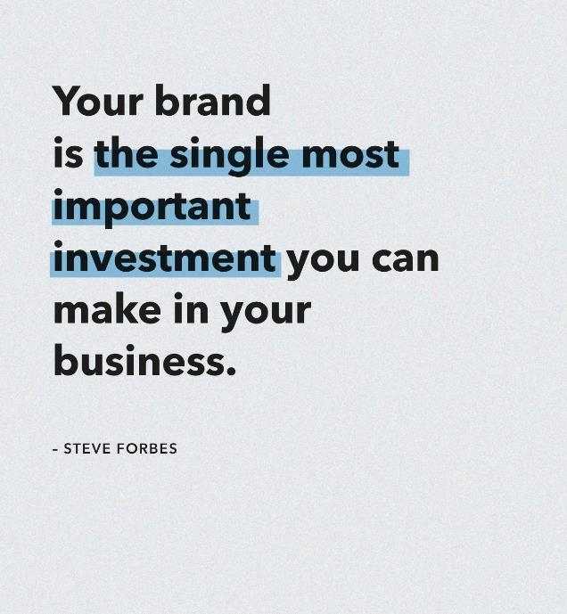
Attract valuable customers
At a lower cost per acquisition
Who are happy to pay a little more
Will buy more often
Notes:
It doesn’t matter that you are not Coke, Nike or Apple, investing in your brand is always a smart move that will earn dividends.
“Your brand is the single most important investment you can make in your business.”
Why is branding the most important investment? Because brand-building has the power to:
Attract valuable customers
At a lower cost per acquisition
Who are happy to pay a little more for your products
And will buy more often

Slide 8
Trends in Private Branding
Growth opportunity
Increase in revenue when a brand is presented consistently across all platforms
Shoppers prefer to buy new products from brands familiar to them
23%
59%
www.forbes.com; 10 Marketing, Web Design & Branding Statistics to Help You Prioritize Business Growth Initiatives
www.invespcro.com; How Branding Influences Purchase Decisions
Notes:
Sales/growth opportunity with private branding:
Consistent brand presentation across all platforms increases revenue by up to 23 percent³
Around 59% of shoppers prefer to buy new products from brands familiar to them⁴
³ https://www.forbes.com/sites/gabrielshaoolian/2018/08/10/10-marketing-web-design-branding-statistics-to-help-you-prioritize-business-growth-initiatives/?sh=2073e029d708
⁴ https://www.invespcro.com/blog/how-branding-influences-purchase-decisions-infographic/

Slide 9
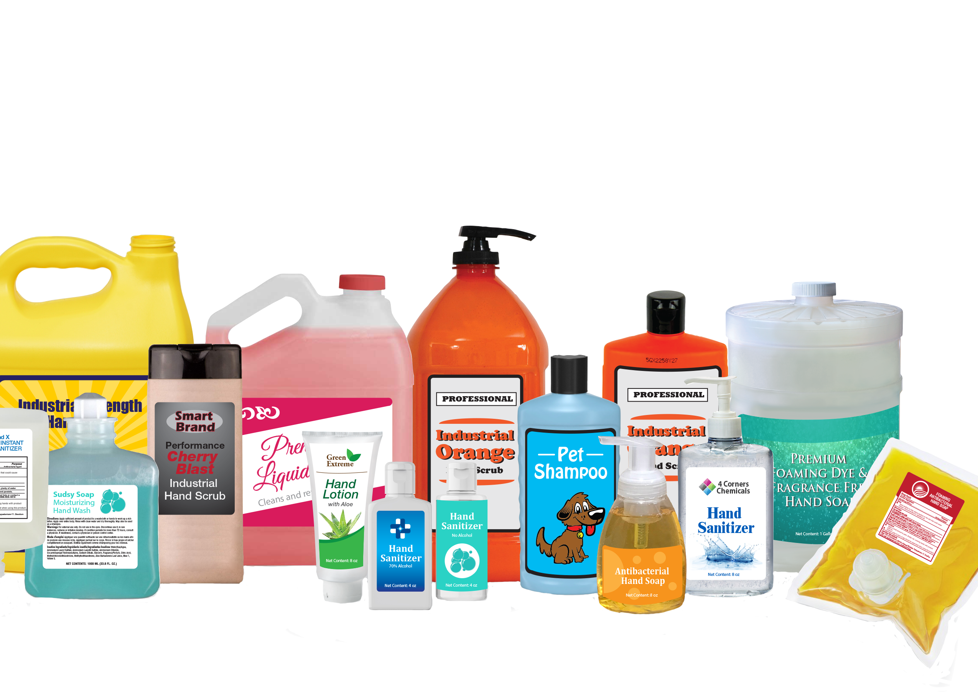
Private Branding Expertise
High-quality skin care products
Dispensing systems
Injection mold design
Injection and blow molding
Bag manufacturing
Foaming pump design and function
Patent knowledge
Custom sourcing plastic, metal, rubber
Check valve design
Soap/sanitizer packaging and filling

Slide 10
Low order minimums
Ultimate flexibility for formulas, containers and artwork
Speed to market
Products are made in the USA in a LEED® Silver Certified, FDA registered facility
Ample capacity for production and a commitment to continuously expand that capacity
Benefits of Our Expertise

Slide 11
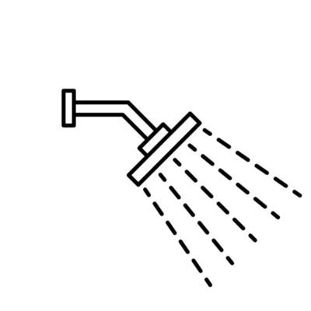
Private Branding Capabilities
OTC Products
Hand Soaps
Body Washes and Shampoos
Chemical Blends
Alcohol Hand Sanitizers
Liquid, Foaming, and Gel Formulas
Cosmetics
Custom Formulations
Heavy Duty Hand Cleaners
Lotions and Creams

Slide 12
Manufacturing Capabilities
200 to 5,000 gallon batches
Control heating and cooling process on manufacturing tanks
Setup to handle high alcohol mixes
Monitor/control production with efficiency software
Provide process validations
Qualify customer material for OTC use
Assist with FDA, Canadian, third-party registrations
Perform stability studies

Slide 13
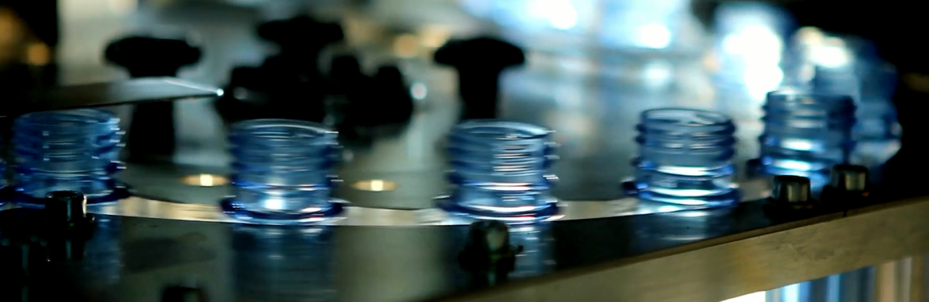
Filling Capabilities
One ounce to tankers
Bottles or bags
Auto label most configurations
In line weight checkers
Sonic sealing capability
Apply unique caps/pumps
1 5/8” or 2” diameter plastic tubes
Thin to thick; water, oil, alcohol based materials

Slide 14
Additional Capabilities
Research and Development
Marketing Support
Field Support
In-house research and development manages and improves custom formulas. New product formulations and packaging are approved only after passing rigorous testing.
Our experienced marketing team creates package and label designs, then provides any follow-up resources needed – including sales sheets, website content and imagery.
Ongoing support for your private brand in the field comes from dedicated sales representatives as well as friendly and knowledgeable customer service.
Notes:
Additional benefits of private branding with Kutol includes:
In-house research and development – formula development and testing
Marketing support – packaging, labels, literature
Field support – sales reps (if needed), customer service

Slide 15
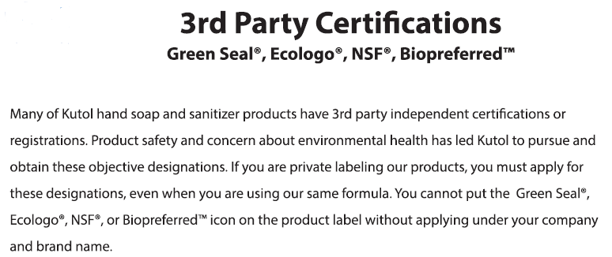
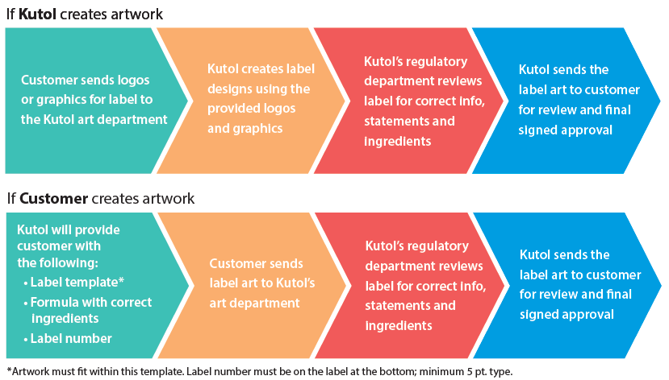

Slide 16
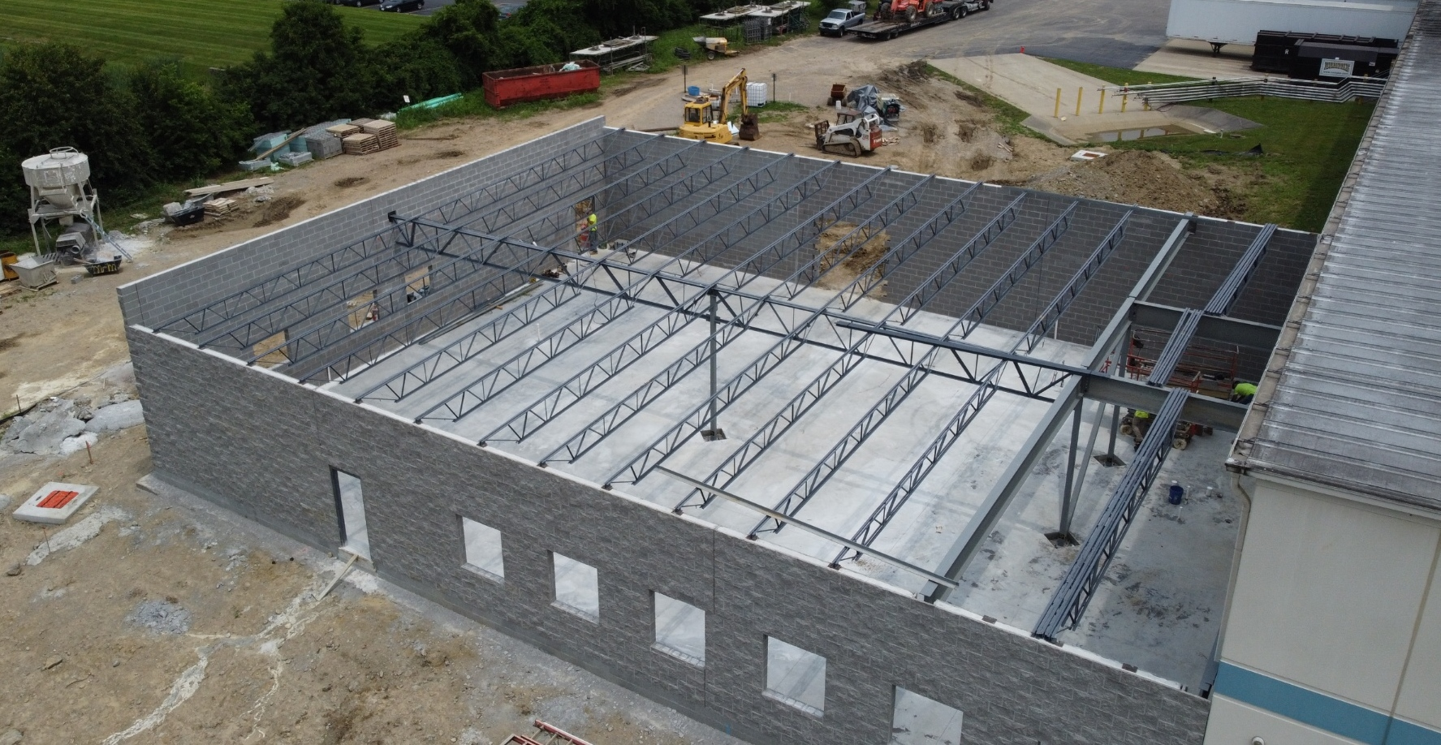
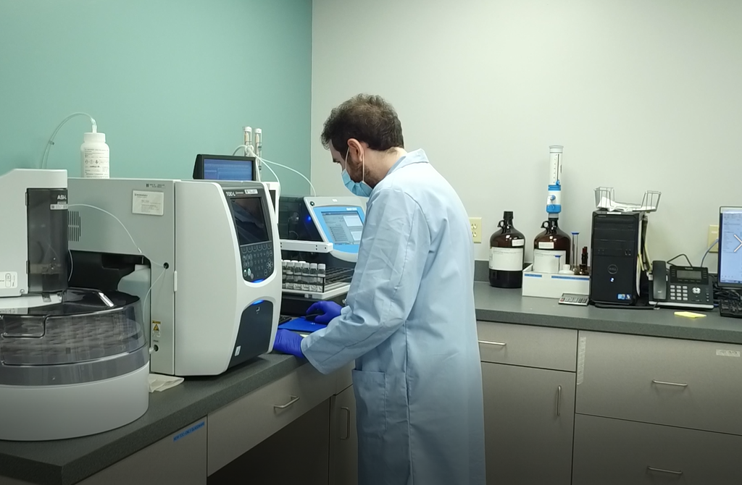
Manufacturing Investments
Addition of high speed filling lines
Upgraded water and sanitization systems
Installed inline labelers
Increased number of mixing tanks
Adding shear and powder blenders
Doubled warehouse space
Constructed 7,500 sq. ft. technical center

Slide 17
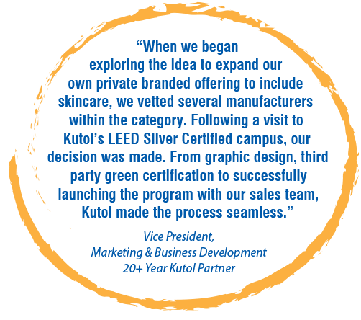
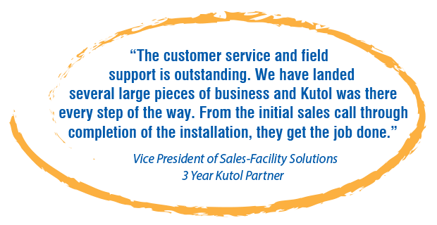
Testimonials
Kutol has been private branding for more than 50 years
Nearly 60% of all products we ship are private branded
More than 200 partners trust Kutol with their private brand
Notes:
The numbers are testimonials to Kutol’s success in the skin care private branding space.
What our customers say about us also speak to how well we do skin care.

Slide 18
Dispenser Options
No Touch or Manual

Slide 19
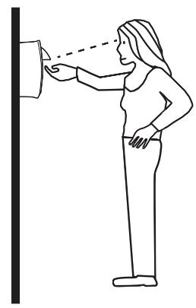
Top Dispensing
Benefits of this technology
Eye-level dispensing
Reduces wasteful product dispensing
Saves on product and cost
Top placement eliminates valve leaks
Notes:
Innovative top dispensing technology – one of the only JanSan suppliers to offer this
Top dispensing prevents dripping = cost savings
No drip tray needed!
Top dispensing placement eliminates valve leaks
Better dispensing visibility: eye-level
Reduces wasteful pushes and extra product dispensing
Saves on product and cost

Slide 20
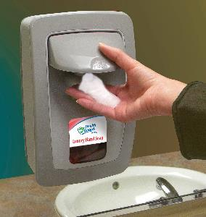
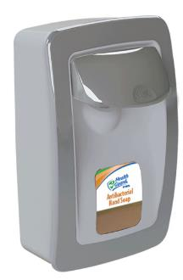
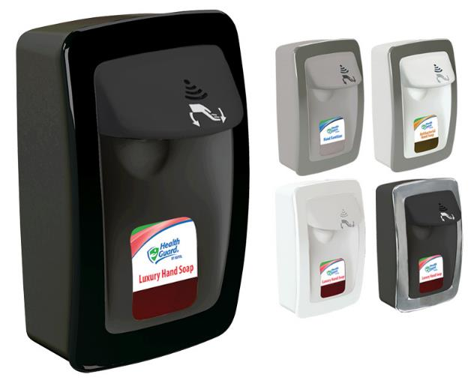
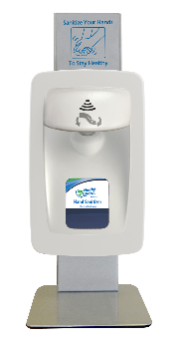
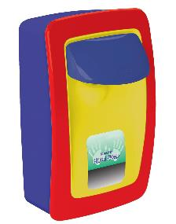
No Touch and Manual
Wall Mount, Counter and Floor Stands
Designer Series
Sleek, modern styling
Manual
(six color options)
No Touch

Slide 21
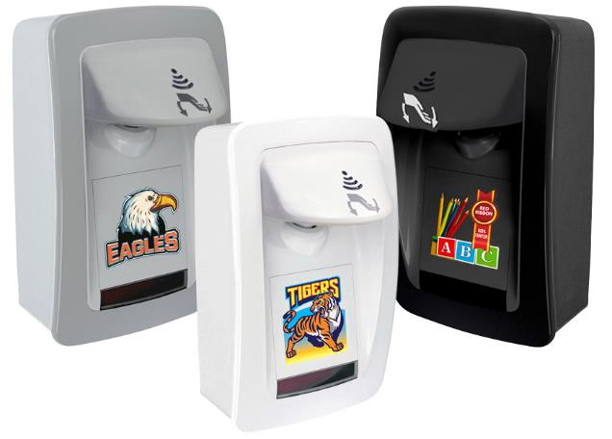
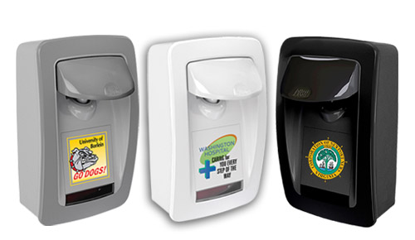
Custom Branded DECO Dispensers
Full-color UV digital printing – NOT a sticker
Large 3.5” x 3.5” printing area
Easy, professional process
LOW 24 MINIMUM
Manual
No Touch

Slide 22
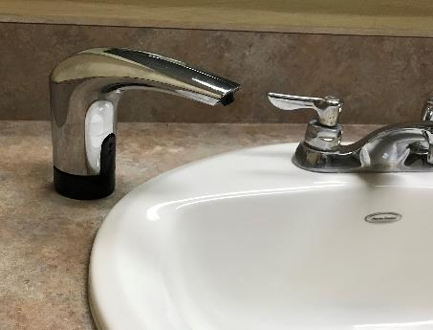
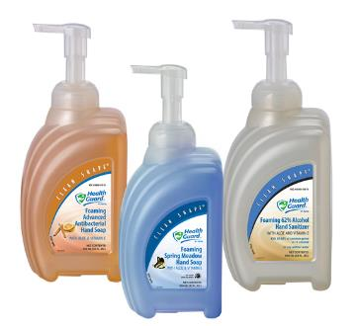
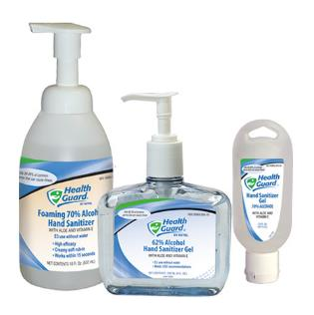
Counter Mount, Sinktop and Portable
TOPFILL™ Counter Mount
Patented design – refills from ABOVE the counter
Sealed system eliminates risk of contamination
Clean Shape®
portable bottles
Specialty bottles

Slide 23
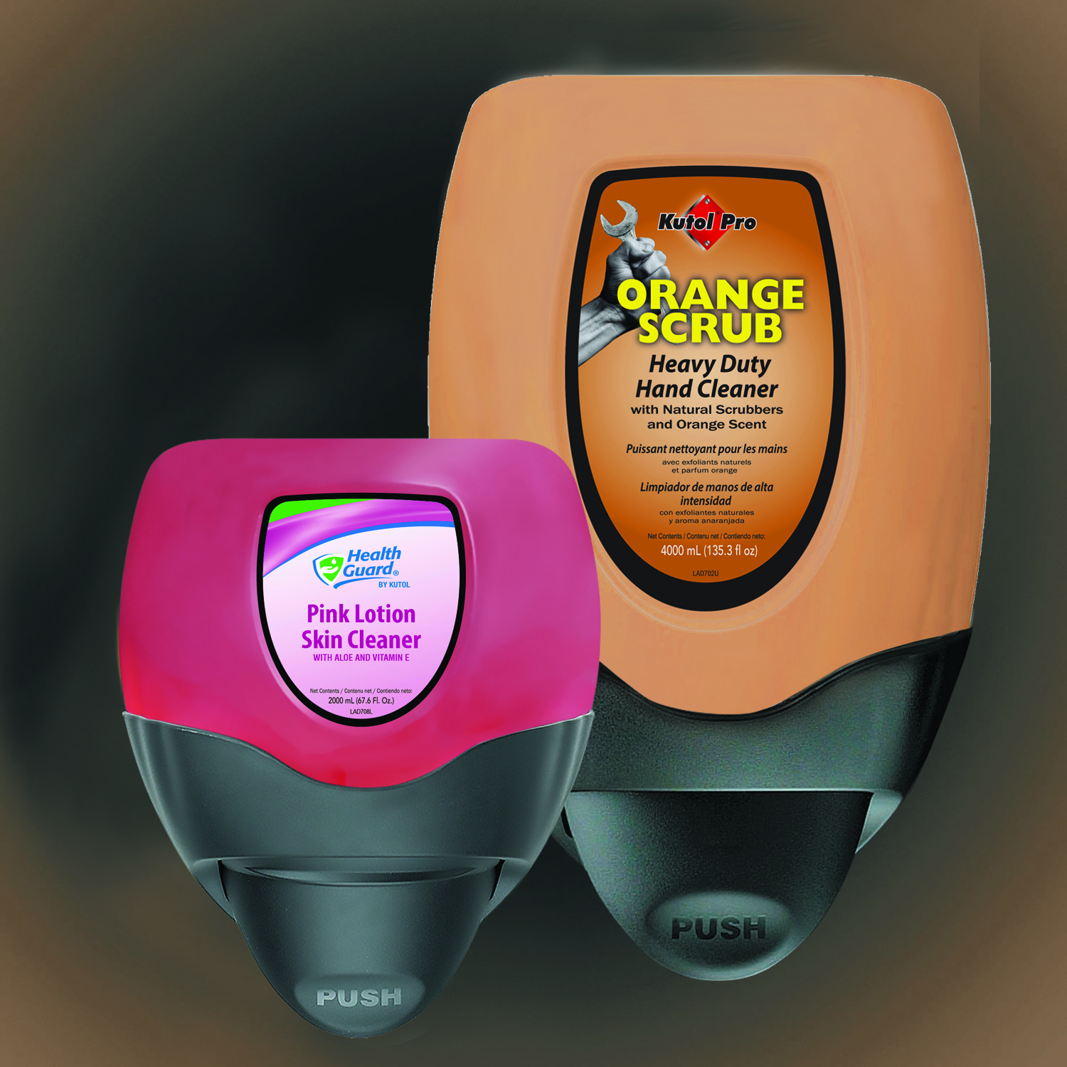
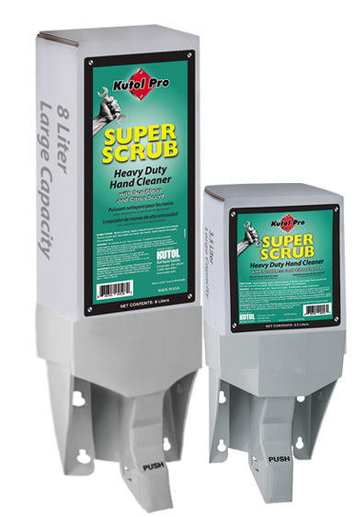
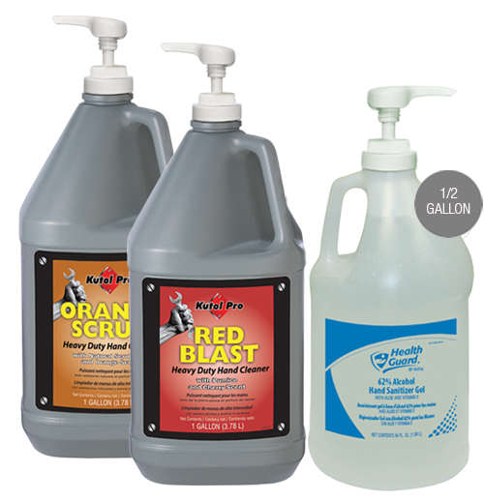
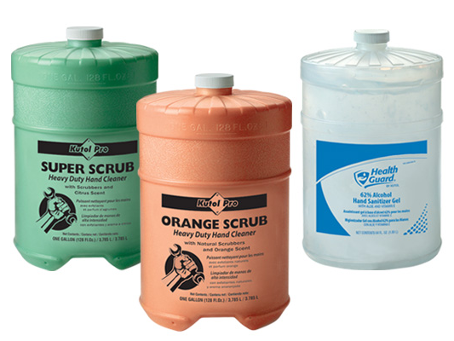
Heavy Duty and Bulk
DuraView
Large capacity: 2 L and 4 L refills
Waterproof
Gallons
Flat top, pour top and pump
Capacity Plus
Largest bag-in-box system
3.5 L and 8 L refills

Slide 24
Formula Options
Soap, sanitizer and specialty skin care

Slide 25
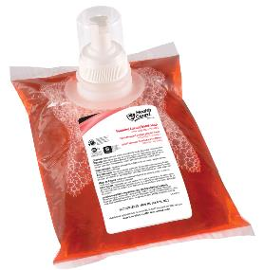
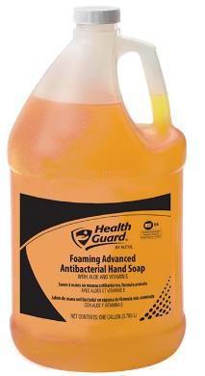
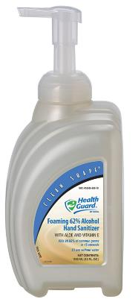
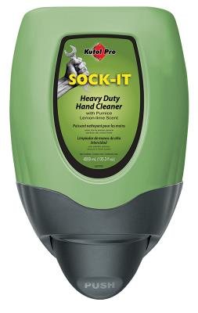
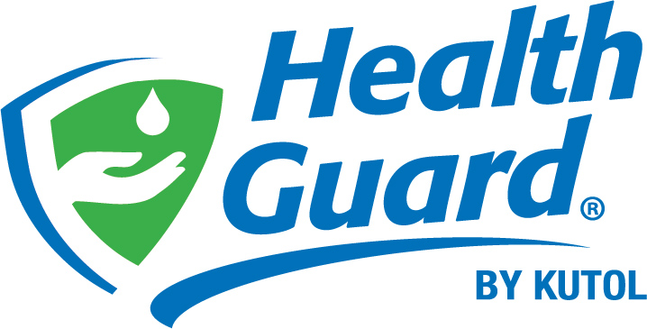
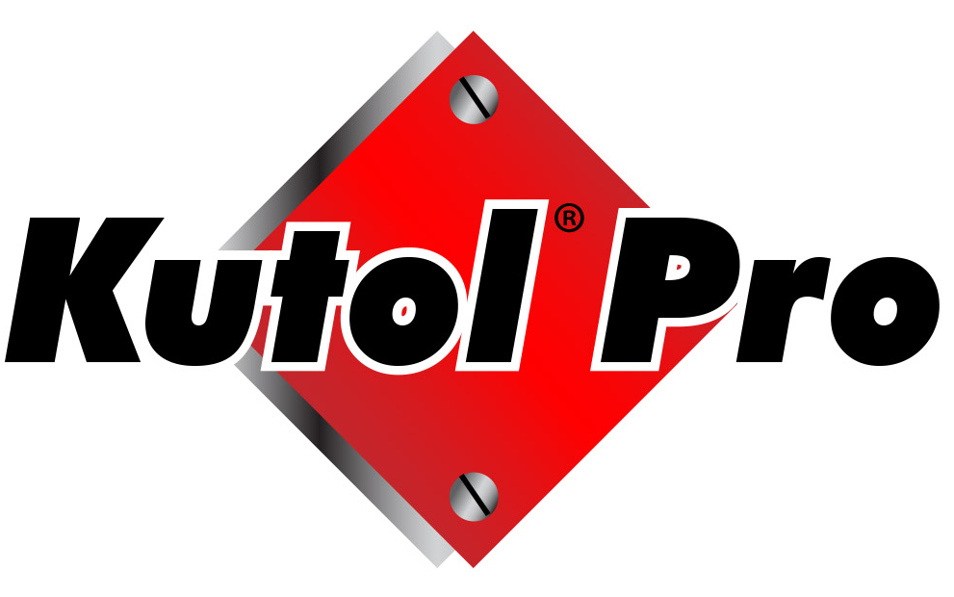
Top Formulas
Soap
690: Foaming Luxury Soap
213: Foaming Advanced Antibacterial Soap
686: Foaming Luxury Dye & Fragrance Free
566: Pink Lotion Skin Cleanser
683: Foaming E2 Sanitizing Soap
Sanitizer
688: Foaming 62% Alcohol Hand Sanitizer
056: 62% Alcohol Hand Sanitizer Gel
682: Foaming No Alcohol Hand Sanitizer
Heavy Duty
045: Super-Scrub with Scrubbers
016: Sock-It with Pumice

Slide 26
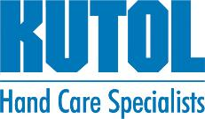
The Kutol Difference
Skin Care Only
Private Label Expertise
Family Owned
No retail
Full line
Best in class
100+ years
Stable
Notes:
We talked about the Kutol pillars at the beginning of this presentation – those pillars being what makes us different. In summary:
Skin care only manufacturing – we won’t leverage other chemicals against you
Full line offering
No retail – commitment is to away from home skin care, no fragmentation
Private label expertise – new PL dispenser platforms that work with current refills
New DECO dispenser for best in class branding
Customized member partner literature
Stable, family owned company – 100 years in the business; not for sale

Slide 27
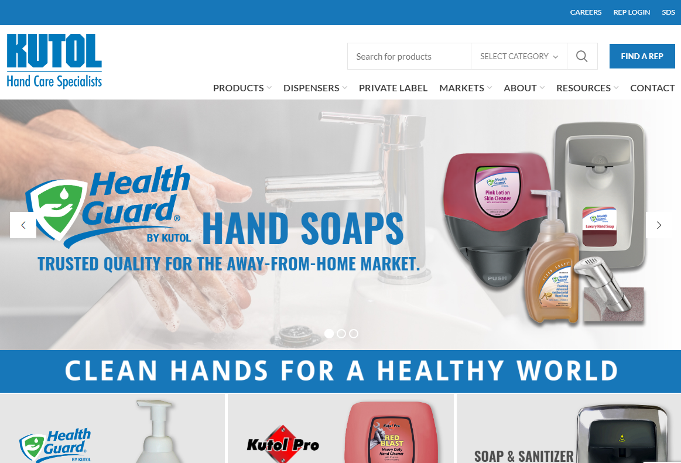
Digital Resources
Kutol.com
Follow us for updates and shareable content:
Scan now!
Notes:
Don’t forget to check out our website – a great resource for digital tools including: cost calculator, DECO visualizer, SKU search, SDS, etc
Follow Kutol on LinkedIn for usable, shareable content relative to your customers

Slide 28
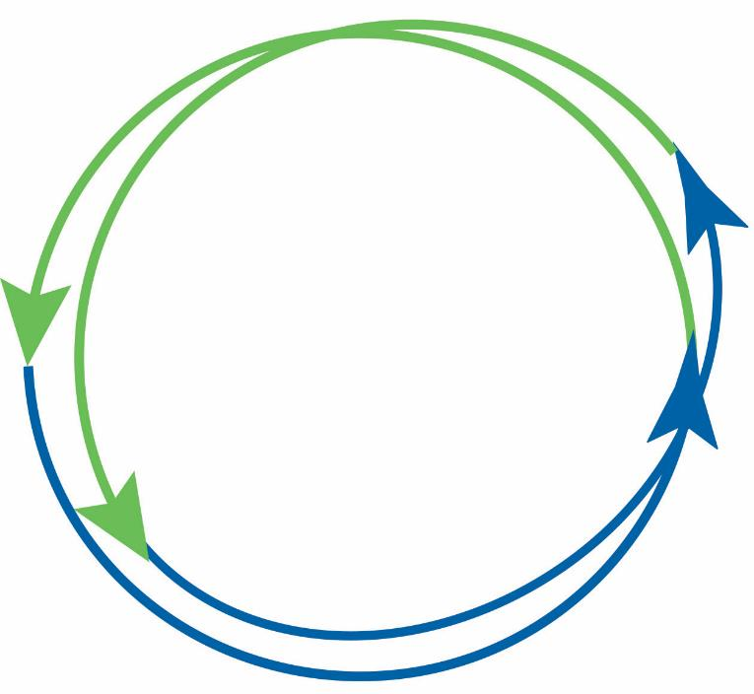
Depend on Kutol
Your Partner in Hand Care
Notes:
{Display Kutol and partner logos within circle. Do not distort circle by dragging to adjust size – marketing is available to help with resizing, etc.}
Grow your customer base with Kutol
We look forward to the next steps in the process to be your preferred skin care partner

Slide 29
Kutol Products
Recap and Questions

