Slide 1
TOPFILL™ No Touch Counter Mount

Slide 2
Intro
Differentiators
Packaging / Demo Kit
Specs, installation, refilling
Sales and Marketing Tools
Opportunities and Selling Scenarios
Pricing
Next Steps
Questions and Feedback
Agenda

Slide 3
Marketing Video

Slide 4
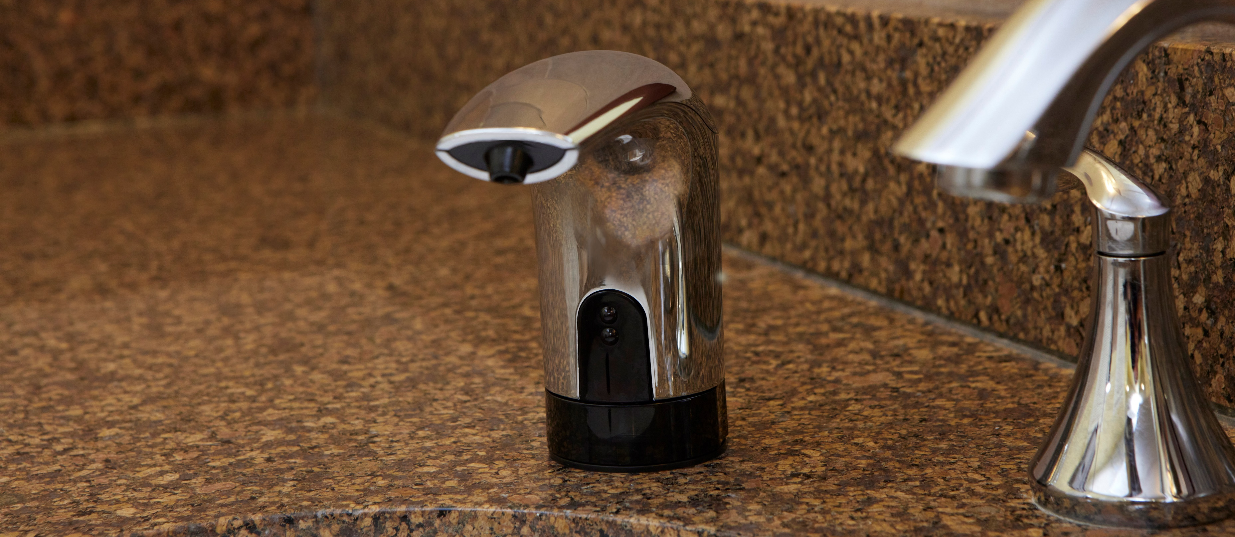
Differentiators
Pandemic Bump
Tech and Innovation
Labor Efficiencies
Cost Savings
Sanitizer Shift
New Product Offerings
Image Enhancement
Safety and Health

Slide 5
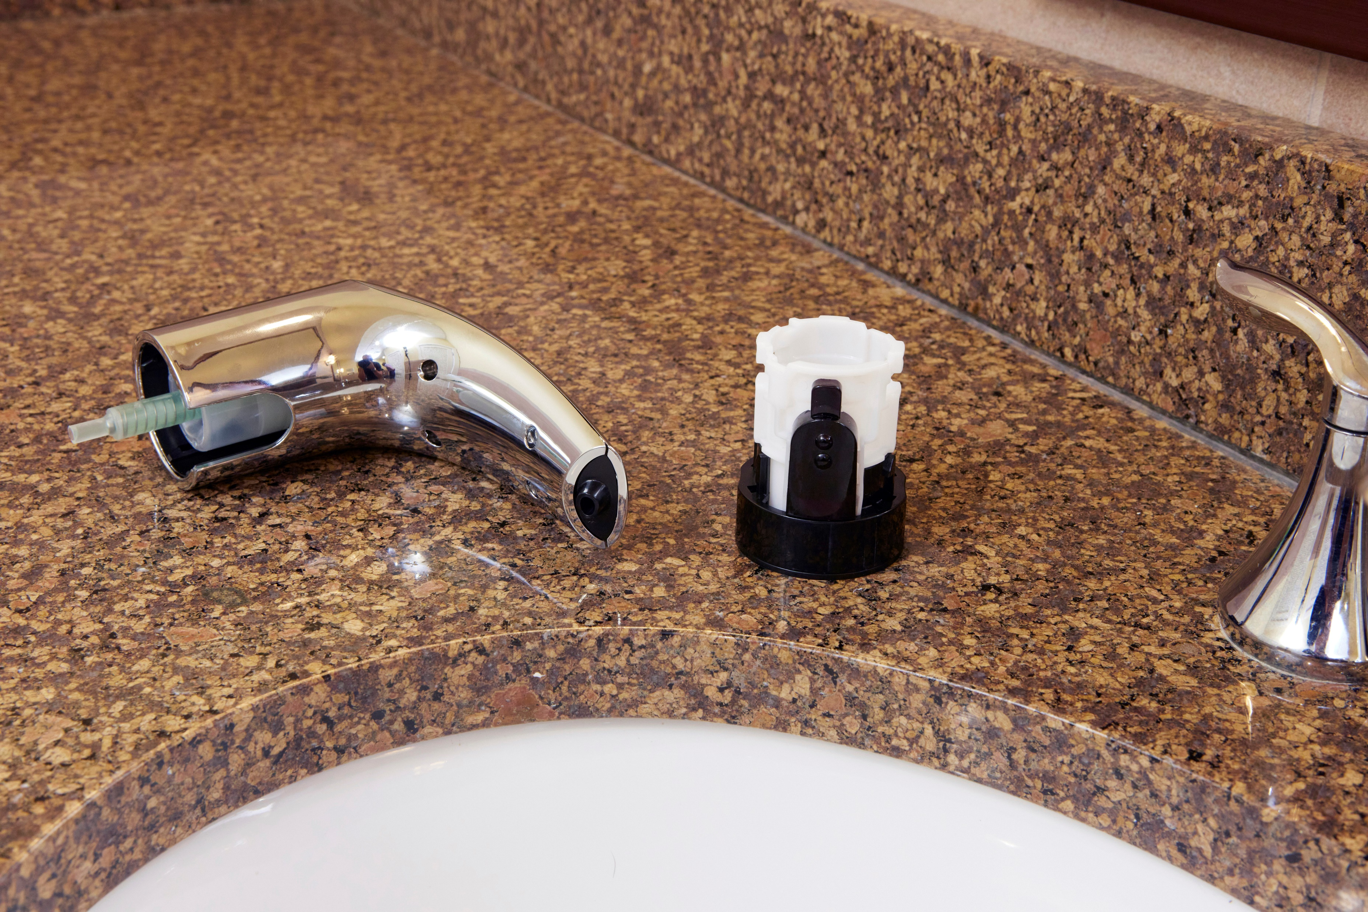
Differentiators: Labor Efficiencies
Easy above counter access – no need to refill from under the counter
Refill at any time – set up efficient refilling schedule

Slide 6
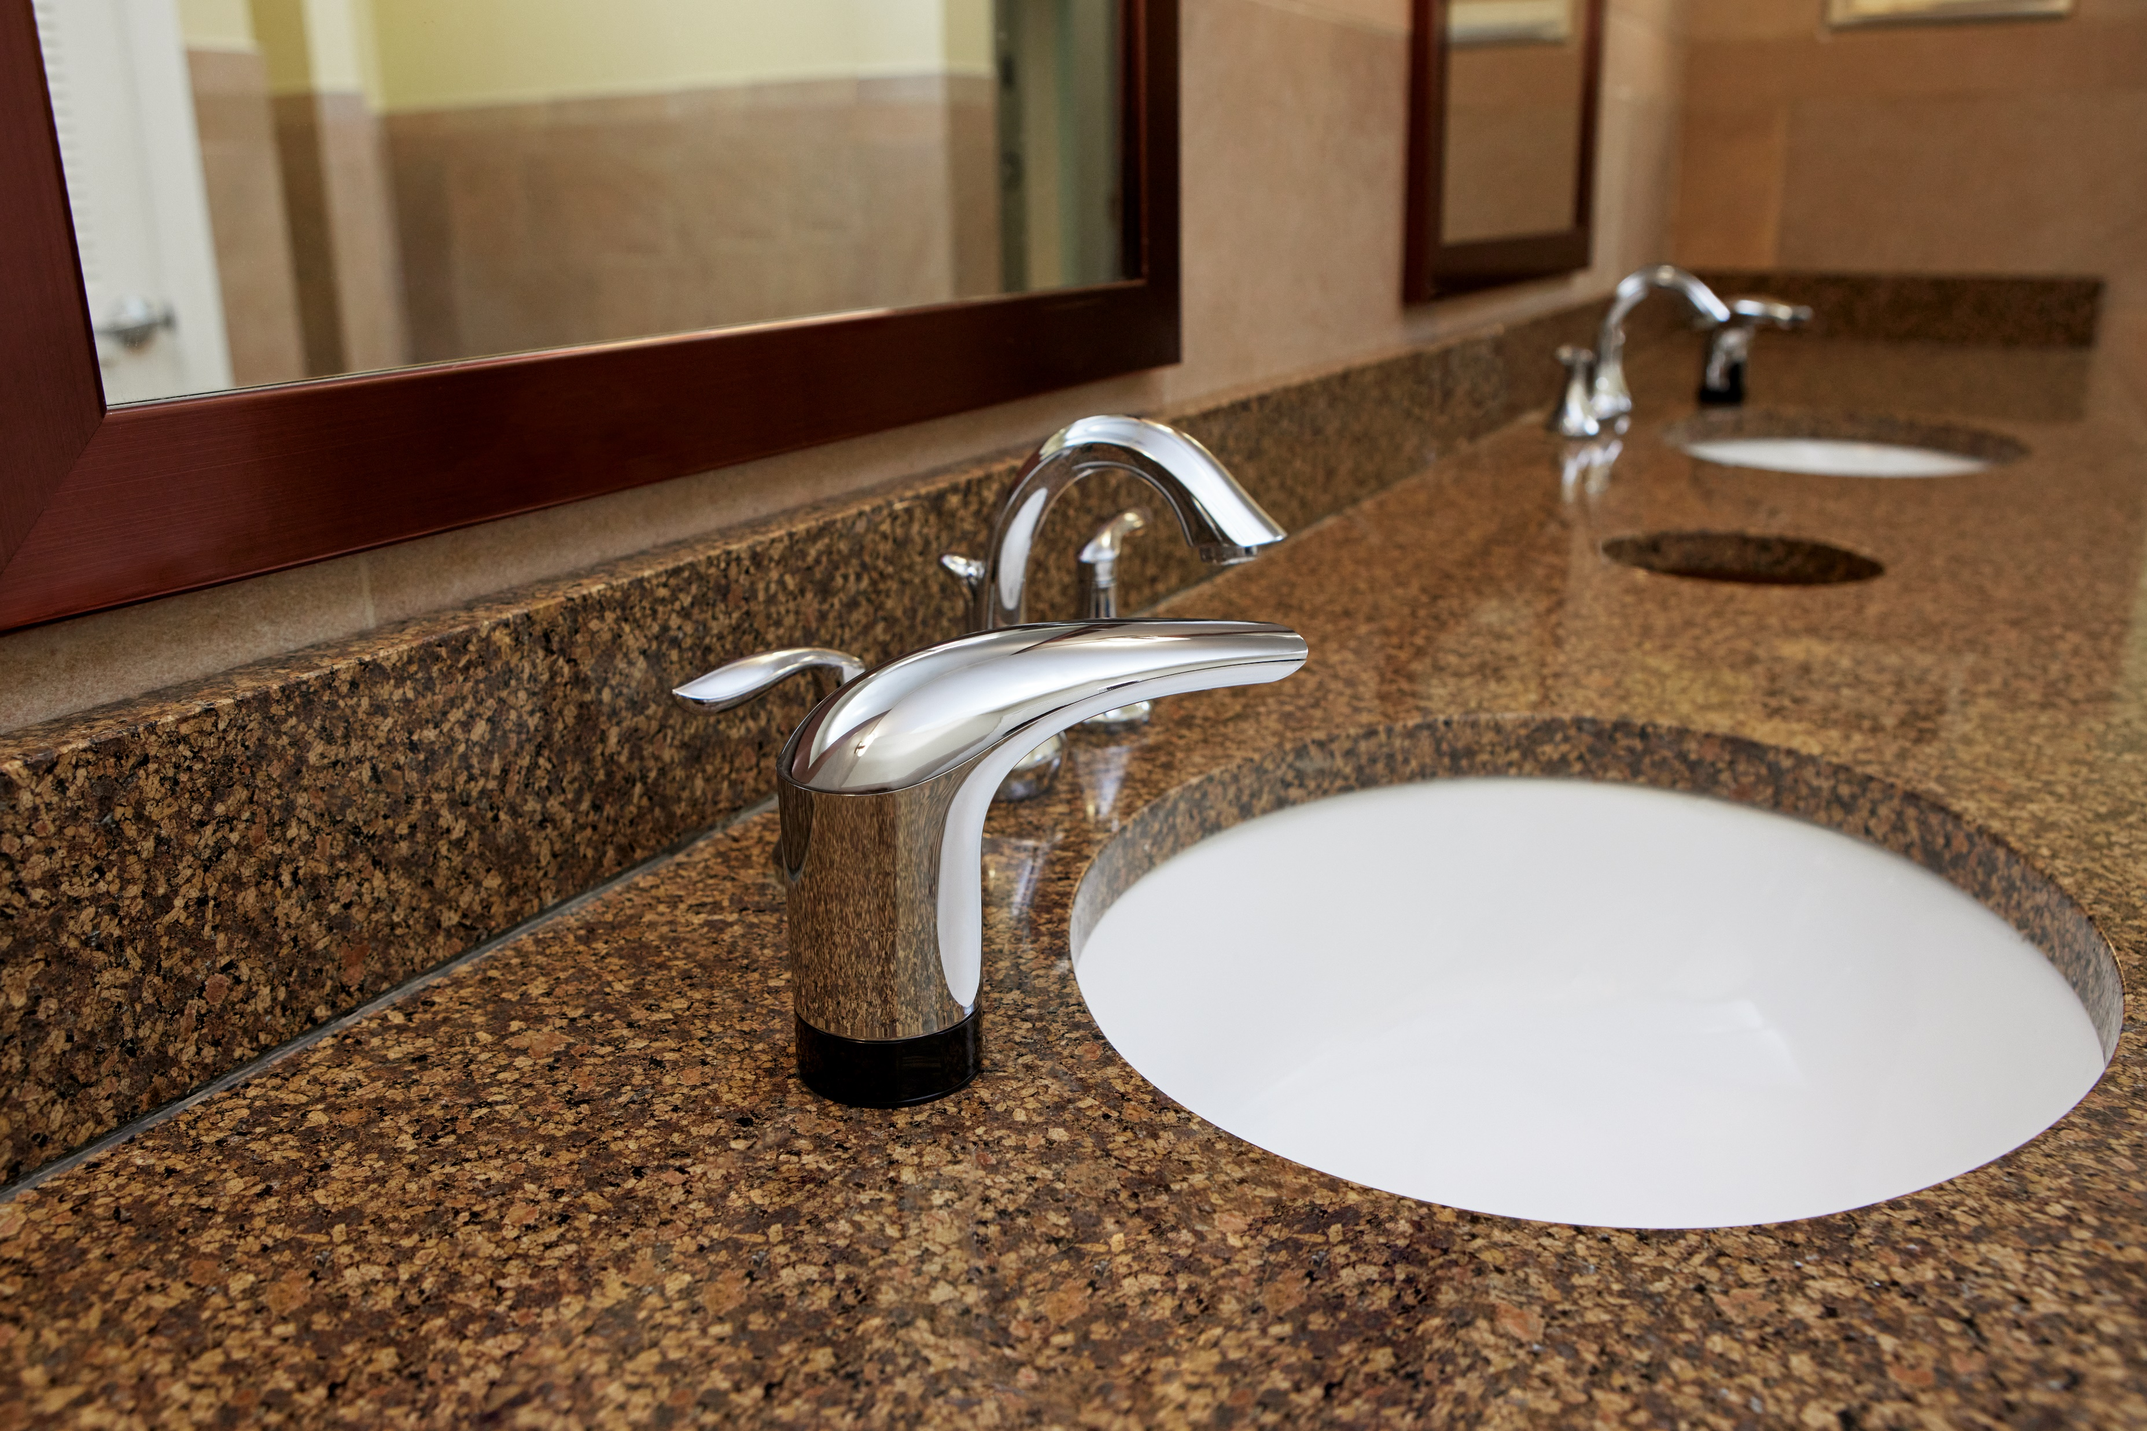
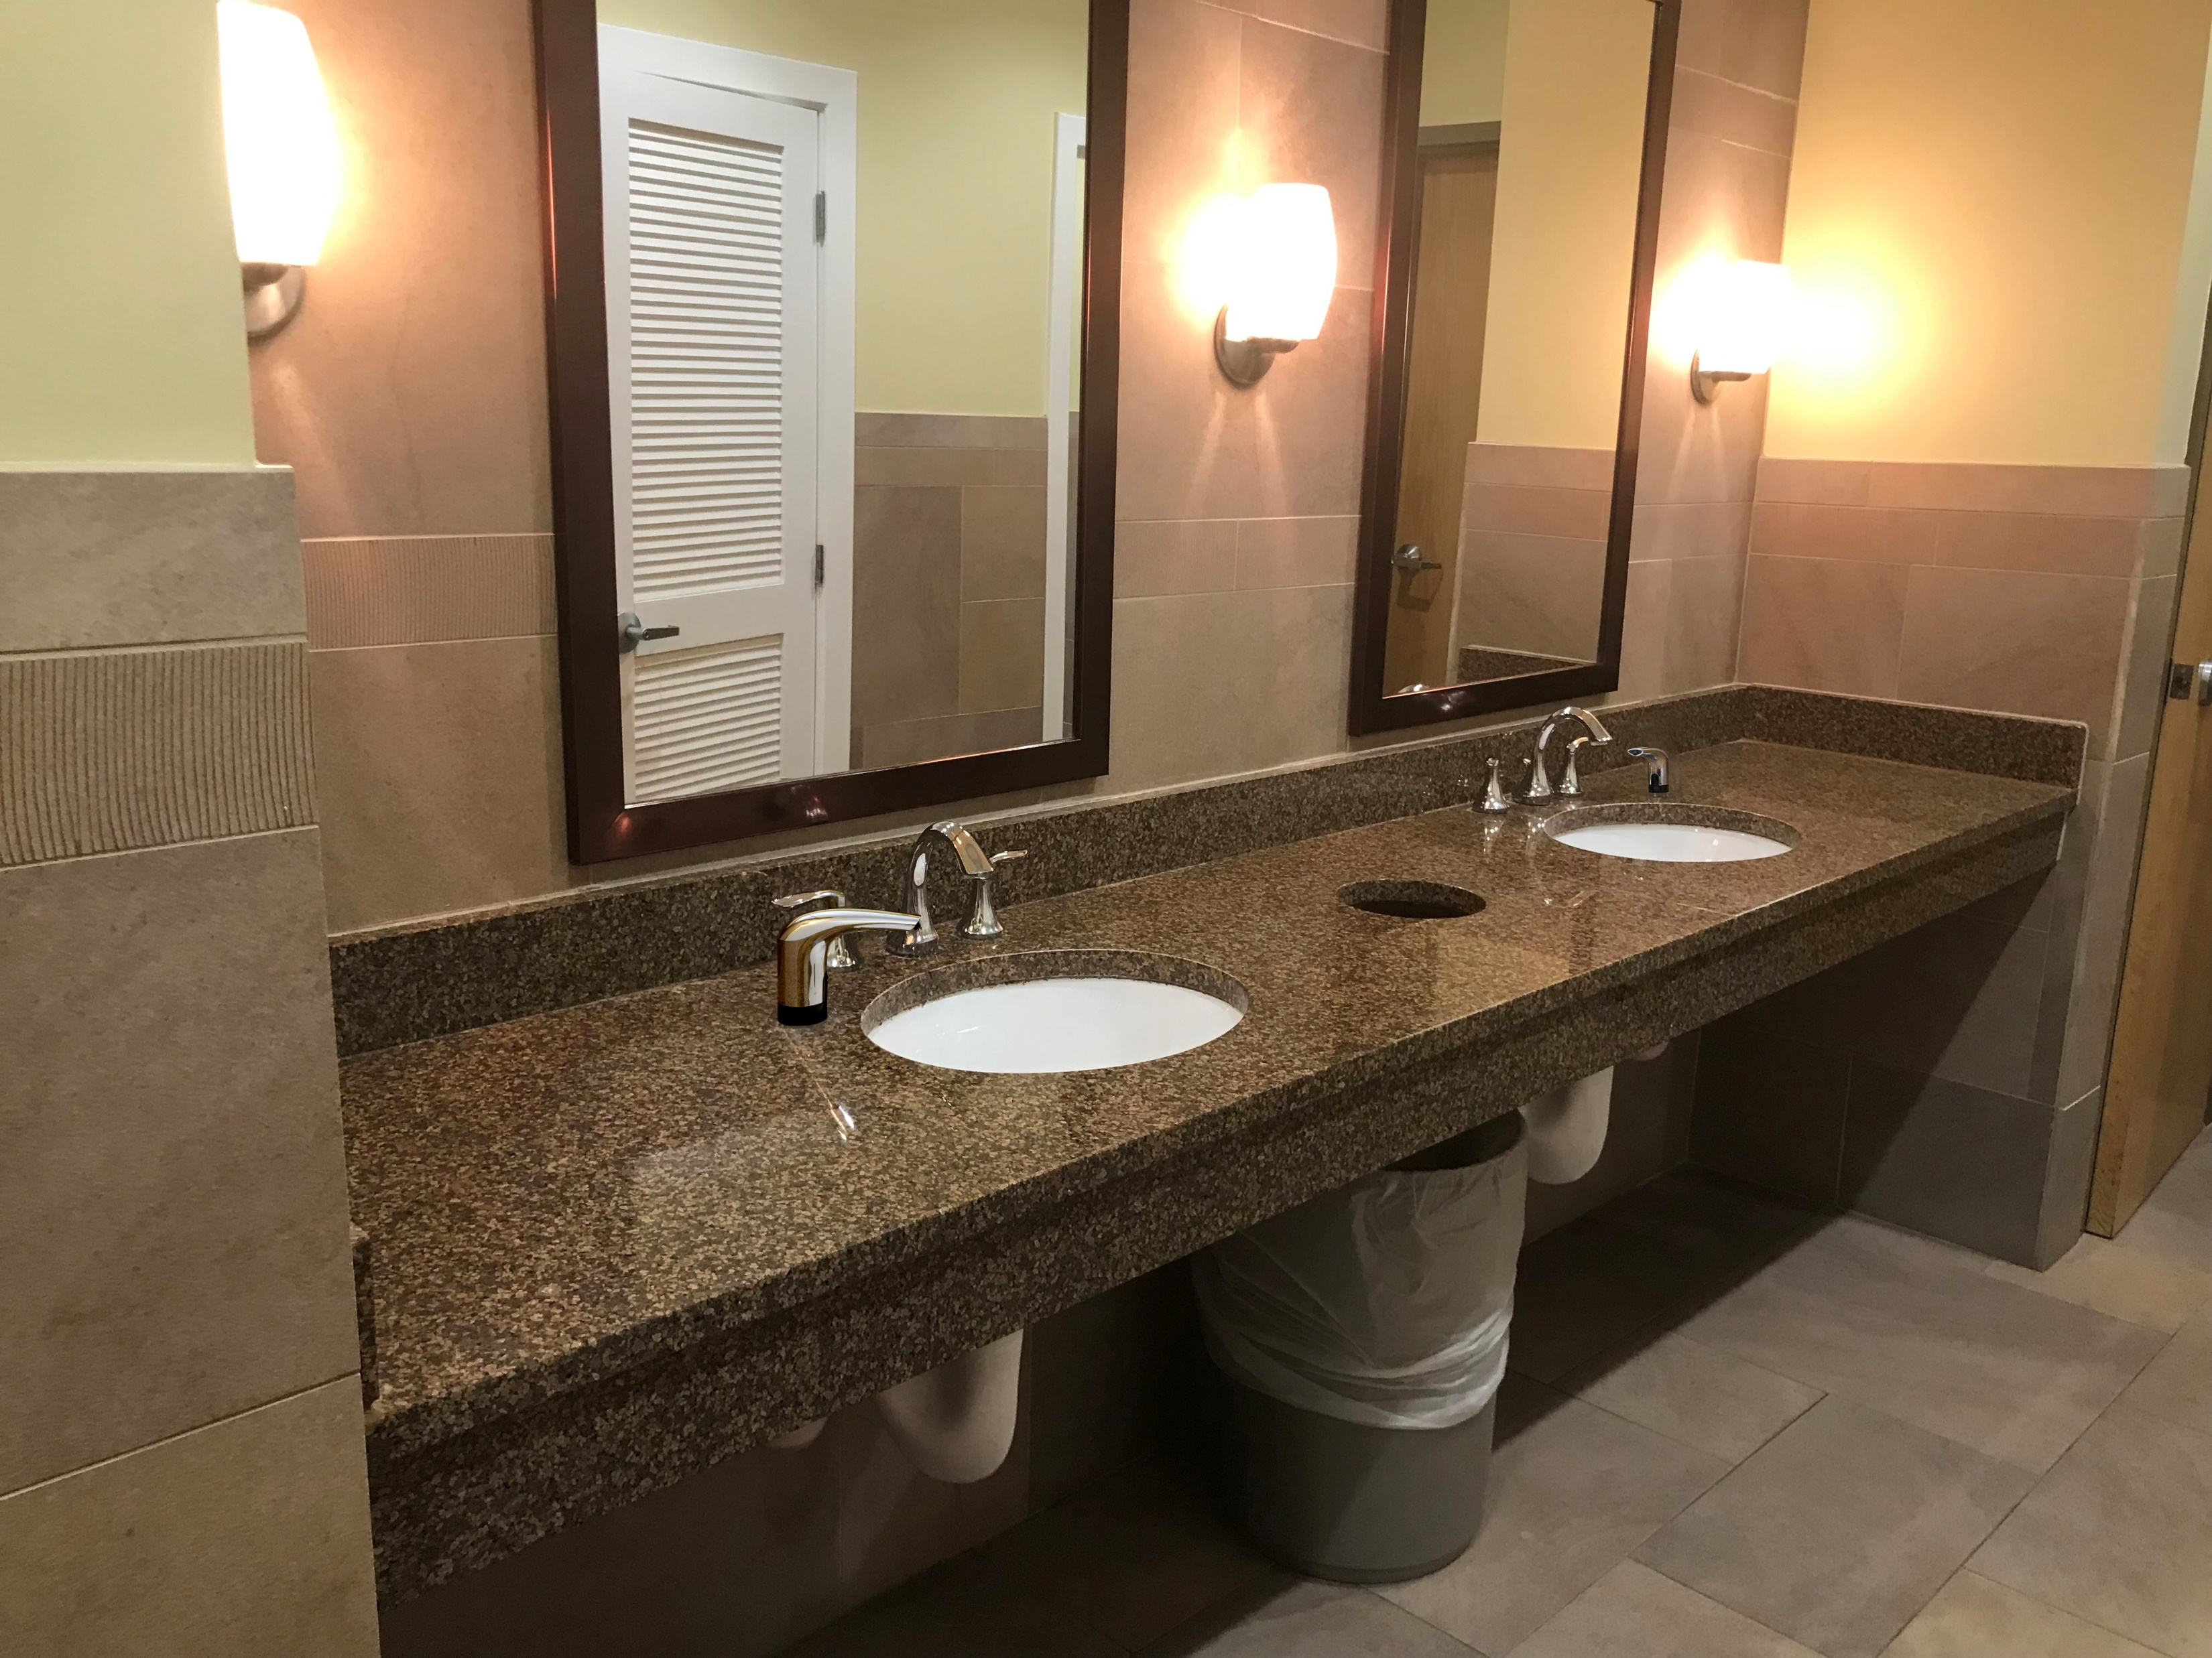
Differentiators: Image Enhancement
Sleek chrome finish
Touch free conveys commitment to a healthy, clean environment
LUX soap refills provide upscale handwashing experience

Slide 7
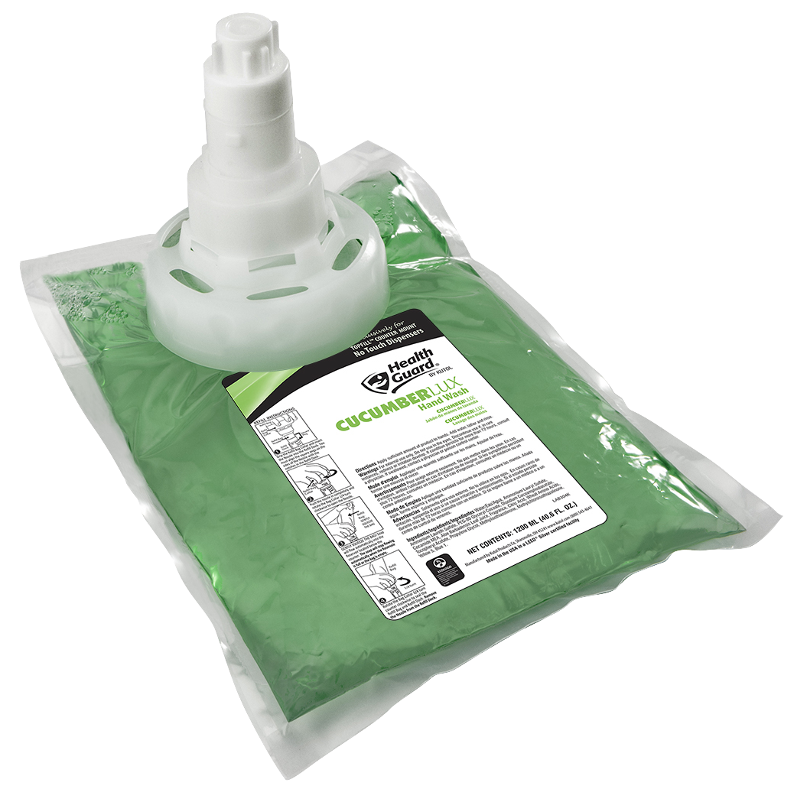
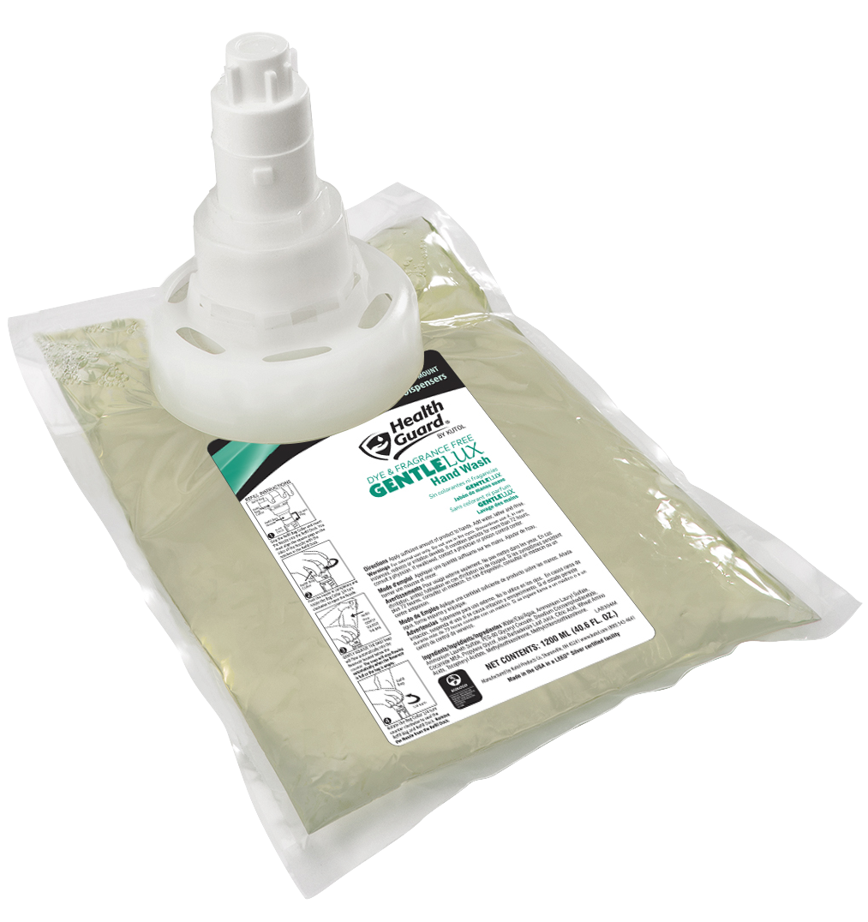
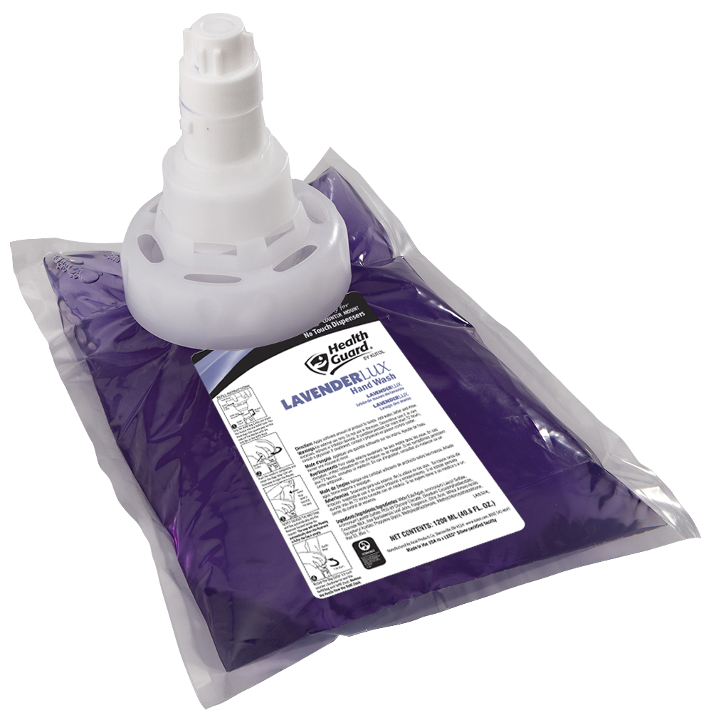
Differentiators: Image Enhancement
NEW!
from
LUX Refills
Extra soft luxury
Sealed, sanitary, locking
2,000 handwashes
1200 mL, 3 per case
Ecologo® Certified
CucumberLUX
Refreshing cucumber scent
GentleLUX
Dye and fragrance free
LavenderLUX
Mild lavender scent
*LUX refills are for No Touch Counter Mount only
Notes:
New formulas from Health Guard have been branded “LUX” to convey the elevated handwashing experience they provide
All three are ECOLOGO certified
WORK ONLY in the NO TOUCH dispenser – refills are NOT interchangeable with the manual counter mount
Reasoning for no antibacterial offering

Slide 8
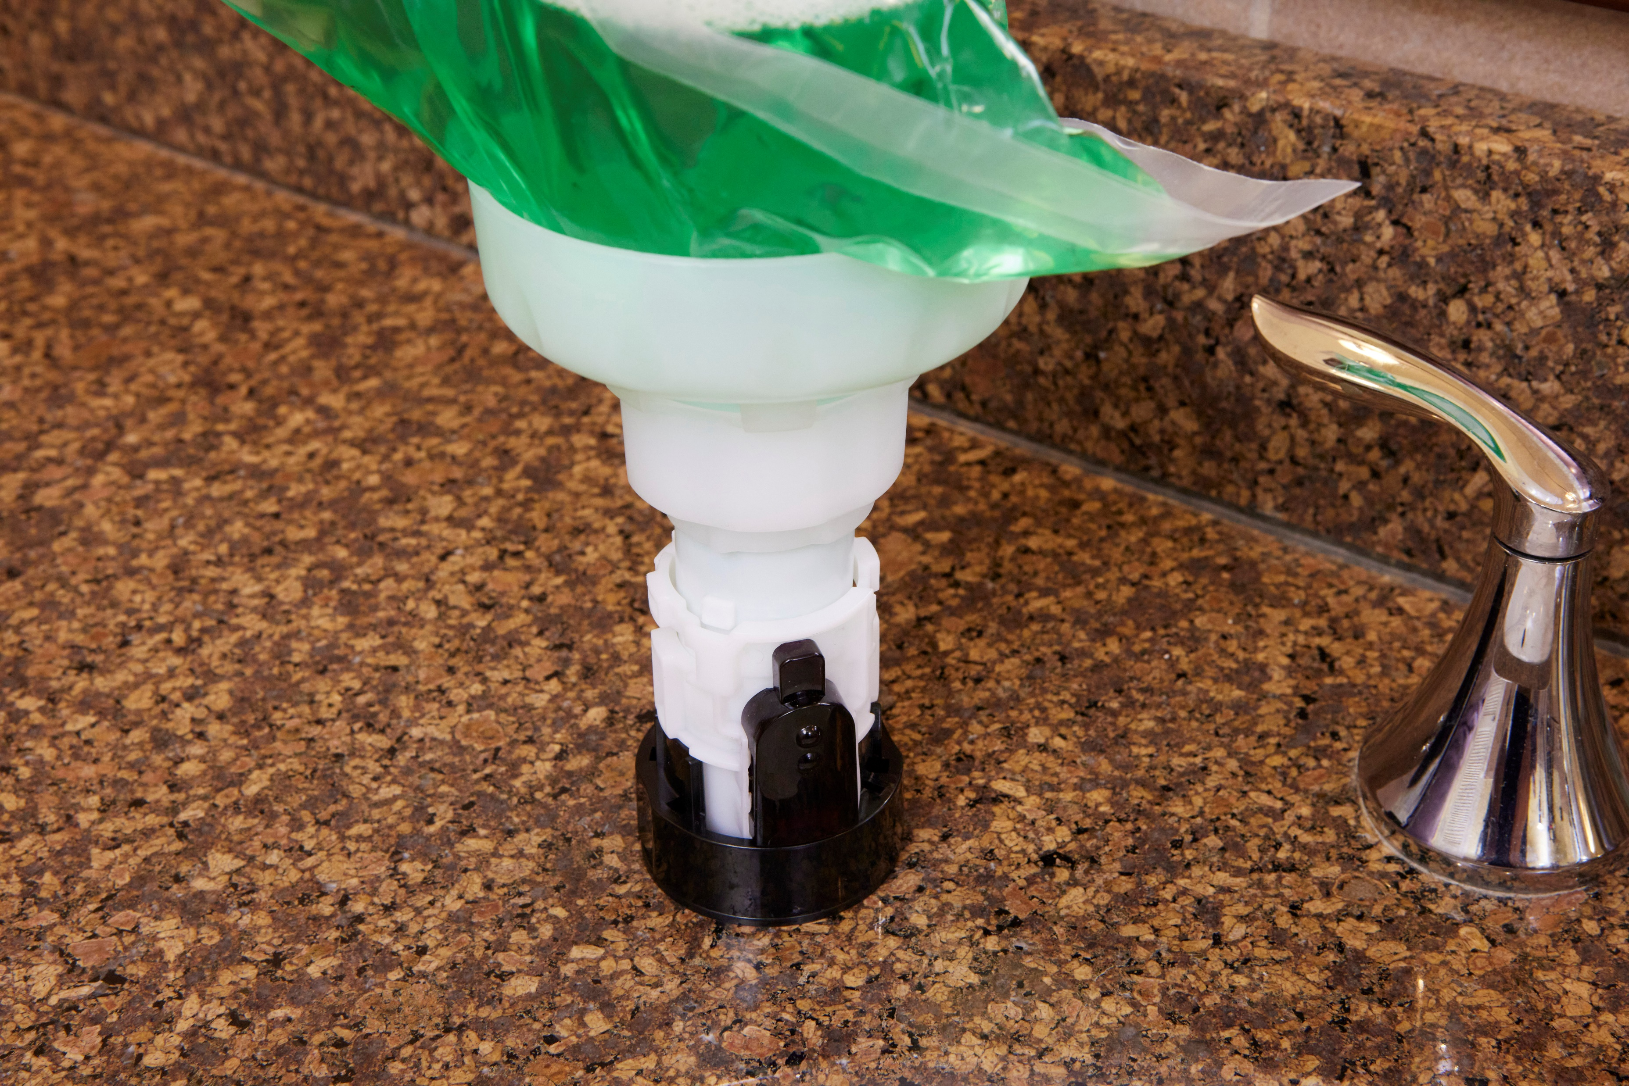
Differentiators: Cost Savings
Evacuates 100% of product
Locking dock/bag eliminates leaks, minimizes product waste and clean-up

Slide 9
Differentiators: Safety and Health
Reduces repetitive motions and routine hazards for safer working environment
No touch prevents spread of viruses and bacteria
Eliminates cross contamination
 | Risk Type | No Risk | Moderate Risk | High Risk
 | Repetitive motions
 | Spread of germs
 | Cross contamination

Slide 10
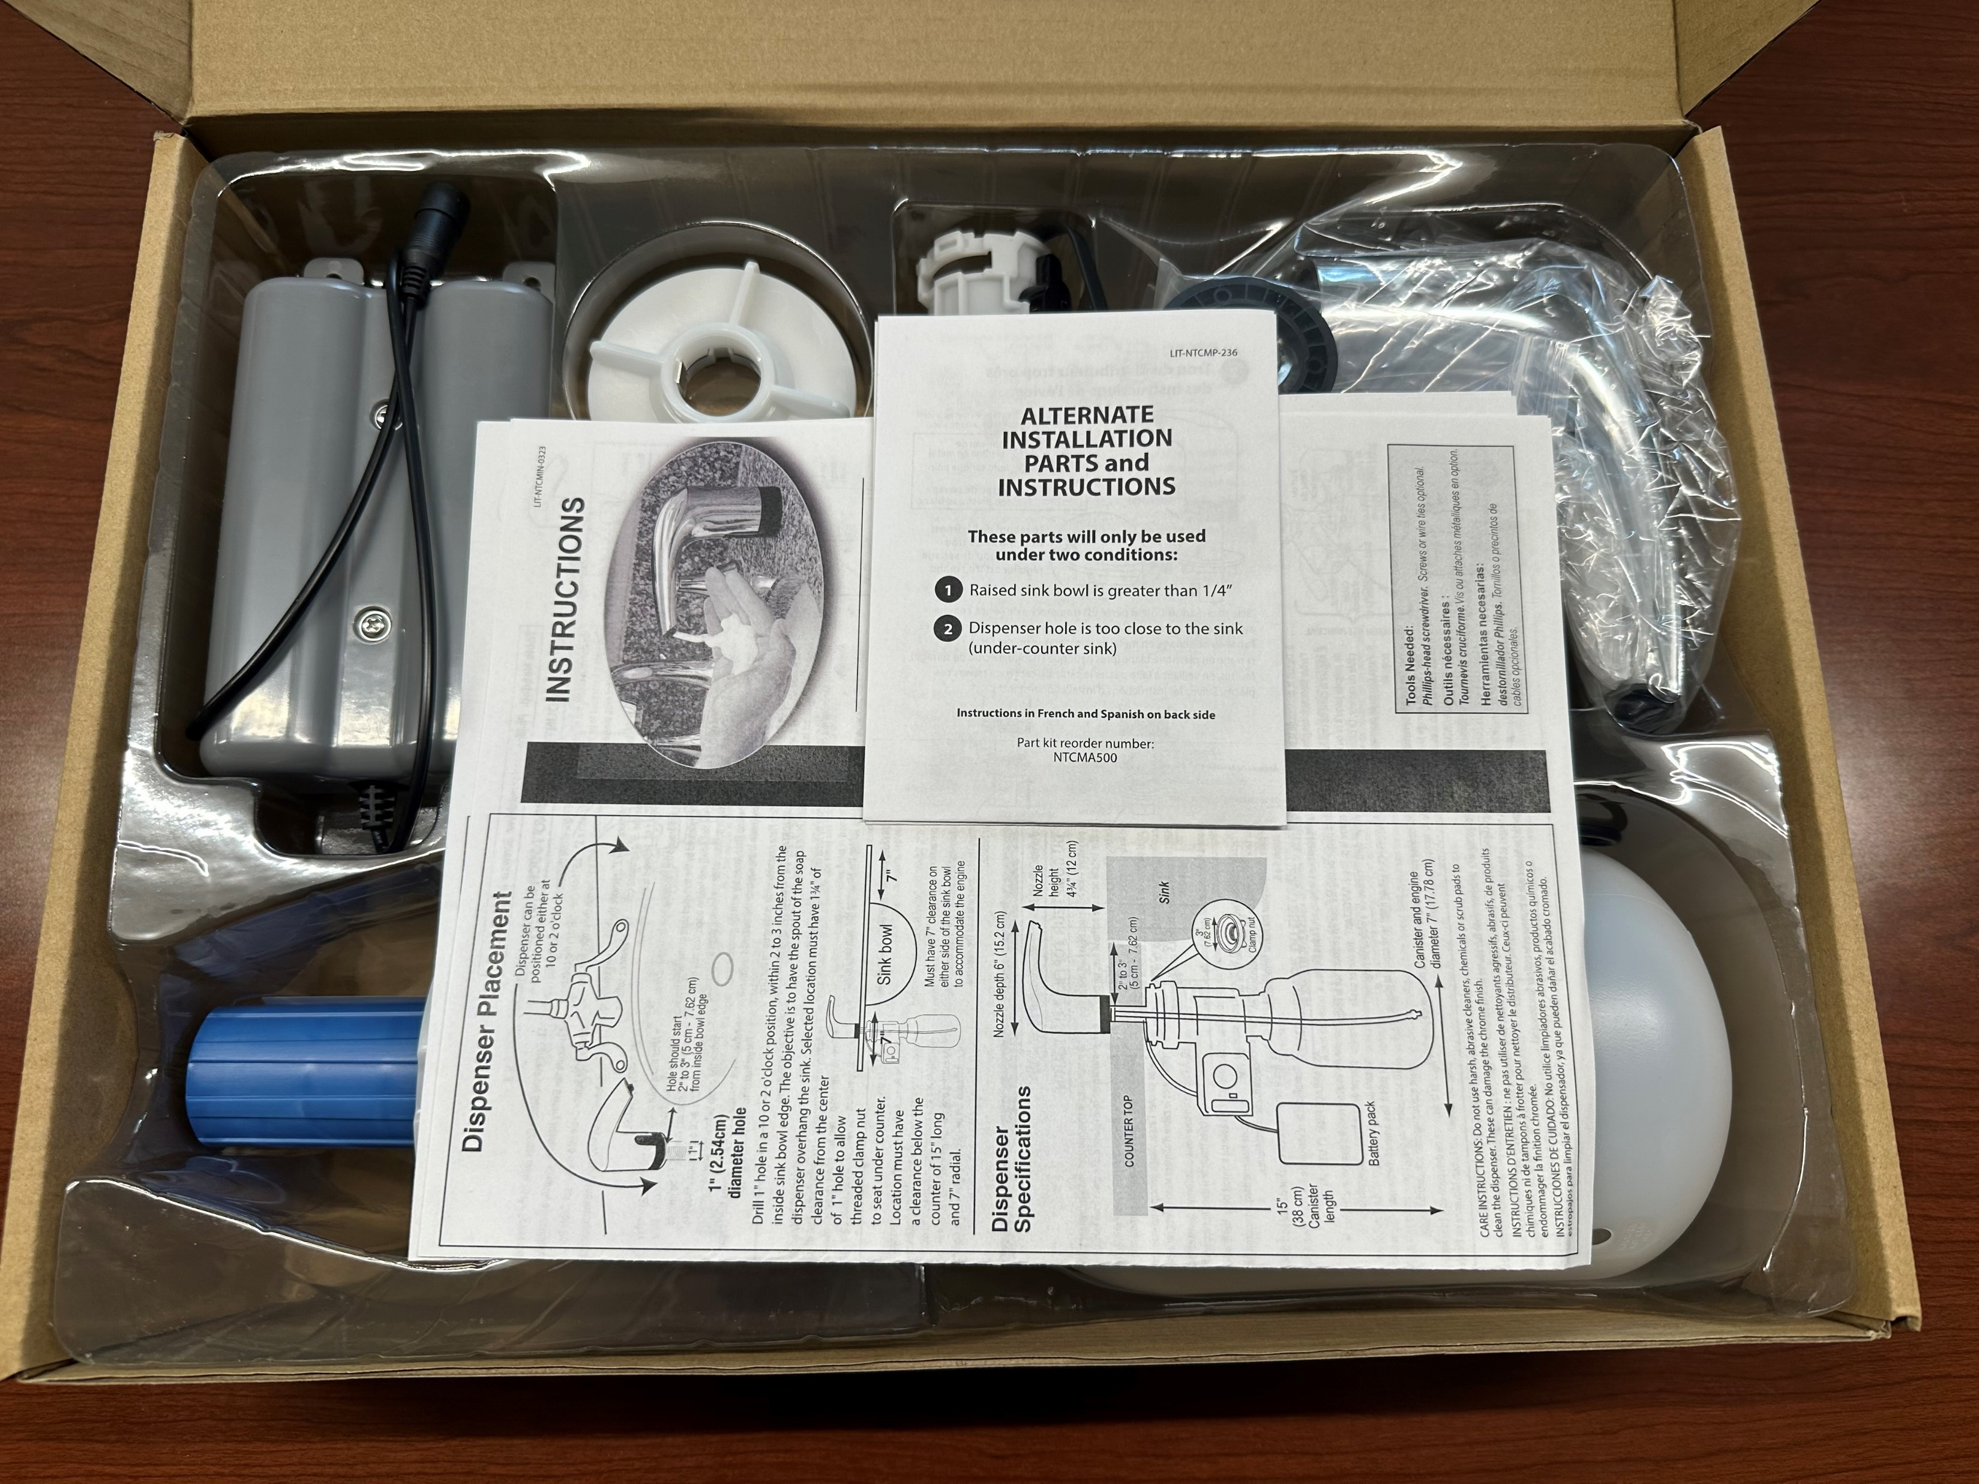
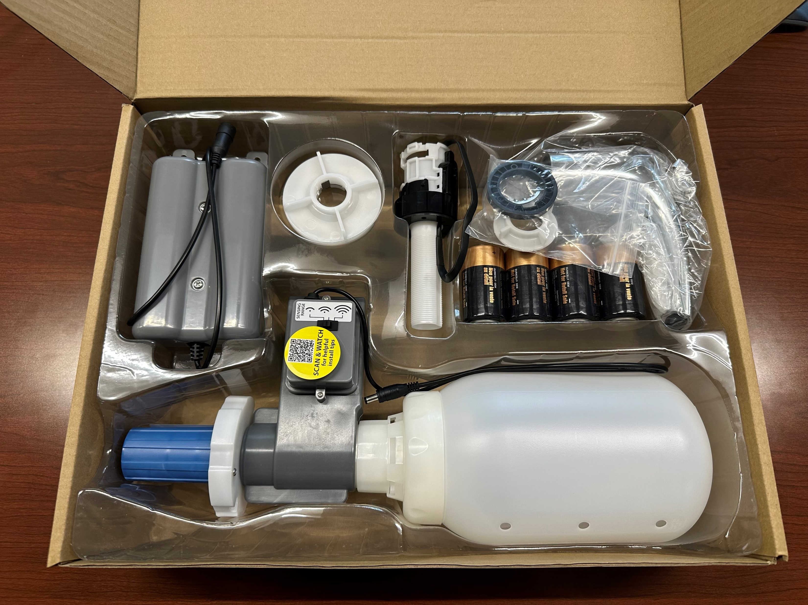
Packaging

Slide 11
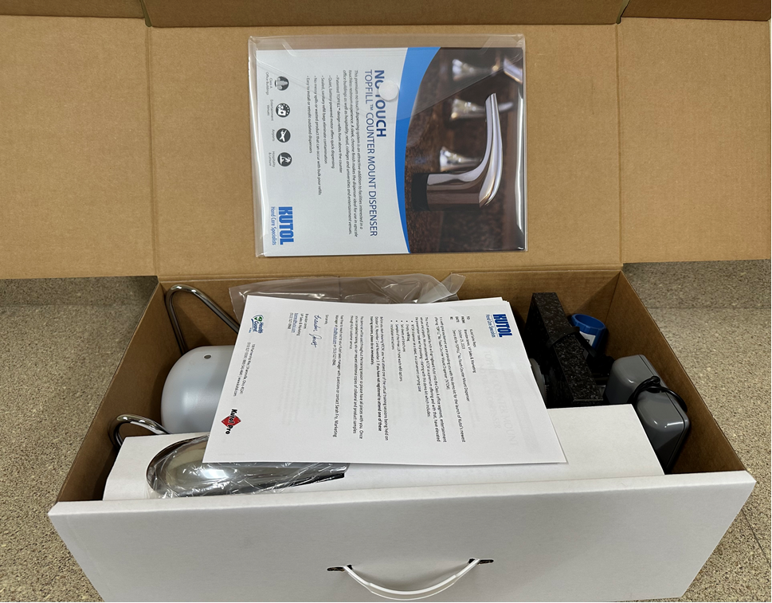
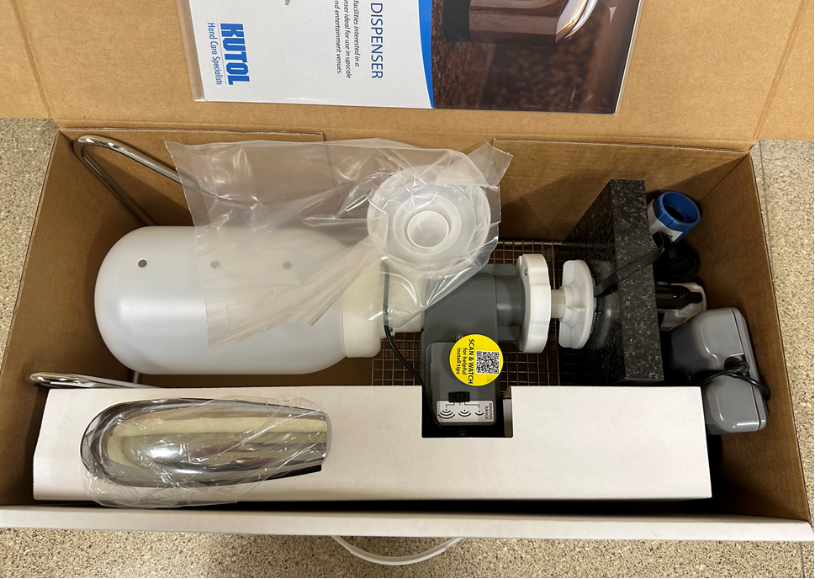
Demo Kit
Notes:
Time to open demo kit and go through the pieces

Slide 12
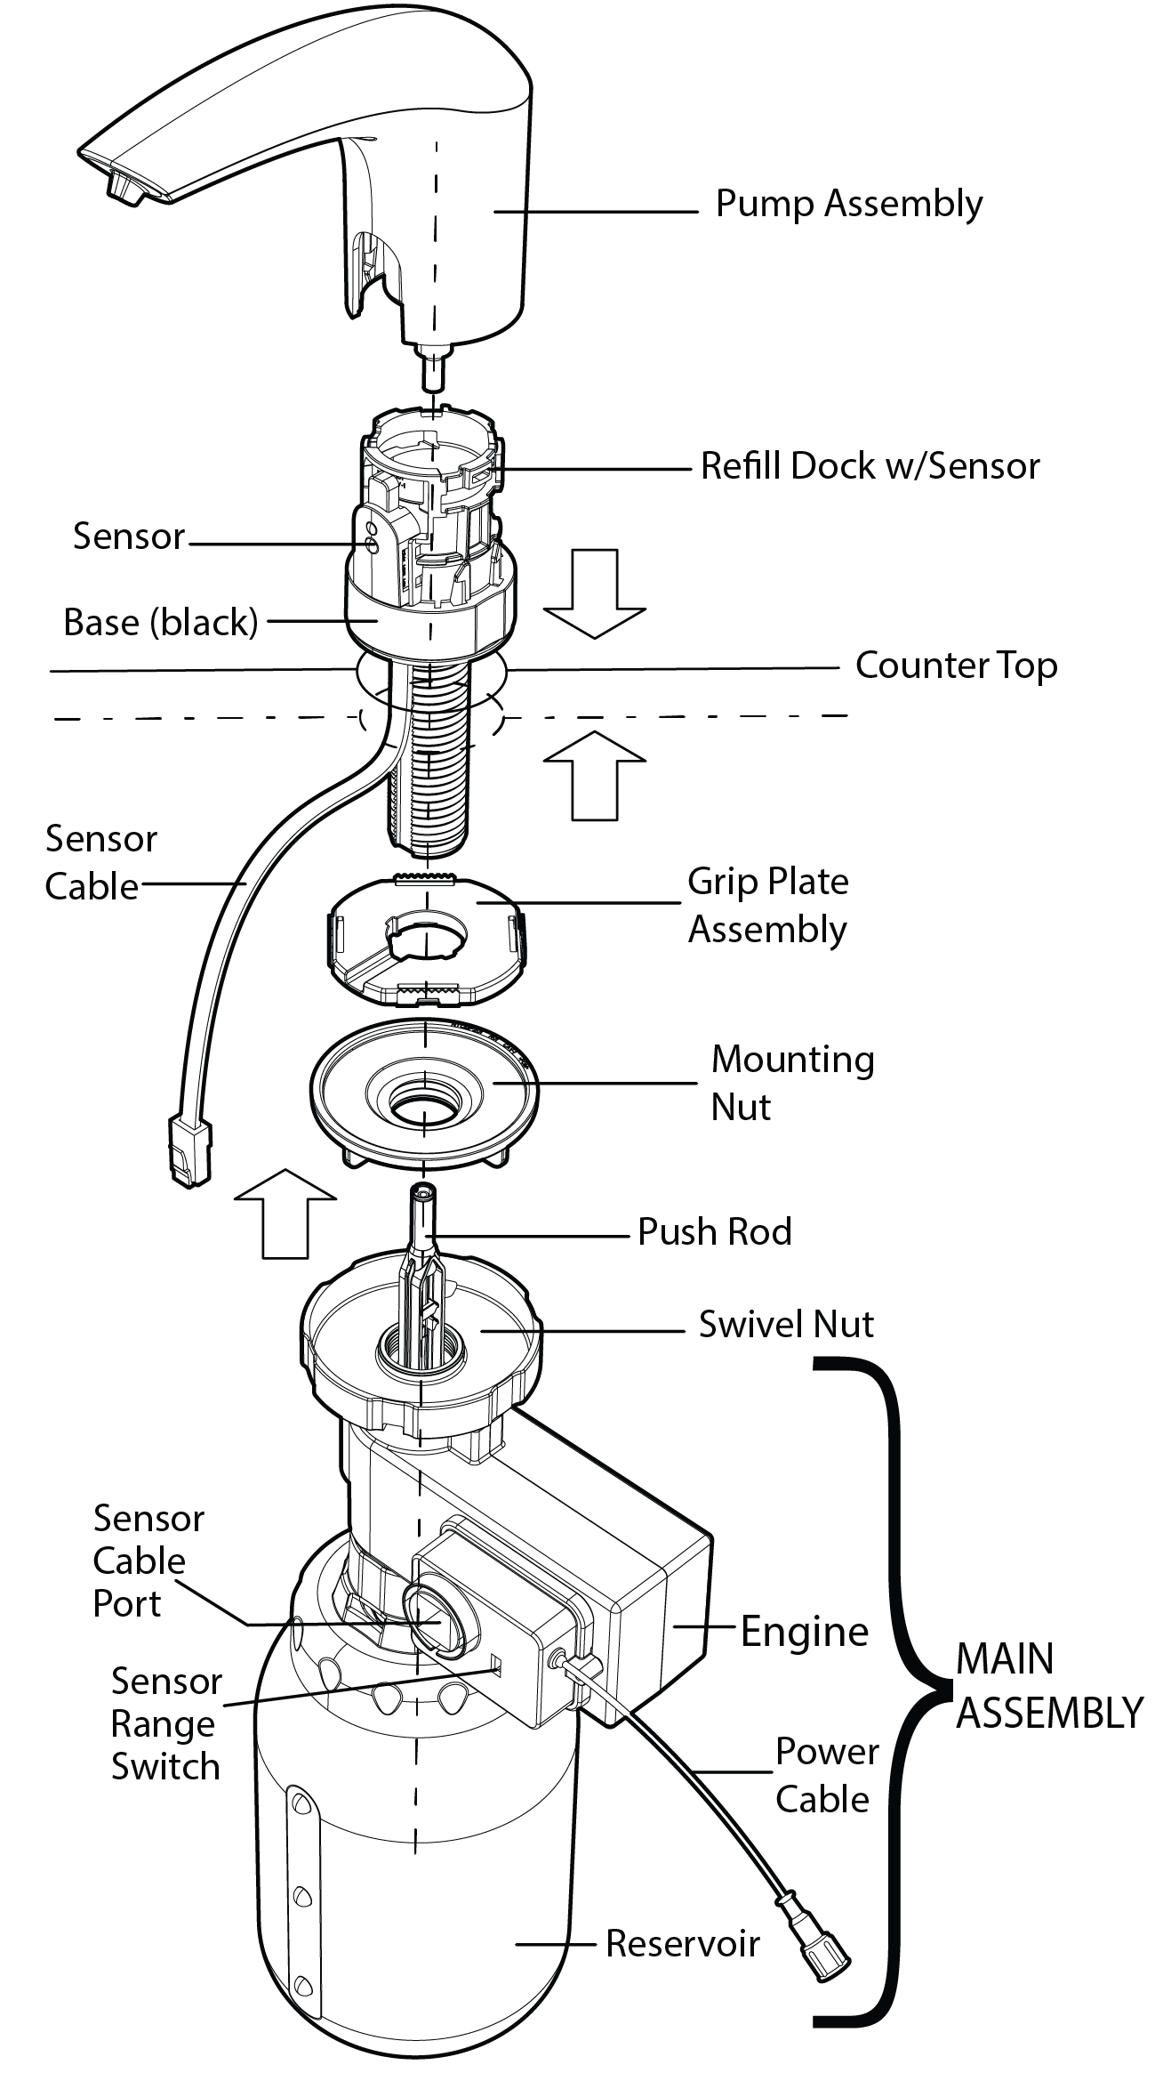
Specs
.6 mL of LUX, high foaming soap per hand wash
1200 mL refill bags = 2,000 hand washes
1500 mL canister capacity
4 D cell batteries = at least 40,000 hand washes
Notes:
This diagram is included in the installation instructions

Slide 13
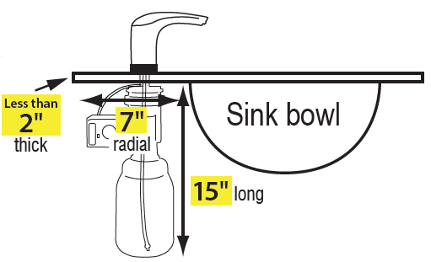
Pre-Install Considerations and Spacing Requirements
Conduct walkthrough
Number of (facility) locations
Number of sinks
Verify spacing requirements
Dispenser hole 2”-3” from sink, 1” in diameter
Countertop thickness 2” or less
Under sink clearance: 7” radial, 15” long
Installer review installation instructions/video

Slide 14
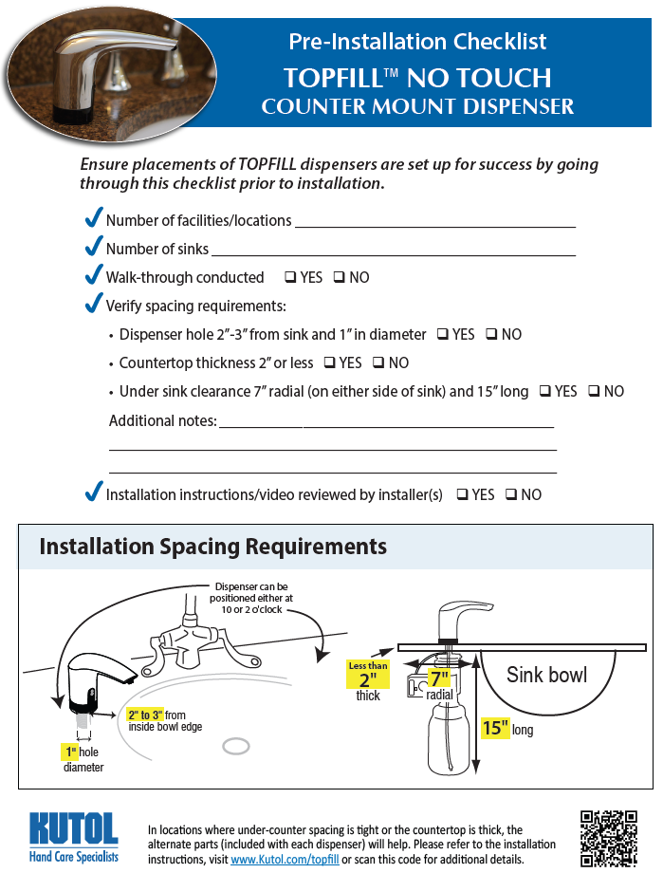
Pre-Install Checklist
https://www.kutol.com/wp-content/uploads/2023/10/NTCM_Presale-Site-Survey.1023-fillable.pdf
Notes:
Fillable PDF that should be used as part of a site survey or pre-install walk through

Slide 15
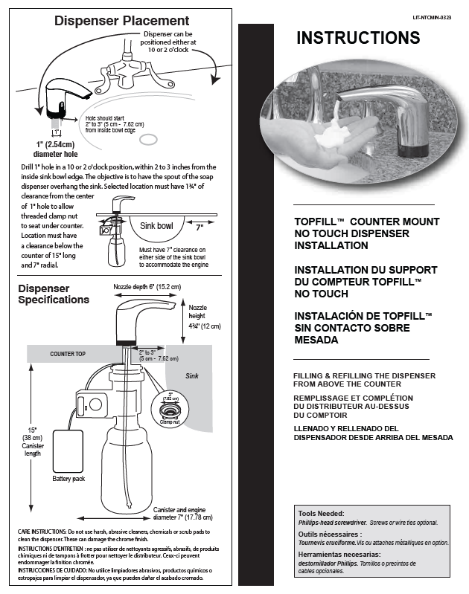
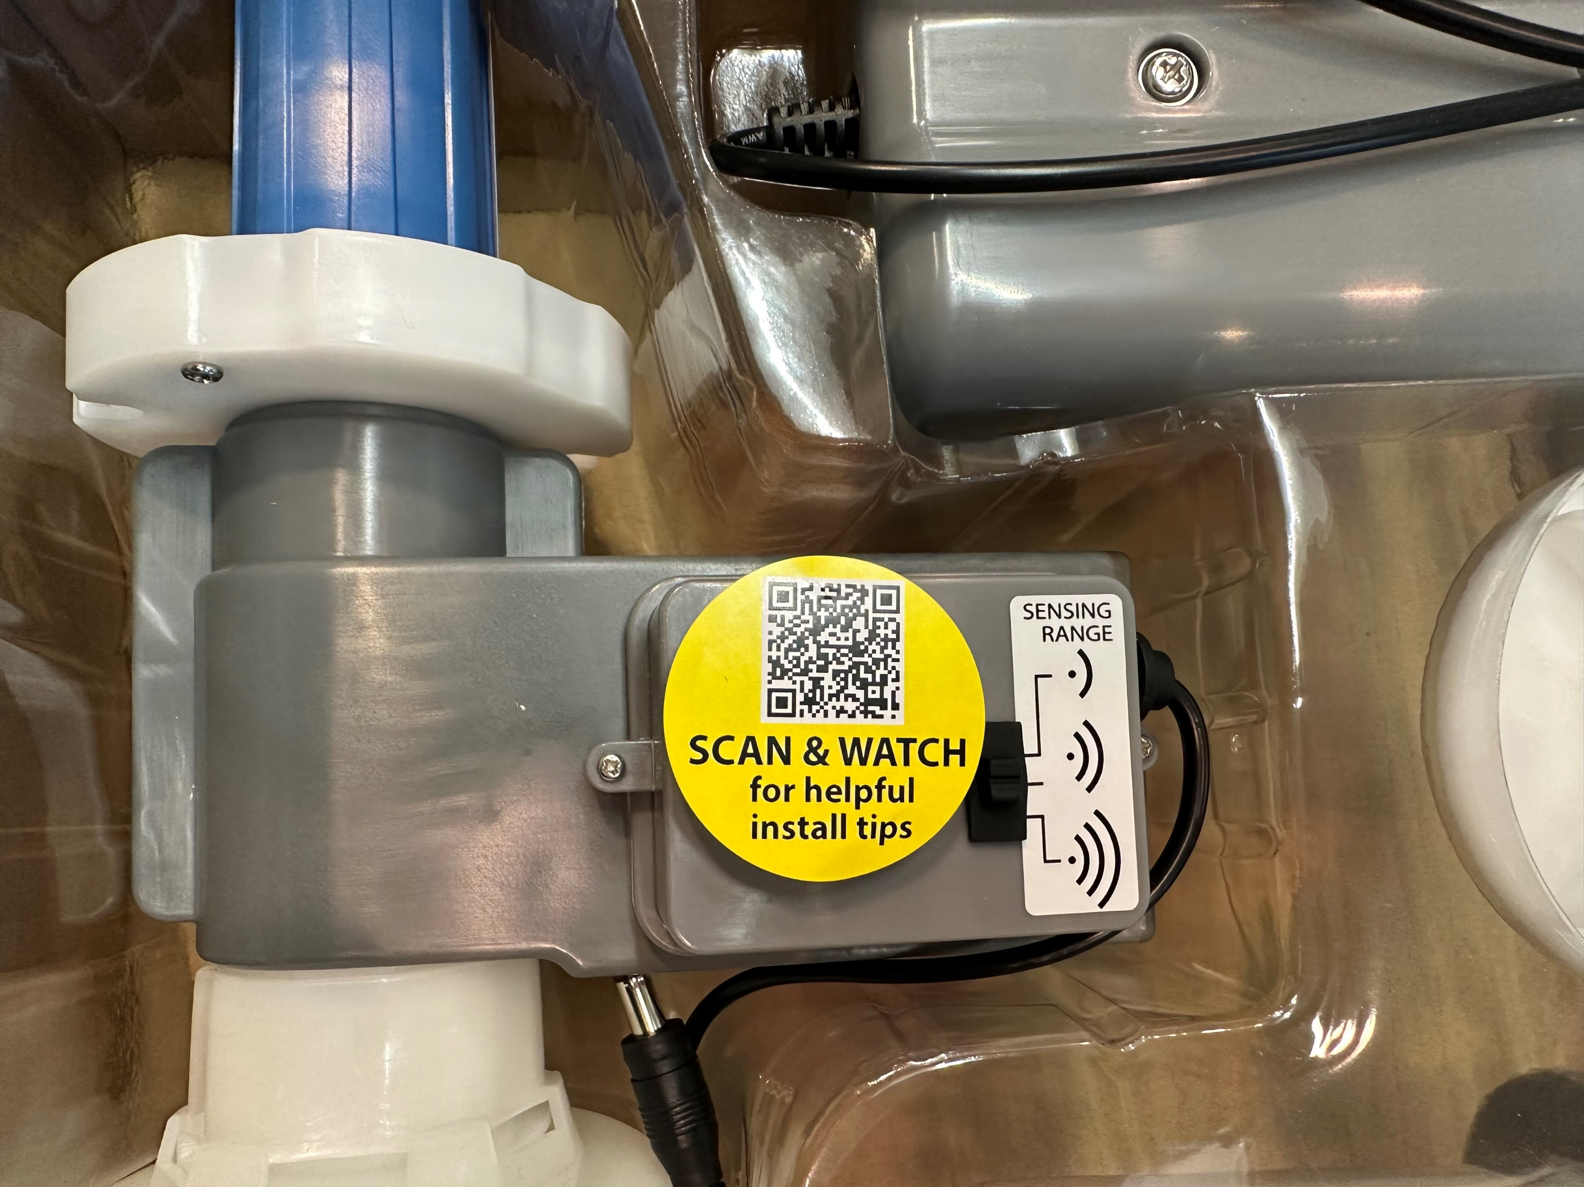
Installation Instructions
Following the installation instructions is critical to the successful function of the dispenser.

Slide 16
Installation Video

Slide 17
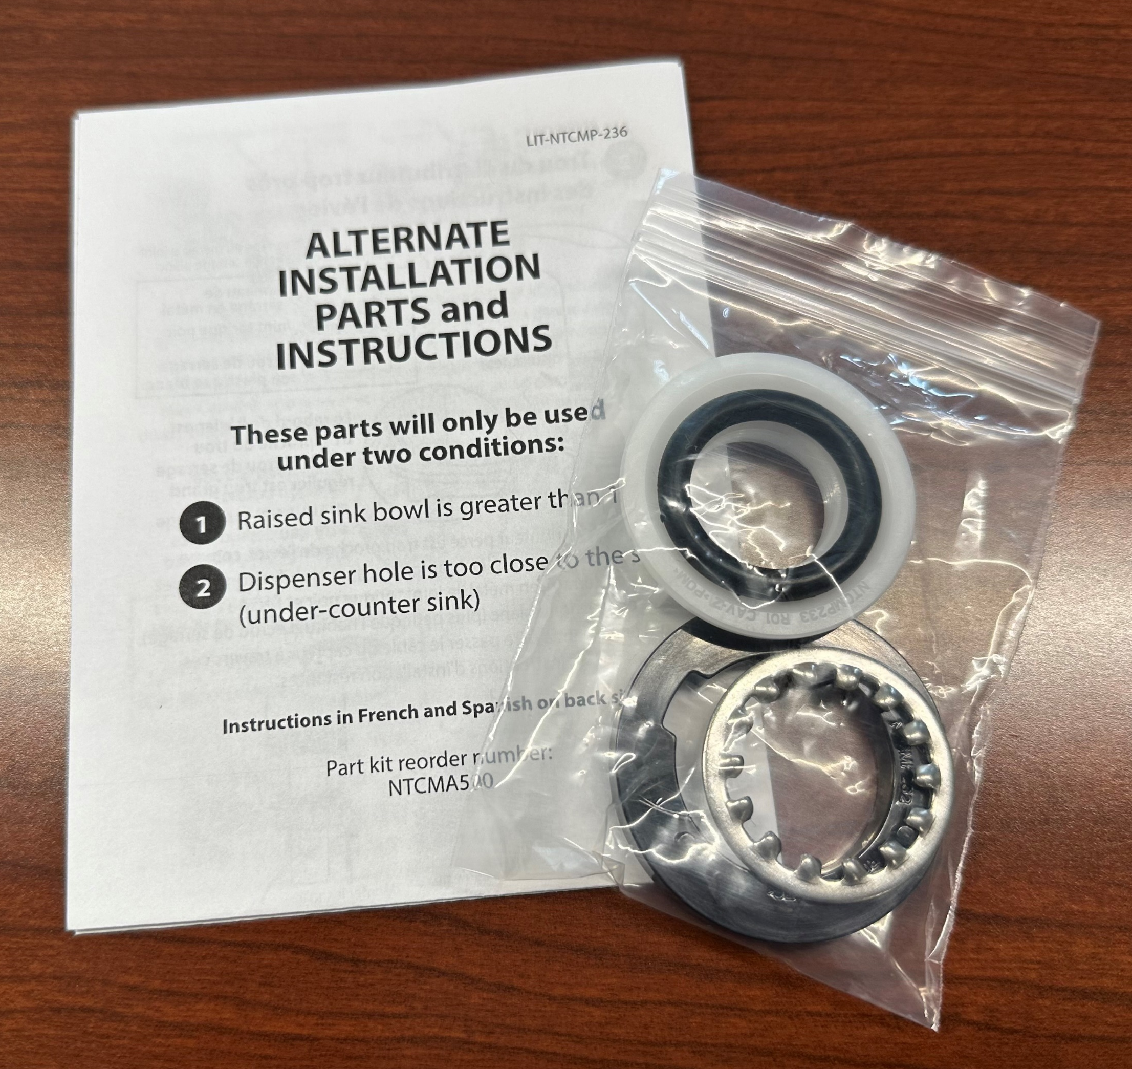
Installation – Alternate Parts
For use in specific scenarios:
Tight area under sink
Raised sink bowl
Thick countertop
Any combo of the above

Slide 18
Alternate Parts Video

Slide 19
Refilling Video

Slide 20
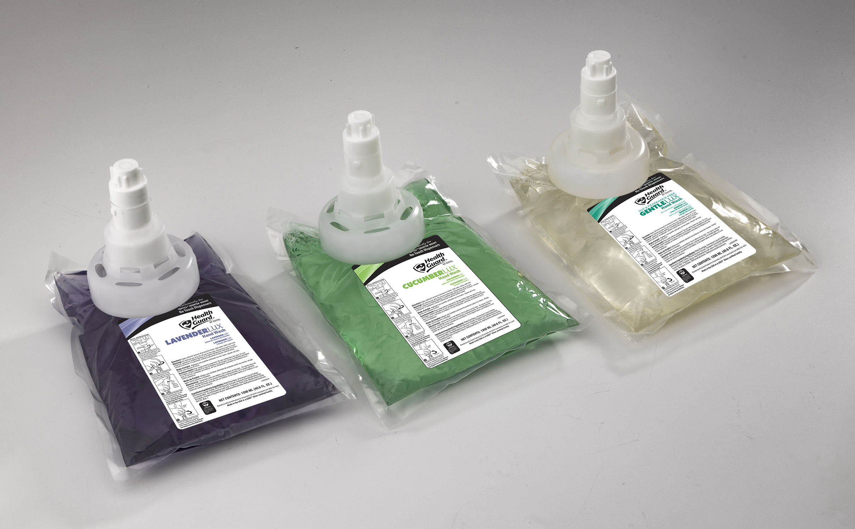
Sales and Marketing Tools
Videos
FAQ
Sell Sheets
And more…

Slide 21
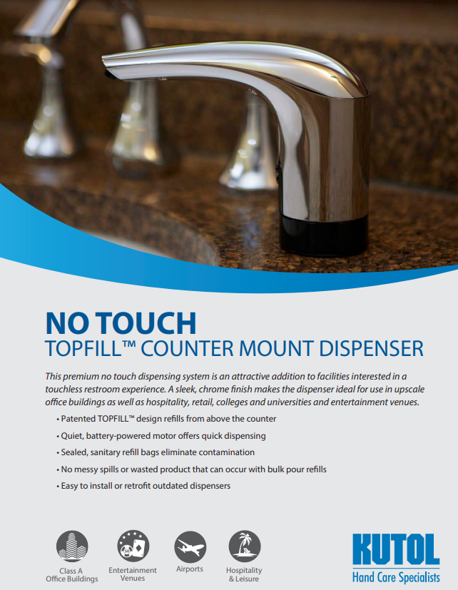
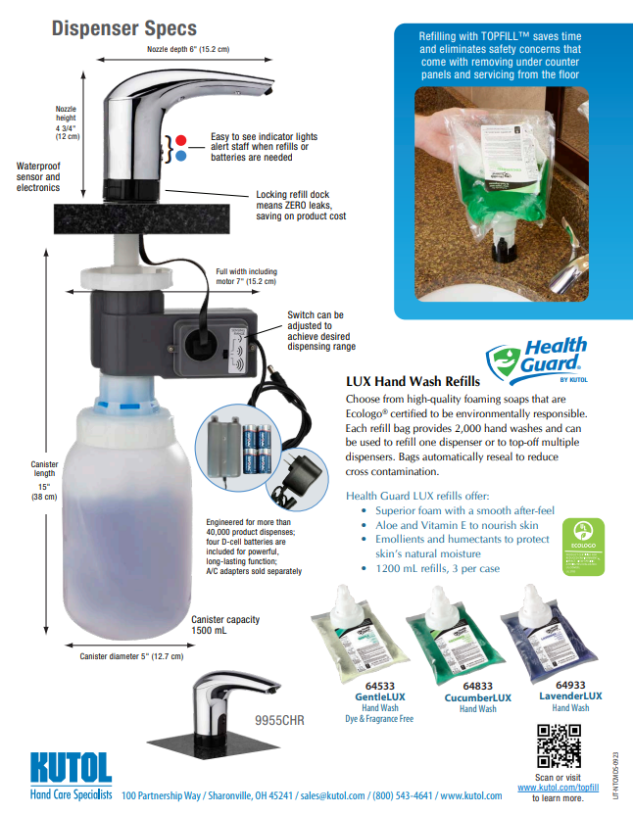
Sales Flyer
https://www.kutol.com/wp-content/uploads/2023/09/TOPFILL-No-Touch-Counter-Mount-Flyer_0923.pdf

Slide 22
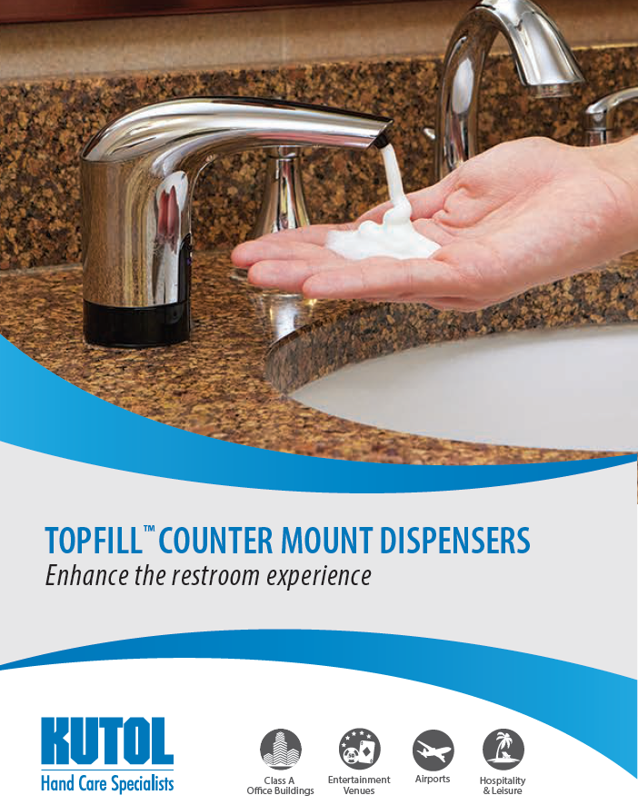
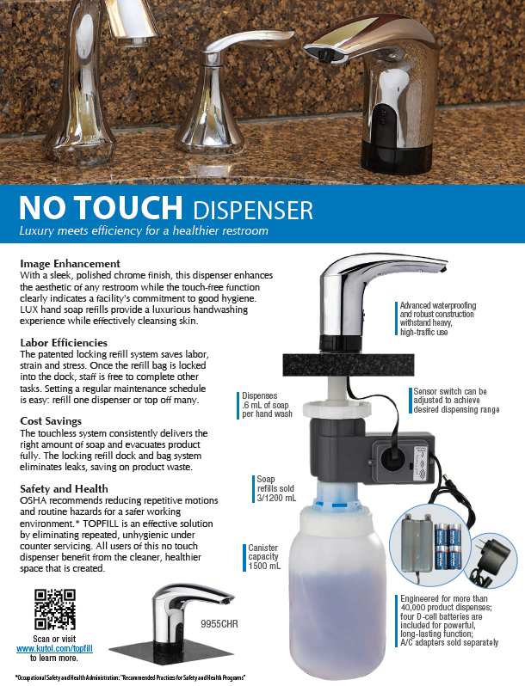
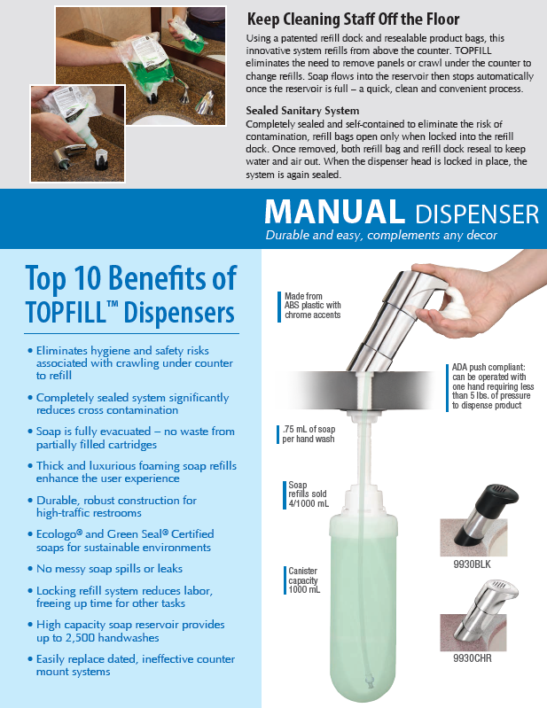
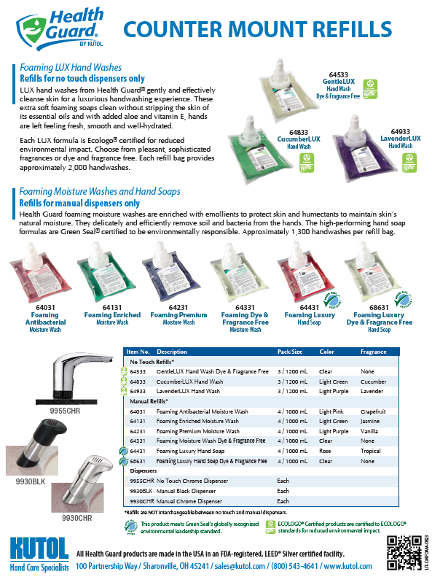
Brochure (No Touch and Manual)
https://www.kutol.com/wp-content/uploads/2023/09/TOPFILL-Counter-Mount-NT-and-Manual.pdf

Slide 23
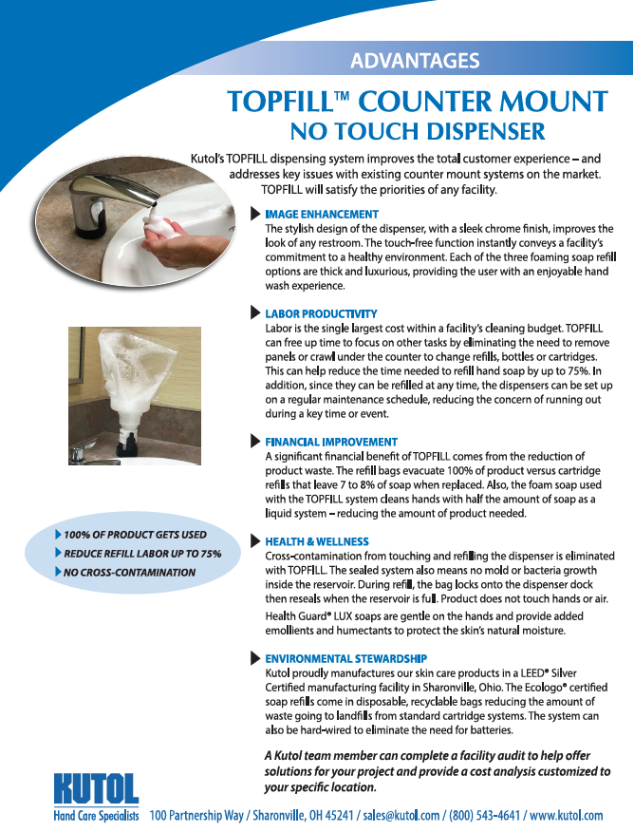
Advantages Flyer
https://www.kutol.com/wp-content/uploads/2023/09/NTCM-DISPENSER-BENEFITS-FLYER-Final.pdf

Slide 24
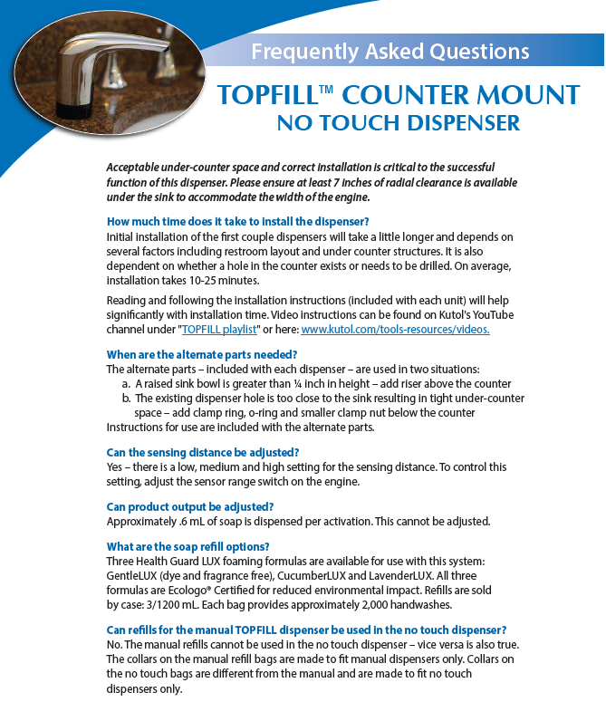
FAQ
How long does it take to install?
Can the sensing distance be adjusted?
Can product output be adjusted?
Are the manual and no touch refills interchangeable?
When are the alternate parts needed?
What is the warranty?
https://www.kutol.com/wp-content/uploads/2023/09/NTCM_Q-A-Flyer.0923.pdf
Notes:
This was included in the demo kit

Slide 25
Quick Links
Digital
Website
YouTube Playlist:
Marketing Video
Installation Video
Refilling Video
Alternate Parts Video
Collateral
Sales Flyer
Brochure
Advantages Flyer
FAQ
Pre-Install Checklist
Scan and save!
Notes:
Links to the materials and videos we’ve discussed. Scan the QR code for the no touch counter mount page on our website.

Slide 26
Opportunities

Slide 27
Selling Scenarios
Labor is an issue
Simplified filling process – maintain refill schedule or top off when needed
Time is of essence
Eliminates need to remove ADA panels, crawl on floor
Waste is a concern
Top off partially filled cartridges instead of tossing – never throw out product
No hardwiring available
Option for A/C or battery operation
Potential for contamination
Sealed sanitary design prevents contamination from foreign substances/bacteria

Slide 28
Pricing
Pricing is confidential and for internal use only.

Slide 29
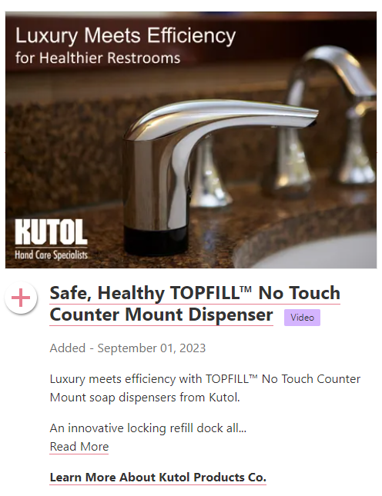
Next Steps
VOTE for ISSA Innovation Showcase Awards here
Launch at ISSA
BSC target list
Order/ship Q1 2024

Slide 30
Questions and Feedback

