Slide 1


Experts in Skin Care
Kutol Products Company

Slide 2


Company Overview
Kutol is recognized as a leading manufacturer of commercial hand hygiene products, offering diverse, tailored solutions to meet customer needs across various sectors.

Slide 3
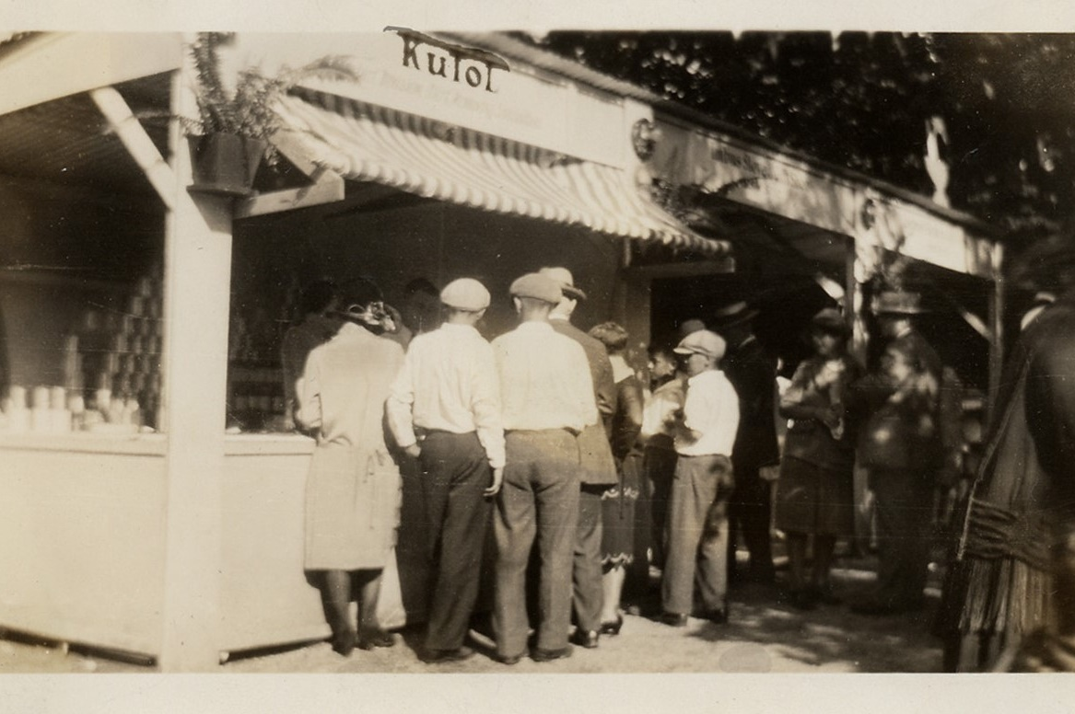
Historical Background
Established over a century ago in 1912, Kutol boasts a rich history of quality and flexibility in the commercial skin care industry.

Slide 4
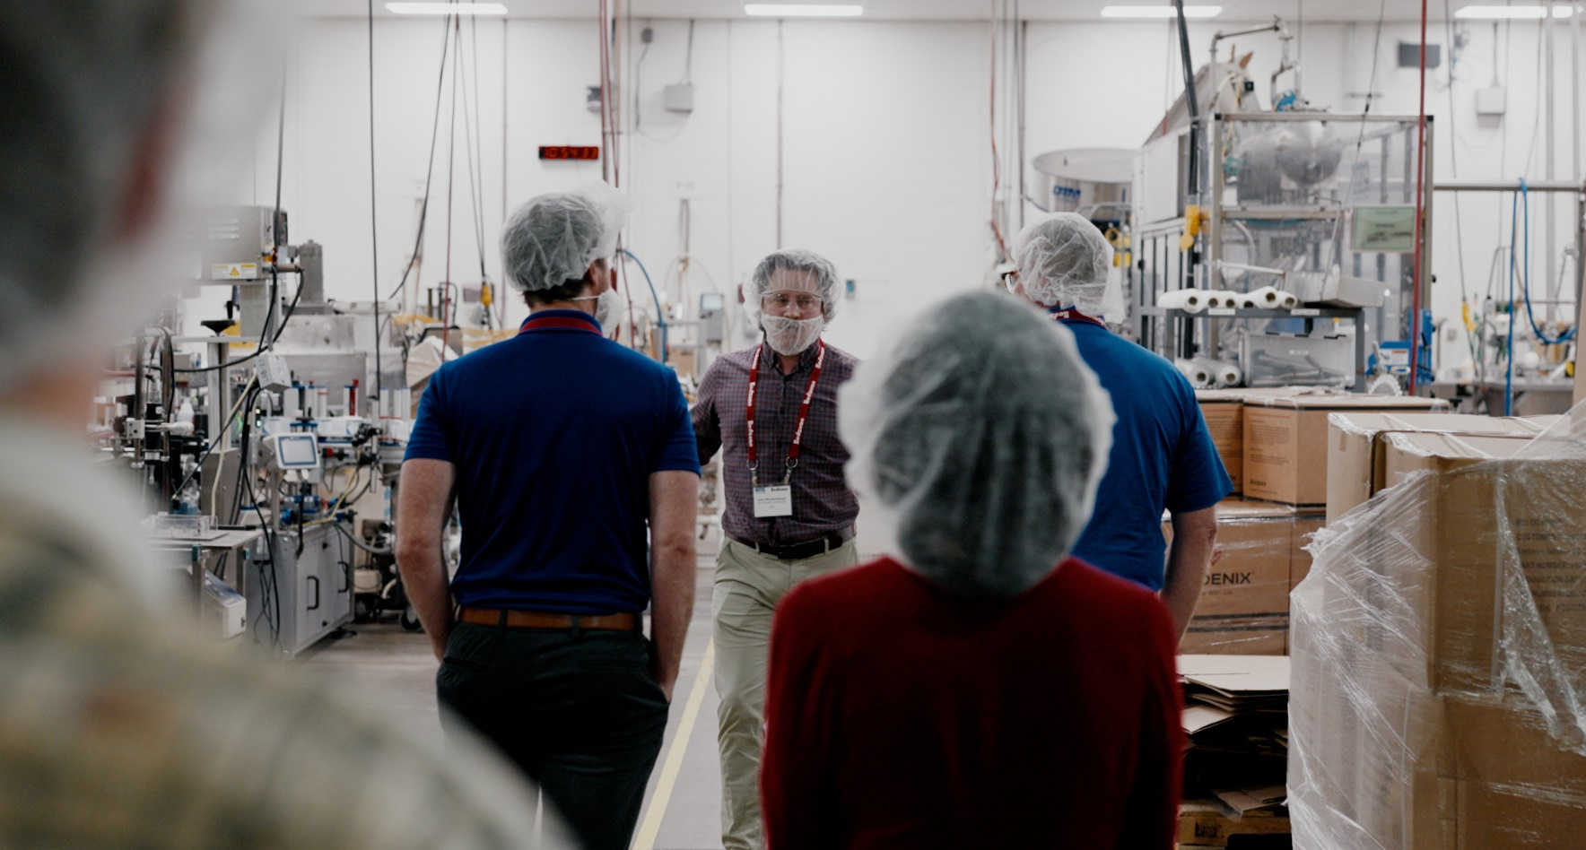
Differentiators
FDA-registered, LEED Silver Certified Facility
Sole Focus on Skin Care
Fourth Generation Family Owned and Operated

Slide 5





Kutol Makes Five Promises to All Stakeholders:
01
Stability: 100+ years of expertise with the assurance of consistency and reliability
02
Flexibility: Offering tailored skin care programs by being nimble and agile
03
Innovation: Delivering intelligent, winning solutions that solve stakeholder challenges
04
Value: Maximizing customer investment without compromise
05
Sustainability: Dedicated to responsible practices for a cleaner, healthier plant

Slide 6
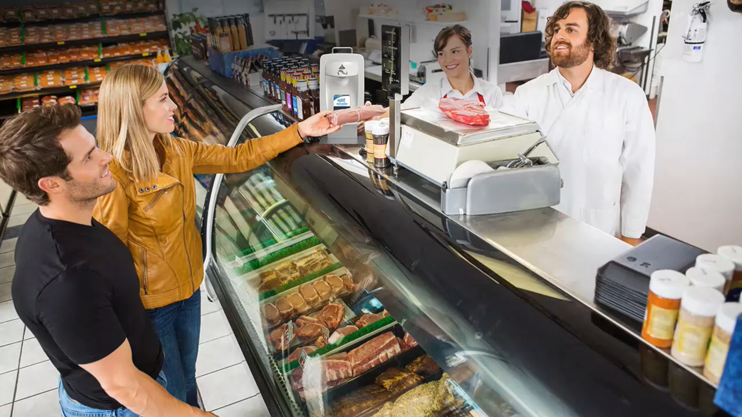
Segment Fit and Market Presence
Kutol's products serve many segment types with reliability and trust
  Commercial: Cost-effective, durable solutions for high-traffic facilities
  Food Service: E2 sanitizers to prevent cross-contamination and ensure food safety
  Healthcare: Alcohol sanitizers and antibacterial soaps for compliance
  Education: Custom hygiene systems to promote health and reduce absenteeism
  Industrial: Heavy duty scrubs for tough grime that clean in one application
  Travel and Hospitality: Sleek dispensers with premium formulas for guest comfort

Slide 7



Product Range
Kutol offers a wide variety of skin care products under our trusted brands…
Health Guard: High-quality general purpose skin care solutions – designed to promote hygienic facilities and healthier end users.
Kutol Pro: Powerful industrial formulas that clean and protect hard-working hands – built to tackle the toughest soils and stains.

Slide 8
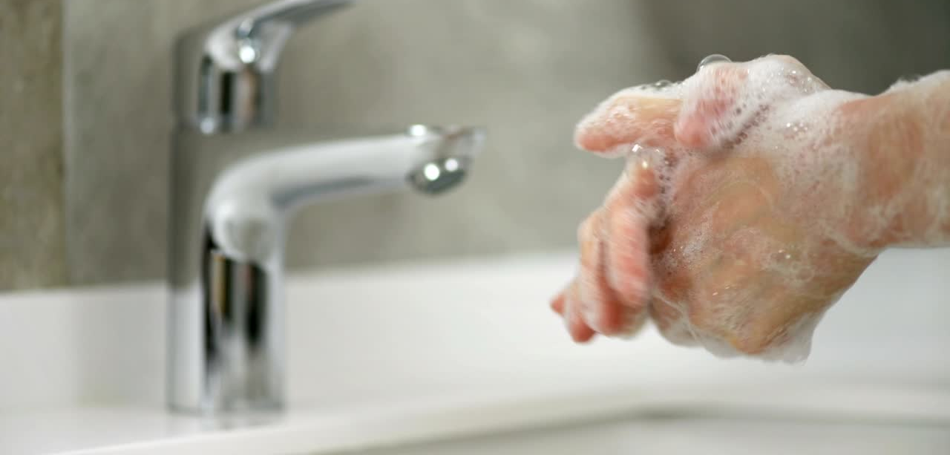
Dispenser Platforms
Kutol offers dispenser systems that are user-friendly and hygienic, designed to minimize waste and optimize usage efficiency.

Slide 9
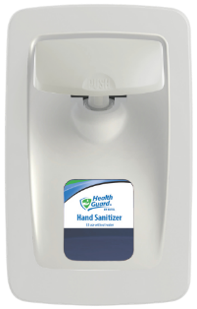

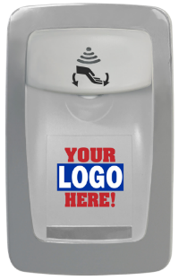
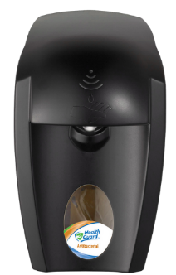
Proprietary Dispensers
Designer Series
  Sleek, streamlined design
Wall Mount
DECO
  Manual and No Touch M-Fit use same 6-pack refills
  No Touch uses 4-pack refills
  Completely sealed and sanitary
  Top dispensing
  Custom: full-color logo digitally printed
EZ Foam
  Durable and economical

Slide 10
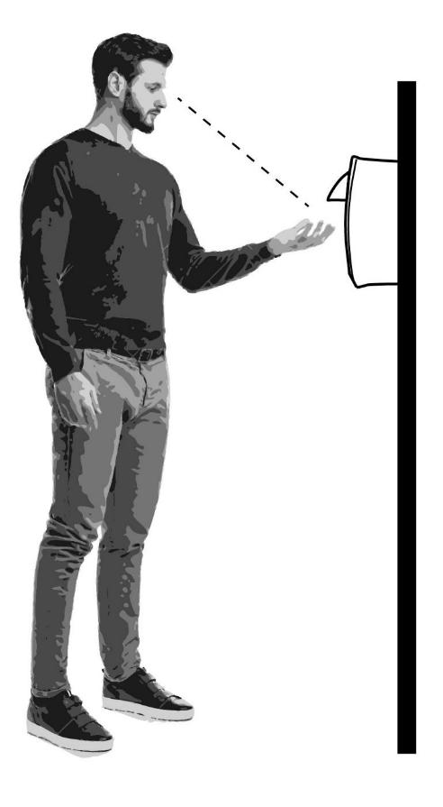
Top Dispensing Advantage
Eye-level dispensing
Users see soap or sanitizer dispensed into hands avoiding extra, wasteful dispenses
No leaks
Top valve placement means no messy leaks from refill bags or bottom of dispenser
Labor savings
Leak-free design saves janitorial staff valuable cleanup time
Enhanced hygiene
Sealed system/refill bags eliminate cross-contamination – no open pouring

Slide 11


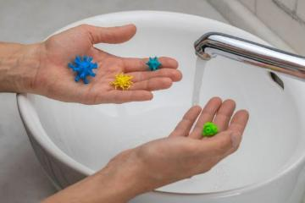
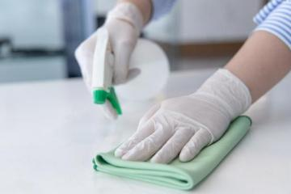

Risk Management
With Top Dispensing Technology
 | Risk Type | No Risk | Moderate Risk | High Risk
 | Slip and fall hazards
 | Cross contamination
 | Missed procedures
Notes:
OSHA recommends reducing routine hazards for a safer working environment.
How does top dispensing help?
Eliminates leaking – prevents slips and falls
Sealed sanitary – eliminates contamination
Ease of refilling – no extra steps, pouring, etc.

Slide 12

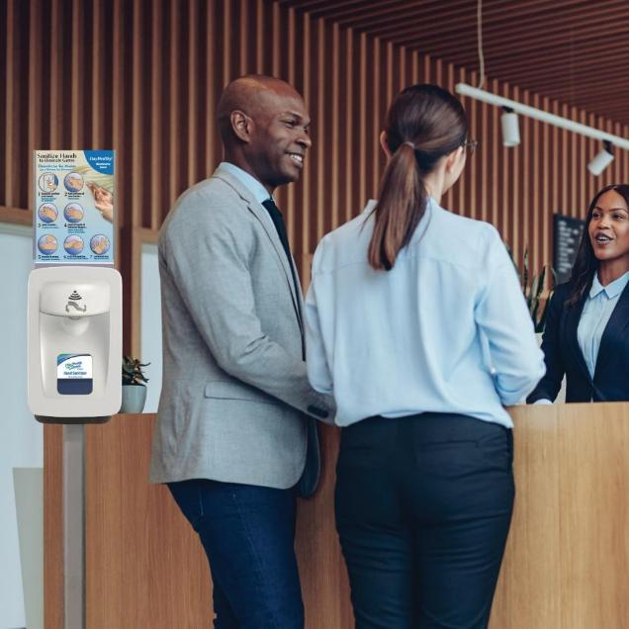
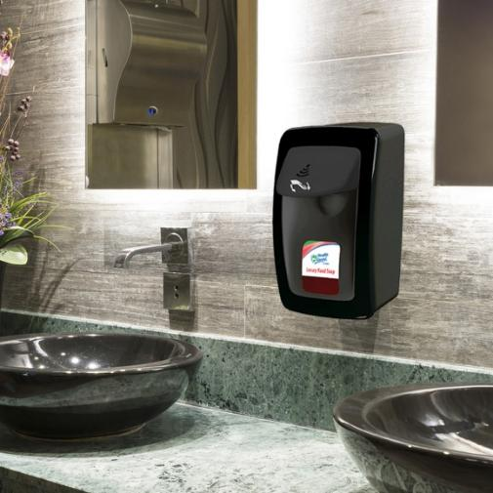
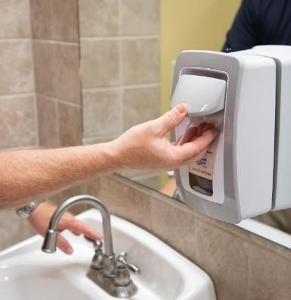
Designer Series
Manual and No Touch M-Fit use same 6-pack refills
No Touch uses 4-pack refills
  Sleek, streamlined design
  Made of durable ABS plastic
  Large product view window
  Keyed locking option
  .75 mL output, .4 mL available
  Heavy duty tape or screw mounting

Slide 13
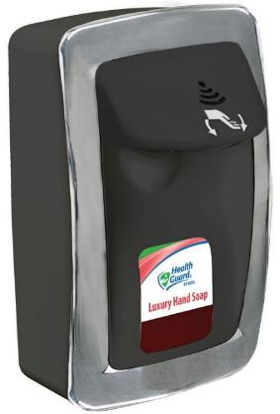
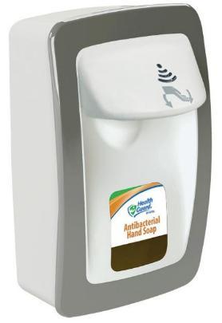
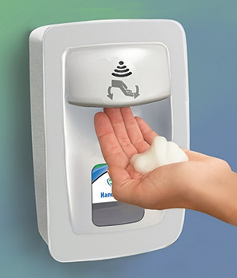
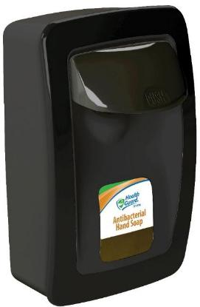
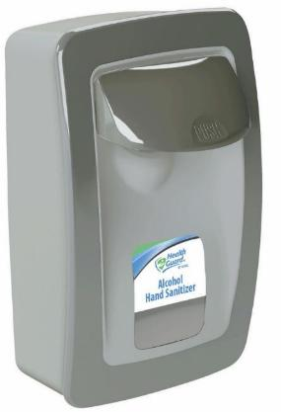
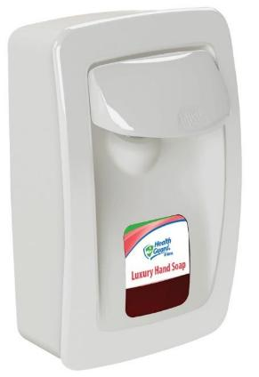
Designer Series
Manual
  No metal parts
  Waterproof
DM016BK34
DM016WH32
No Touch
  Powerful, quiet engine
  Four C batteries included = 30,000 dispenses
  Sleep mode after 30 mins
  Easy to see usage indicator lights
SS001BK31
SS001GR32
SS001WH33
**Additional dispenser colors available.

Slide 14
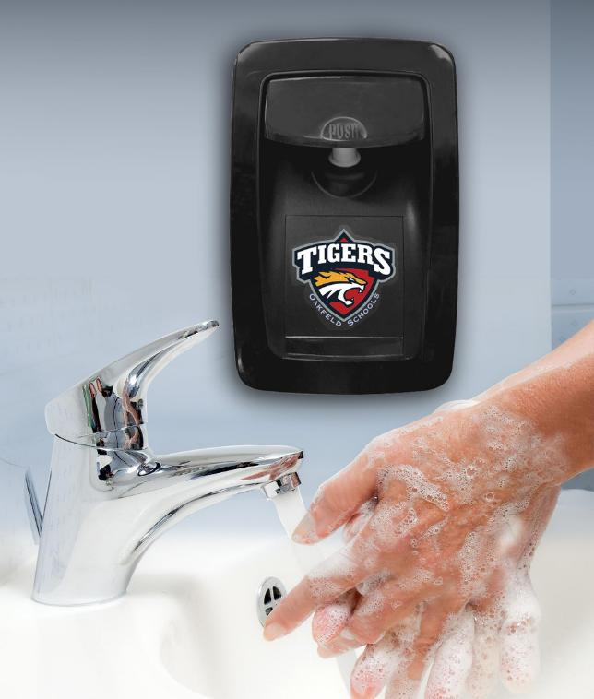
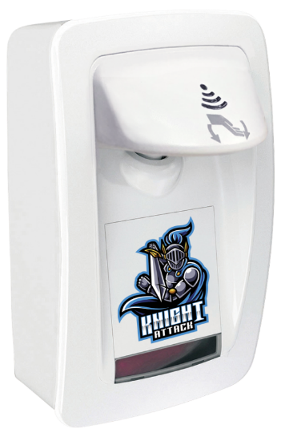

DECO
Manual and No Touch M-Fit use same 6-pack refills
No Touch uses 4-pack refills
  Full color logo/mascot printed on front cover
  Large 3.5” x 3.5” print area attracts attention
  UV digital printing - not a sticker or decal
  Lowest minimum in the industry: 24
  Great for schools and universities to boost spirit and build morale!

Slide 15
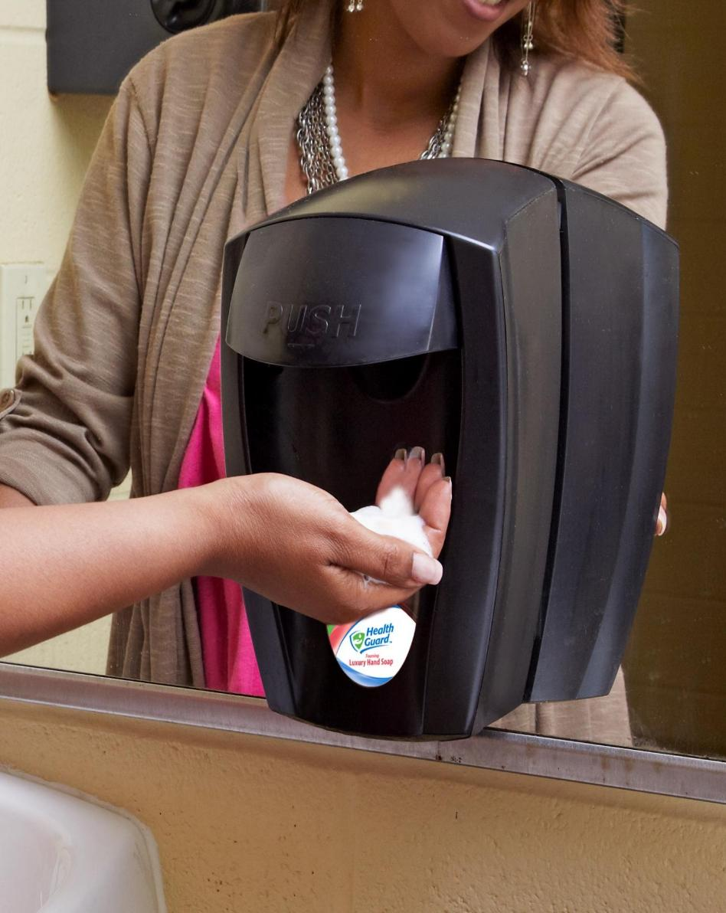
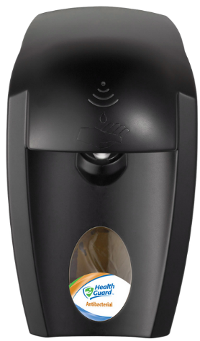
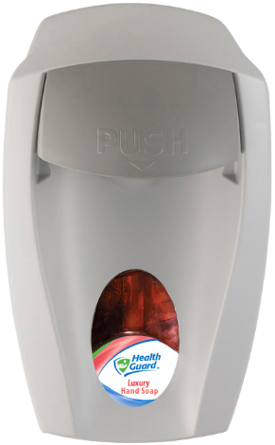
EZ Foam®
Manual and No Touch M-Fit use same 6-pack refills
No Touch uses 4-pack refills
  Economical and durable
  Made of durable ABS Plastic
  Keyed locking option
  Large product view window
  Standard .75 mL output
9981BLK
9941GRA

Slide 16

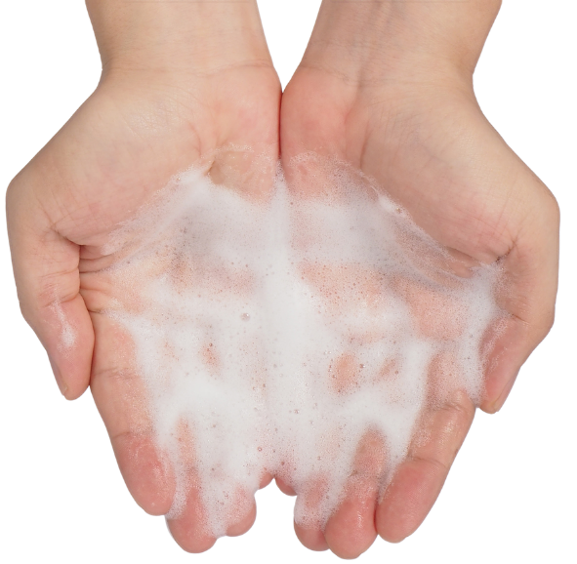

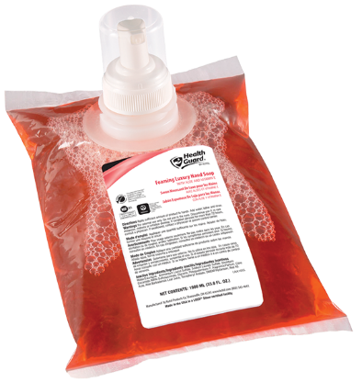
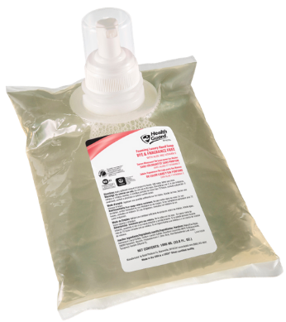
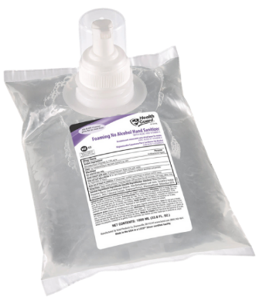
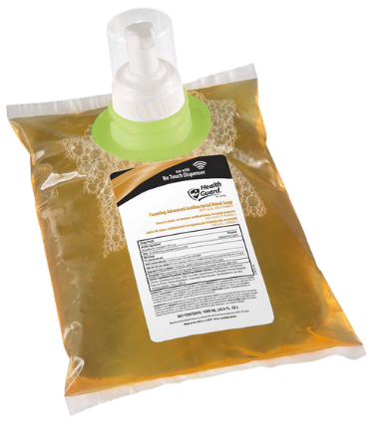

Top Formulas
for Wall Mount Dispensers
  Foaming Luxury Hand Soap
  Foaming Advanced Antibacterial Hand Soap
  Foaming Luxury Dye & Fragrance Free Hand Soap
  Foaming No Alcohol Hand Sanitizer
Proprietary collar
Clear = 6-pack refills
Proprietary collar
Light green = 4-pack refills
68641
68241
69041
21344

Slide 17
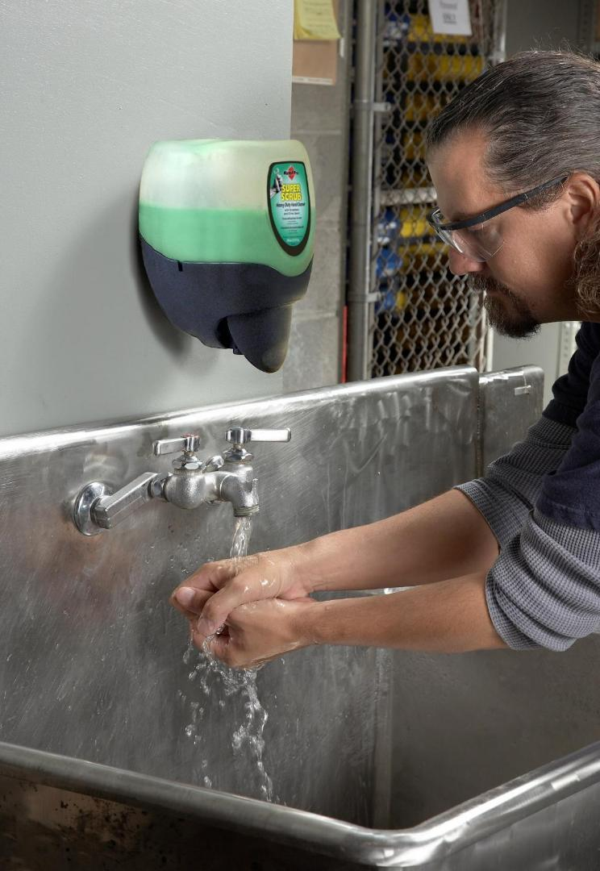
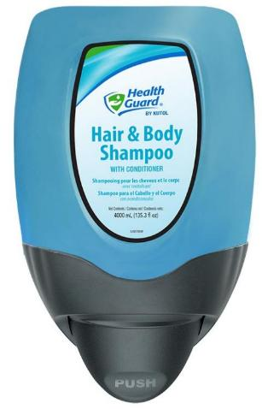


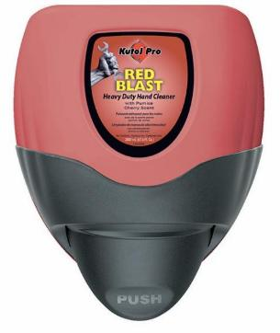
DuraView®
  High capacity: 2 and 4 Liter cartridges of Health Guard® general purpose soaps/shampoos or Kutol® Pro heavy duty scrubs
  Proprietary fitment
  Extra durable
  HDPE cartridge is waterproof and recyclable
  Dispenses 1.5 mL
7767
7568

Slide 18
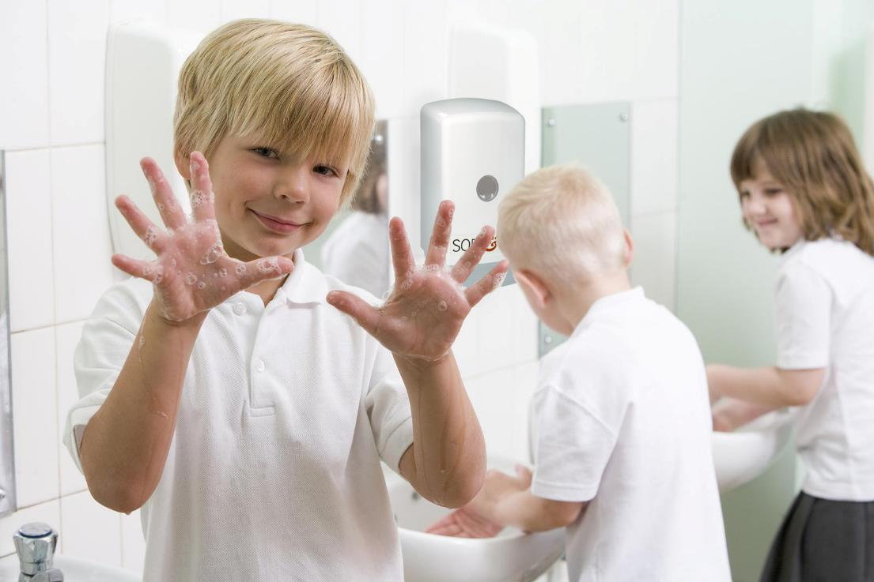
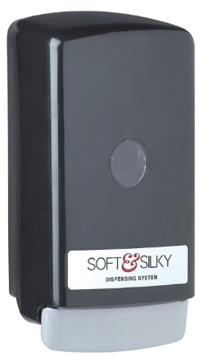
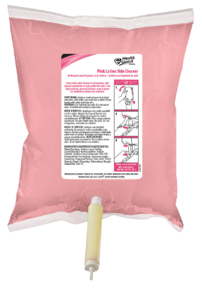
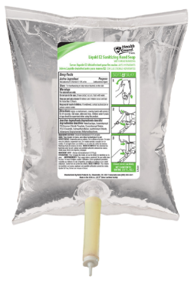
Soft & Silky
Bag-In-Box
  Wasteful outer cartons are eliminated for a more eco-conscious option
  Bottom dispensing
  Dispenses 1.5 mL of product per push
  For use with 800, 1000 and 1200 mL liquid formulas
5665
9951ZPL
1765

Slide 19
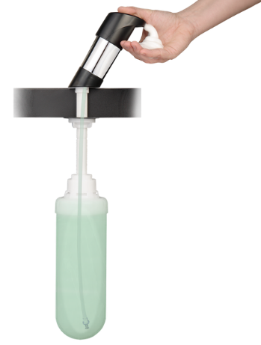
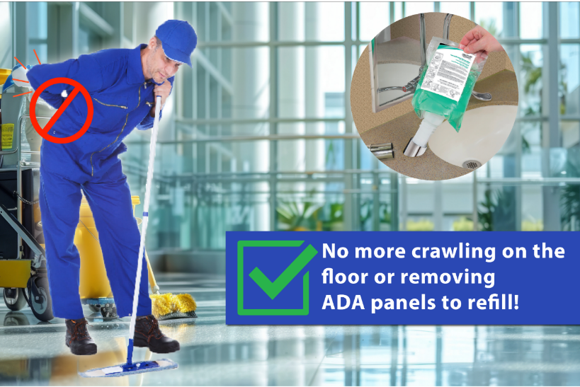
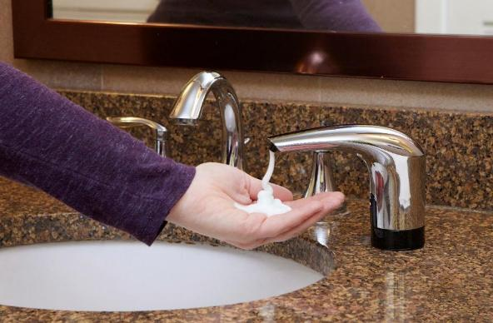
TOPFILL® Counter Mount
Image Enhancement | Labor Efficiencies | Cost Savings | Safety and Health
  Patented docking system: refills from ABOVE the counter
  Eliminates need to remove ADA panels or crawl on floor to refill
  Completely sealed and sanitary
  No touch and manual
  Refills ARE NOT interchangeable

Slide 20
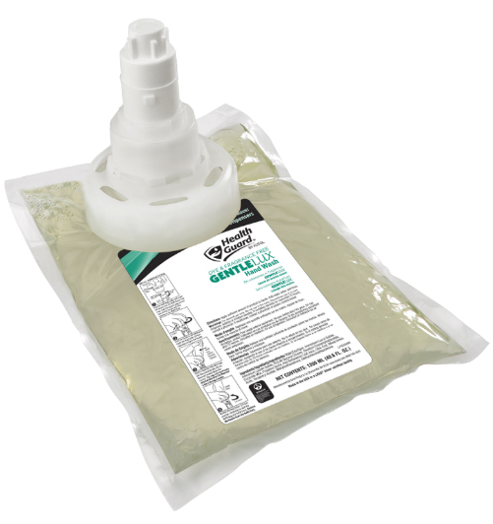
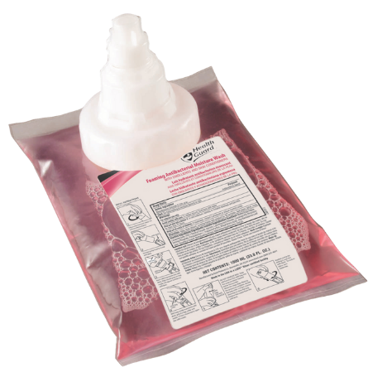
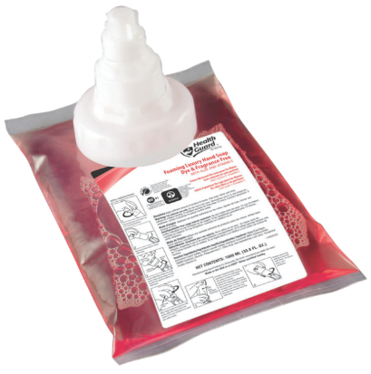


Top Formulas
for Counter Mount Dispensers
  Foaming Luxury Hand Wash (manual)
  Foaming Antibacterial Moisture Wash (manual)
  GentleLUX Hand Wash Dye & Fragrance Free (no touch)
64431
64031
64533

Slide 21
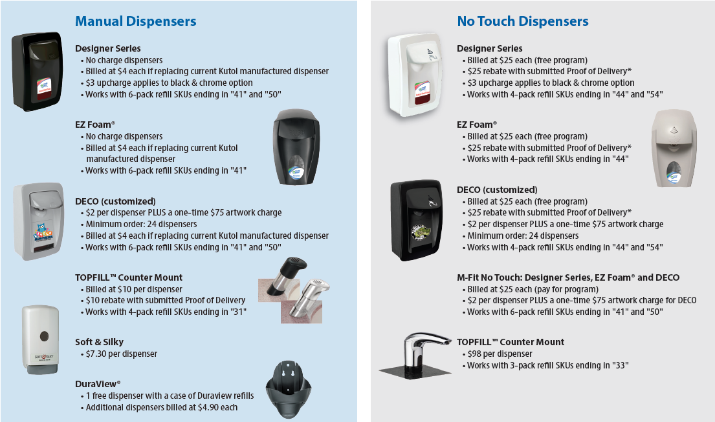
Dispenser Program

Slide 22

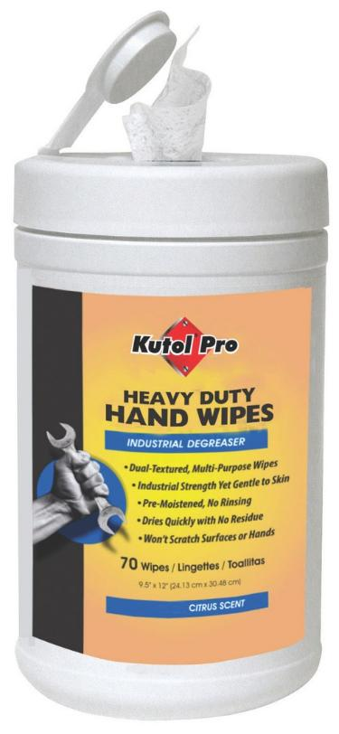
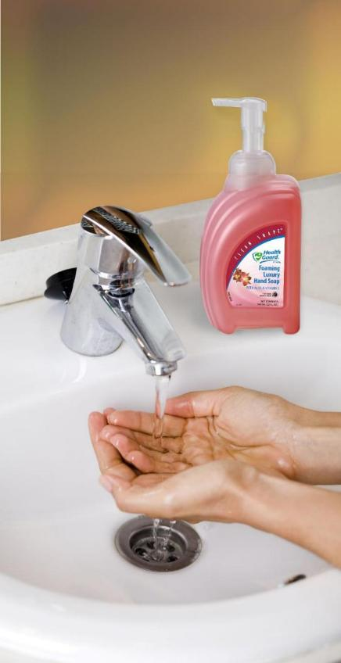
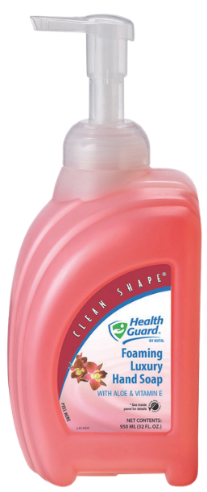
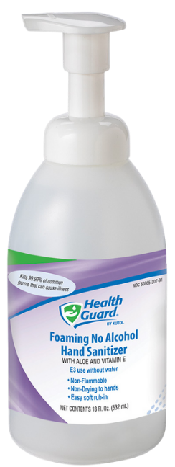
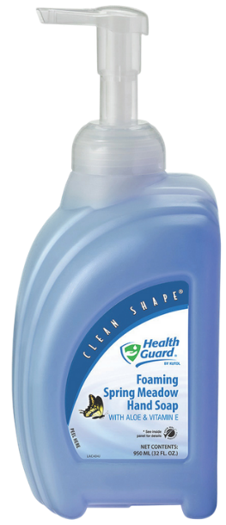
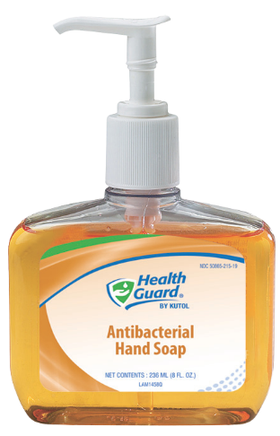
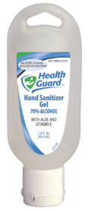
Sinktop and Portable
Clean Shape®
Specialty and Small Bottles
69078
37073
5019
63178
68291
80070

Slide 23










Gallons and Bulk
4507
21309
69009
1707
37079

Slide 24




Heavy Duty Hand Care Solutions
Works in one application on tough soils, paint, grease, adhesives and ink
Wide selection of solvent-based and solvent-free formulas
Options with or without natural scrubbers
Moisturizing ingredients to prevent dryness and irritation

Slide 25







DuraView Dispenser
Waterproof, durable cartridge
Available in 2 and 4 Liter
Bulk Gallons
Portable and convenient
Pump or flat top
4507
7707
1602
4902
4707

Slide 26

Private Branding Expertise
Kutol excels in private labeling and contract manufacturing, providing custom skin care solutions to partners, allowing them to offer proprietary products with proven quality.
Notes:
Over 50 years of experience in private labeling and contract manufacturing
Nearly 40% of our products are private labeled
Products made in the USA in a LEED® Silver Certified, FDA-registered facility

Slide 27


Comprehensive Private Label Capabilities
Product Types: Cosmetics and OTCs; custom chemical blends
Flexibility: Low order minimums, fast turnaround, custom packaging and label artwork
Quality: Proven processes, commitment to regulatory compliance and quality excellence

Slide 28



Marketing Tools
Catalog, flyers, videos and graphics

Slide 29







Digital Resources
www.kutol.com
Follow us for updates and shareable content
youtube.com/@kutolvideos
Notes:
Check out our website – a great resource for digital tools including: cost calculator, DECO visualizer, SKU search, SDS, etc.
Follow Kutol on LinkedIn for usable, shareable content relative to your customers. YouTube for videos, etc.

Slide 30






Get in Touch
NAME
EMAIL w/hyperlink
PHONE
www.kutol.com
Notes:
*You can add customer’s logo to the right of the Kutol logo.
**Make sure to add your contact info to this slide.

